Slide 1


Sequencing Everything
Stephan Ossowski
Genomic and Epigenomic Variation in Disease Group
Notes:
Proposal of the title???

Slide 2


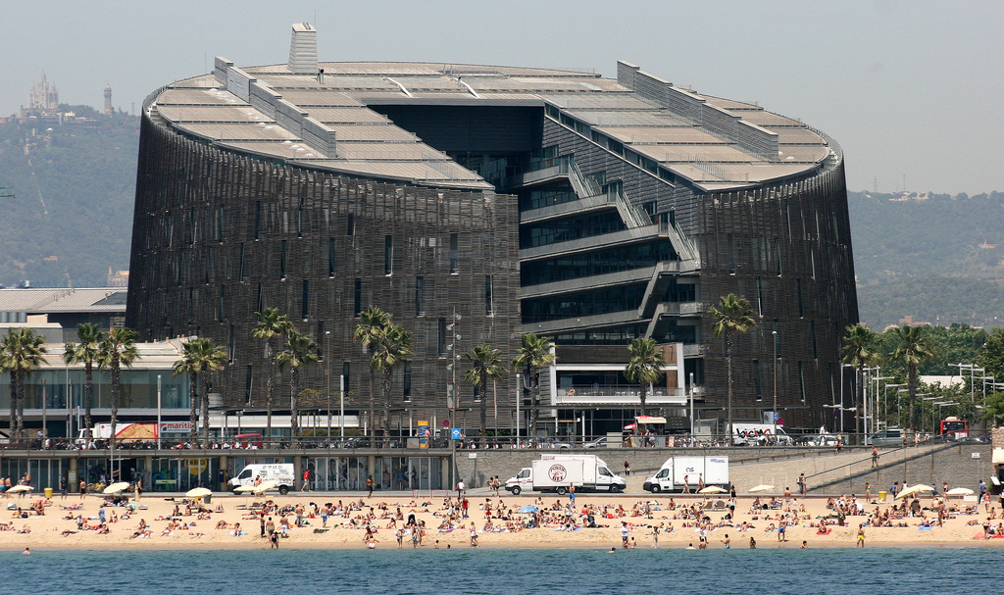

Barcelona: Research and Holidays
5 Million people
live in the urban
area of Barcelona
8 Million tourists visit
Barcelona per year
Notes:
2

Slide 3

Barcelona: Research and Holidays
Notes:
3

Slide 4

The Metro of Barcelona
Notes:
4

Slide 5


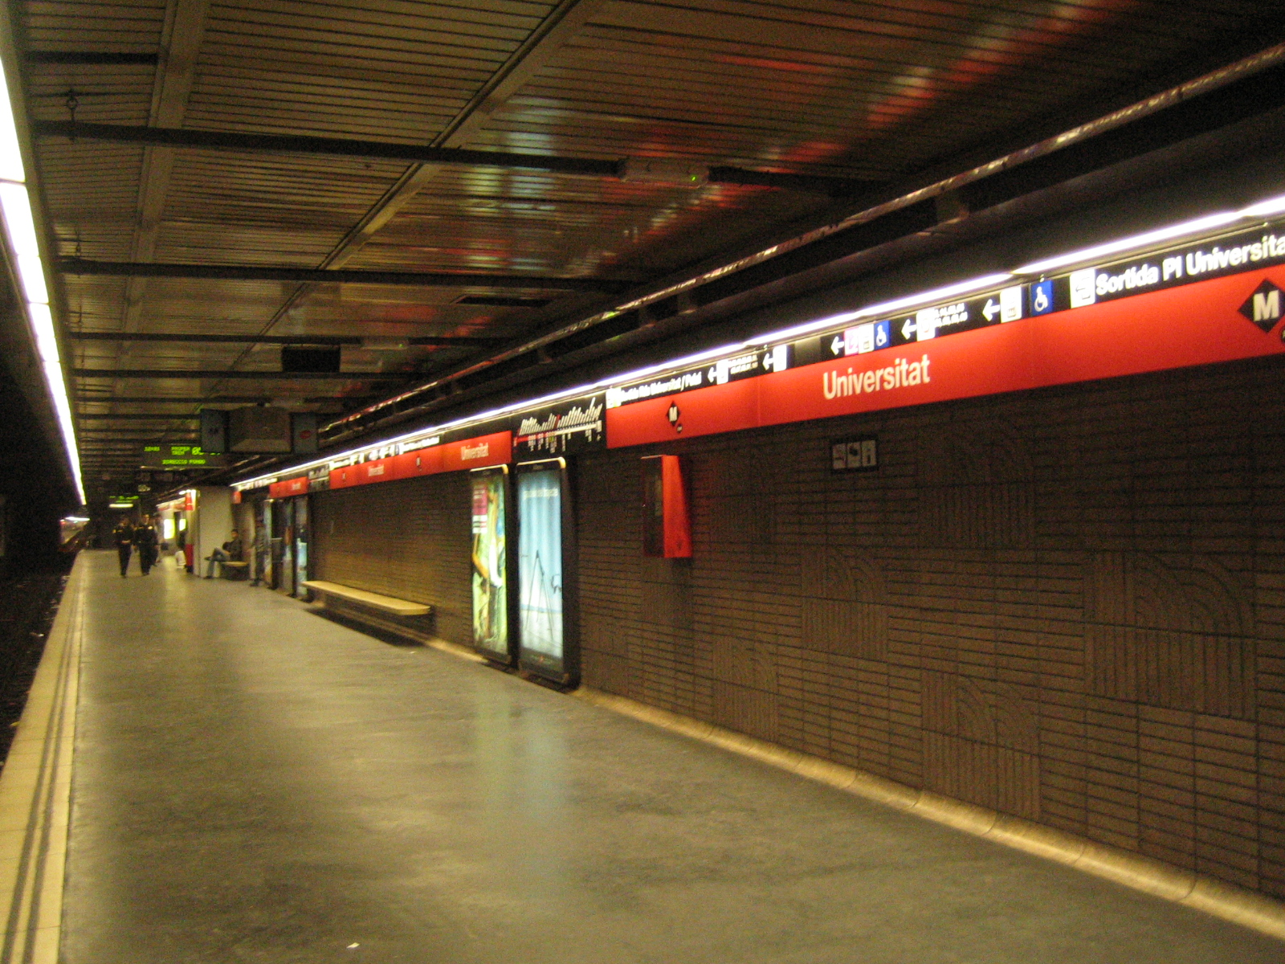
The Metro of Barcelona
Operational since 1924
11 lines
163 Station
Annual ridership: 420 Million
Notes:
5

Slide 6
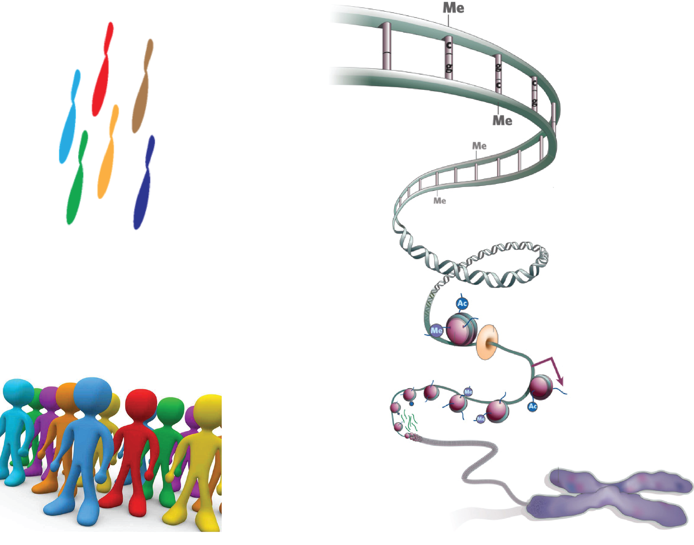
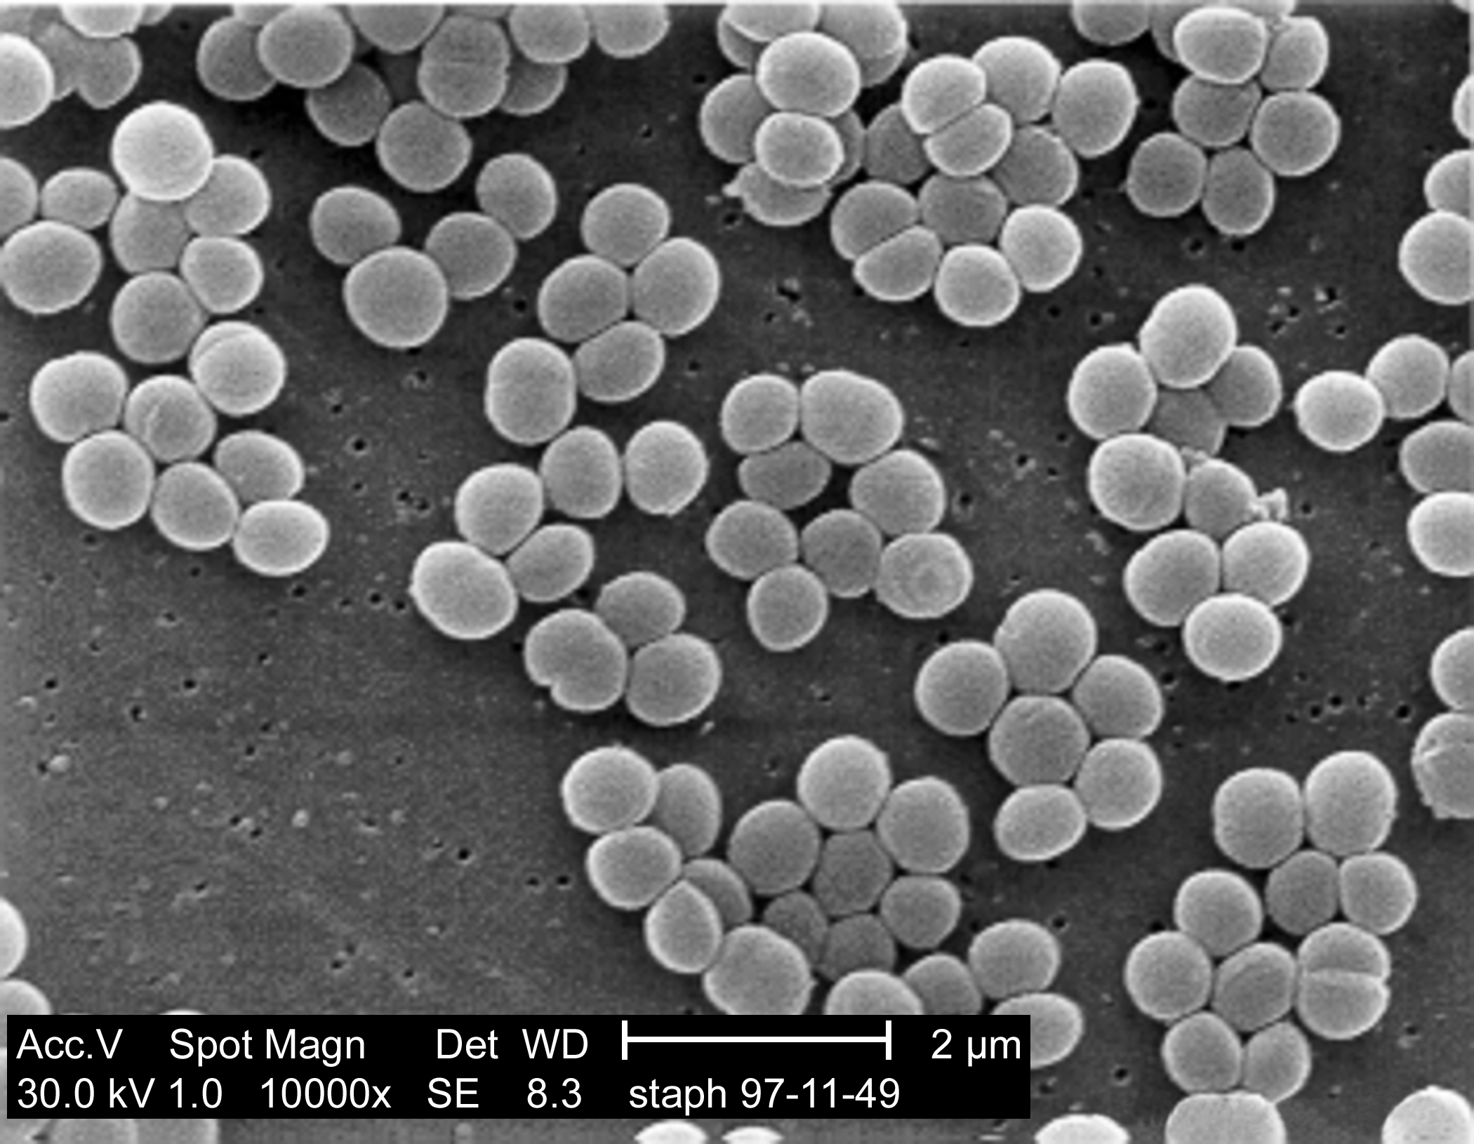
Research Interests: From Genotype to Disease Phenotype
(Epi)Genotypes
Phenotypes & Diseases
Notes:
6
At the very core of studying genetic disaeses is the question of how to correlate genotypes (here shown as chromosomes) with phenotypes and most importantly for us disease phenotypes. This question can be addressed from different angles, for instance we could have a number of patients with the same disease and ask, if there is a common genetic or epigenetic cause. Similarly if we detect a mutation we would ask if it is damaging enough to cause an observable phenotype. Now to better understand this correlation between genotype and phenotype we need to study the imensly complex regulatory program of the chromatin responsible for the timely expression of genes. This includes studying variations at the primary DNA sequence, methylation of the Cytosines, nucleosome positioning, histone modifications, insulator proteins and even noncoding RNAs.
We should also not forget another layer of complexity, the human microbiome, billions of bacteria living in our gut or nose etc.

Slide 7
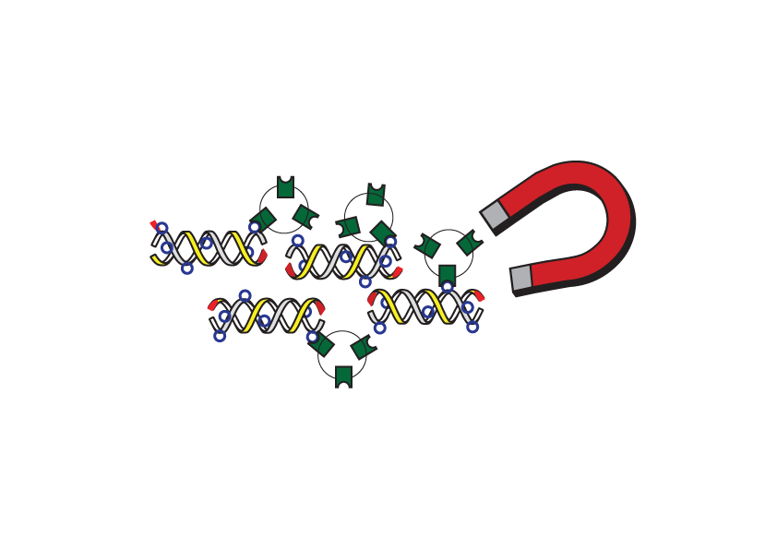
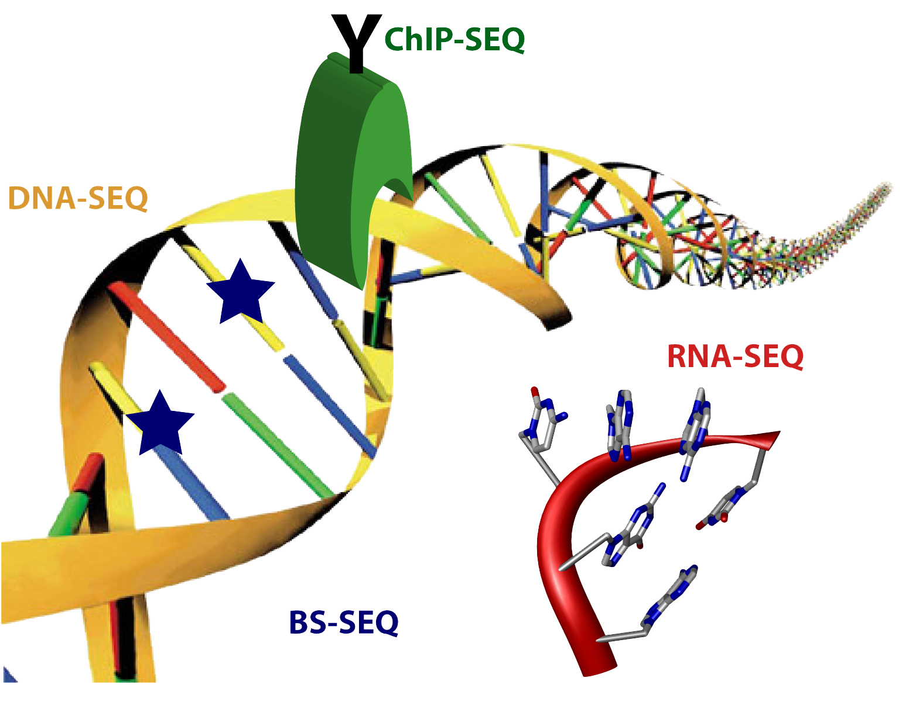
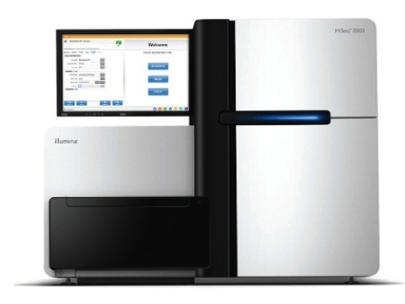
Main Expertise: Sequencing the Genome & Epigenome
ChIP-seq
Whole Genome Seq
Exome-Seq
Exome-
Enrichment
DNaseI-Seq
sRNA-Seq
mRNA-Seq
ATAC-Seq
Chromatin Conformation
Capture: e.g. Hi-C
DNA Methylation BiS-Seq
Notes:
7

Slide 8

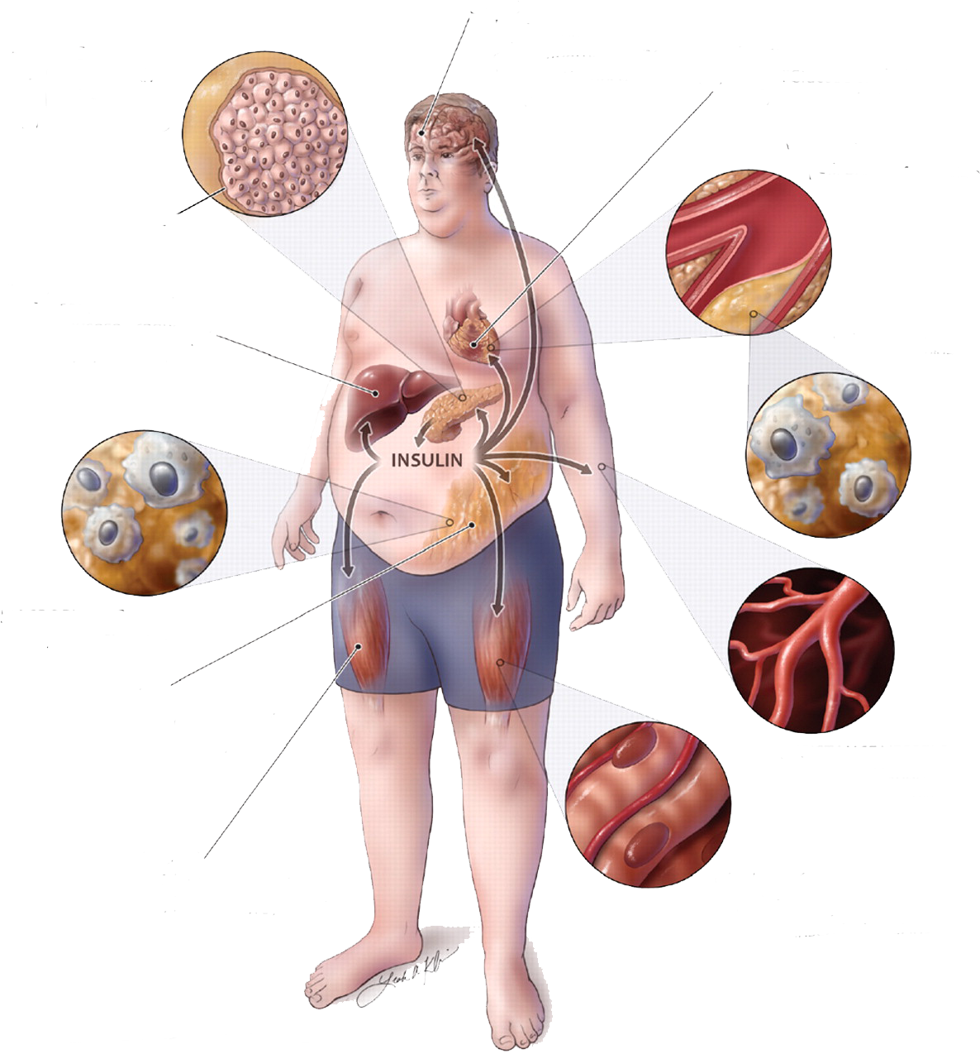
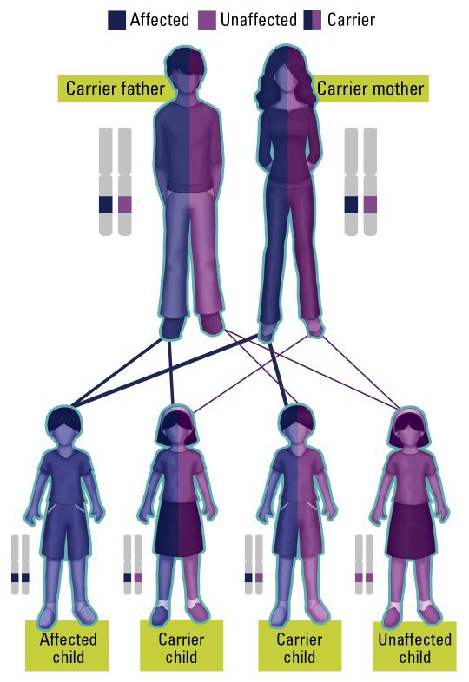
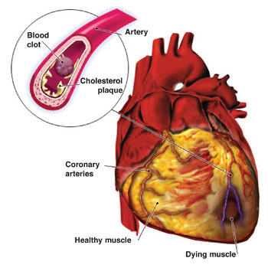
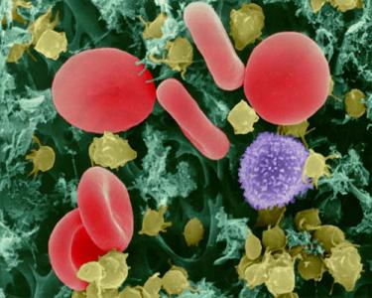
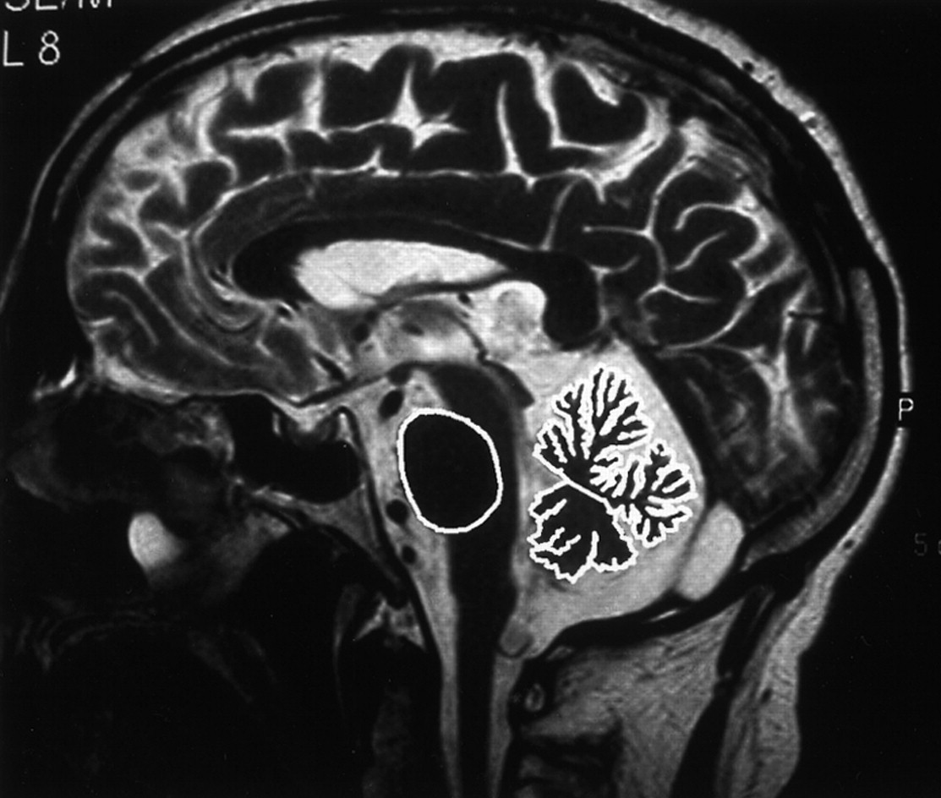
Rare Disease Sequencing Projects
Family and Parent-Child Trios
Metabolic Diseases
Cardio-vascular
Diseases
Congenital Neurological
Diseases
Immunodeficiency
Notes:
8
So what kind of specific questions do we address using Next Generation Sequencing? Our main goal is to determine genetic and epigenetic variations causing disease and cancer. We are for instance involved in the ICGC were we analyze the genomic data from several hundred patients with Chronic lymphocytic leukemia. Leukemias are cancers of the white blood cell and CLL is the most common type of leukemia.
In a second project we are studying the human brain epigenome with the specific goal of comparing epigenomic profiles of healthy brains to brains effected by Alzheimer’s disease and Parkinson’s disease. Therefore we are sequencing different types of epigenomic marks like DNA methylation, histone modifications and chromatin conformation in 7 regions of the brain. We hope that comparison of epigenomic profiles will reveal new biomarkers for the diseases and might reveal new targets for drug development.
Our third project is concerned with detecting causal variants for both rare and common neurological and cardio-vascular diseases. Most of the diseases studied here are complex, which means that they are influenced by more then one gene. To detect genetic variation in these genes we use a technique called exome sequencing, in which the DNA of the coding regions of the human genome is enriched and sequenced. This enrichment makes the sequencing process dramatically cheaper and thus allows us to sequence many more patients. By comparing the variants from healthy people to the variants found in a specific disease we might be able to identify variants that are specific for the disease.
Finally we are analyzing pathogenic Staphylococcus aureus bacteria with multiple antibiotic resistances that are responsible for significant mortality in hospital environments. By sequencing the genomes and transcriptomes of 6 pathogenic bacteria and comparing them to 6 non-pathogenic bacteria we hope to identify causal variants and correlated genes and pathways.

Slide 9


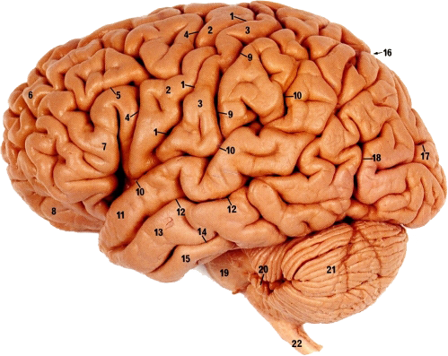

eDIVA Platform: Identifying Causal Mutations in Disease
Secure Storage
Variant
Prediction
Sequencing
Functional
Annotation
Inheritance
Model
Variant
Prioritization
Samples
OMICs Analysis
+
Network Analysis
-
+
-
+
-
-
-
+
+
Visualization
-
Family-History
Patients
?
Notes:
I would like to start with explaining our main sequencing analysis pipeline, which we developed over the last year. The process of analysing Exome-seq can be visualized as a distillation process, starting with with a cohort of patients, a bunch of clinical data and millions of sequencing that lead to the detection of a single causal mutation. As you can imagin this requires a clever analysis pipeline starting with an optimal alignment and variant prediction, the use of all available functional OMICsdata and clinical info and an algorithm for automatically prioritizing causal variants.

Slide 10

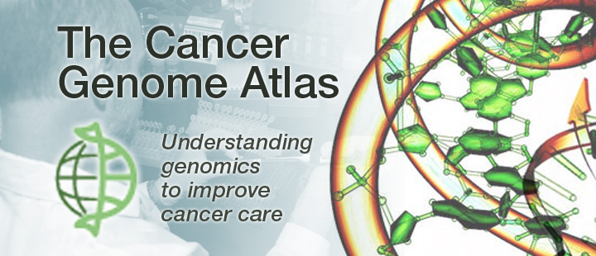
Cancer Projects
International Cancer Genome Consortium: Chronic Lymphocytic Leukemia
ICGC/TCGA Pan Cancer Analysis of Whole Genomes
Notes:
10

Slide 11
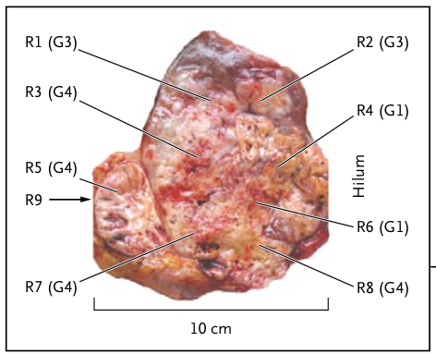
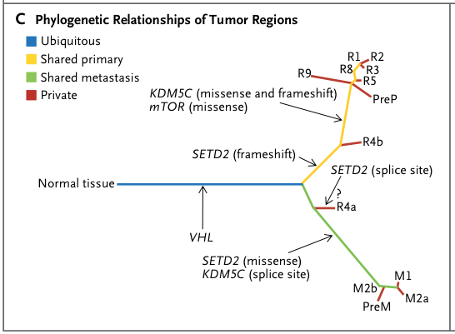
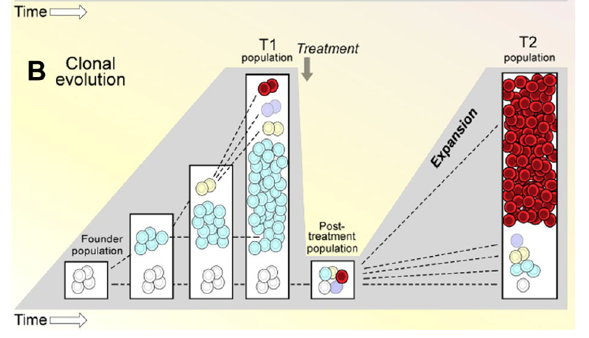
Clonal Evolution and Heterogeneity of Tumors
Gerlinger 2012
Wu 2012
Notes:
11

Slide 12
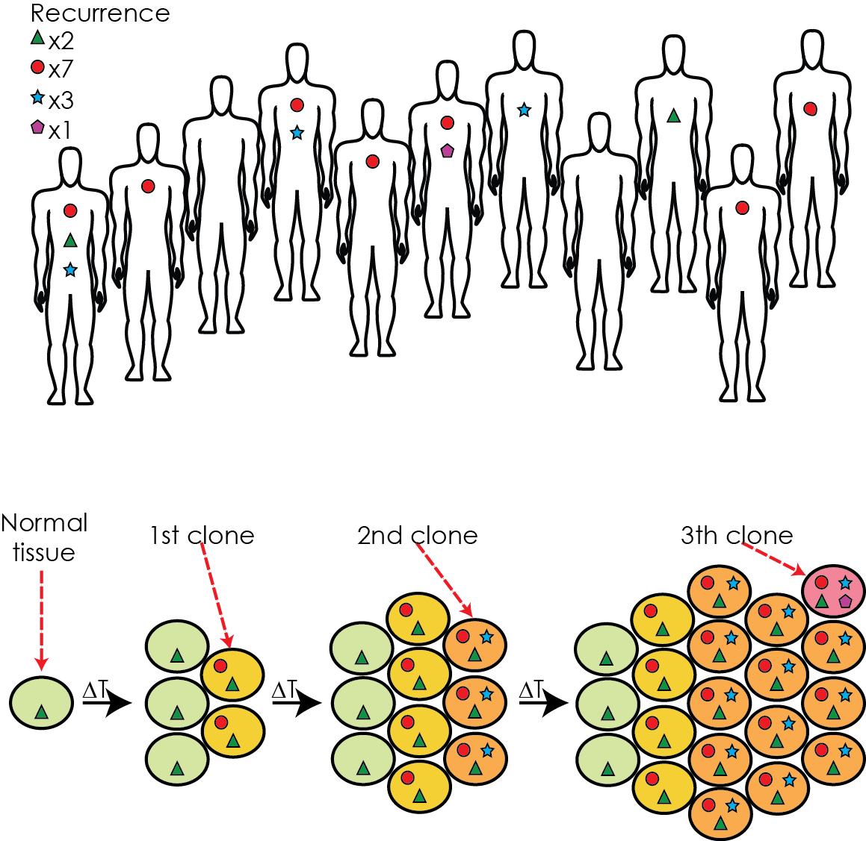
Cancer Driver Identification: Mutation Recurrence Analysis
per-patient
recurrence
per-tumor- cell
recurrence
Notes:
12
As a program flowchart this looks like this. We use multiple tools and algorithms programmed in our lab or in other labs. The pipeline has recently been published as part of our study on hyperkalemia, a cardio-vascular disease.

Slide 13
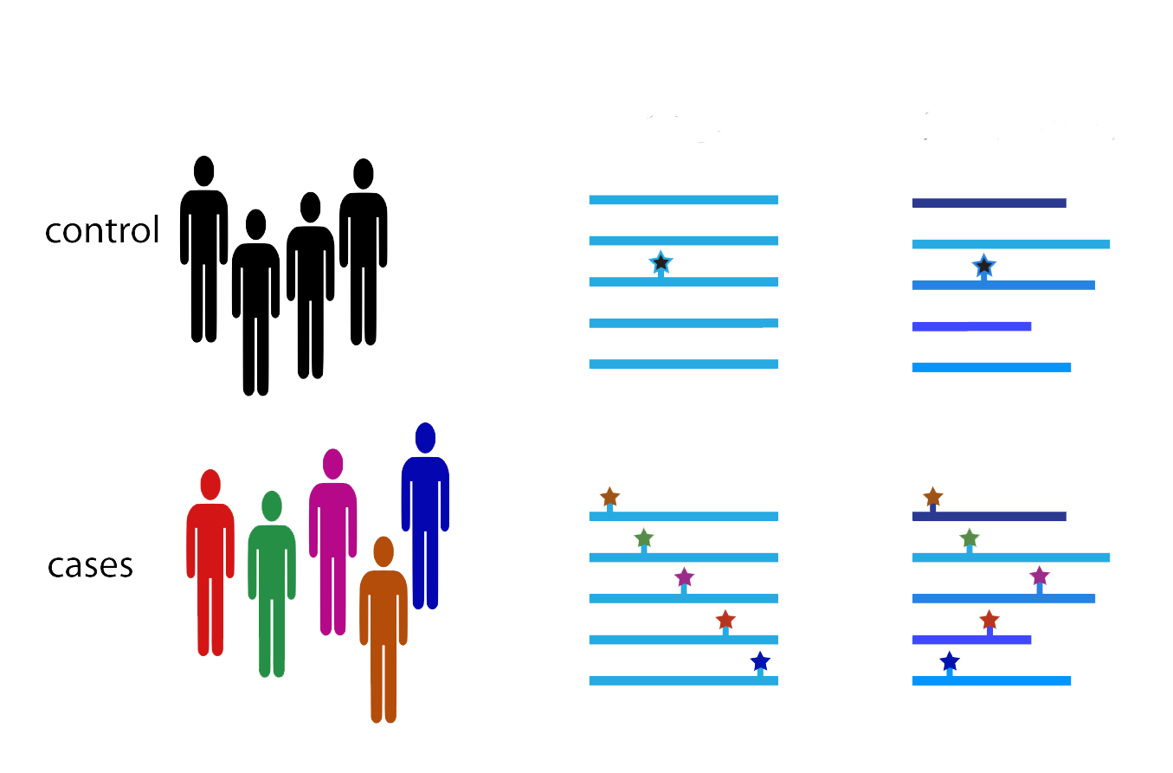
Cancer Predisposition: Rare Variant Association Studies (RVAS)
Gene-wise
Pathway-wise
Notes:
13
a) Identify mutations specific to small sub-clones (low frequency); b) distinguish the driving mutations/genes from passengers; c) identify mutations causing relapse post treatment

Slide 14
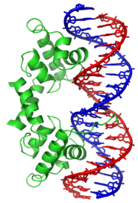
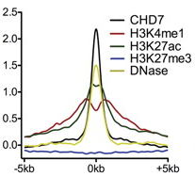
Identifying Candidate Mutations in Regulatory Regions
Chromatin conformation capture
eQTL?
tissue specific
epigenome profile
Notes:
14
When we started to think about identification of causal variants in regulatory regions we faced several problems. First exome-seq as the most common study type does not
identify these variants, while WGS-seq is too expensive for larger cohorts. Second, even if all regulatory variants would be identified there is at the moment no simple measure
for their effect on e.g. TFBS binding, except if the mutations directly hits a known binding motif. However it has recently been shown that epigenetic marks can very efficiently
identify regulatory regions and also give an indication of their activity in a specific tissues. Thus epigenetic patterns can help us to identify variants in active regulatory elements,
which we could then correlate to differential expression patterns.

Slide 15
Epigenomics
Epigenome Sequencing
Notes:
15
a) Identify mutations specific to small sub-clones (low frequency); b) distinguish the driving mutations/genes from passengers; c) identify mutations causing relapse post treatment

Slide 16





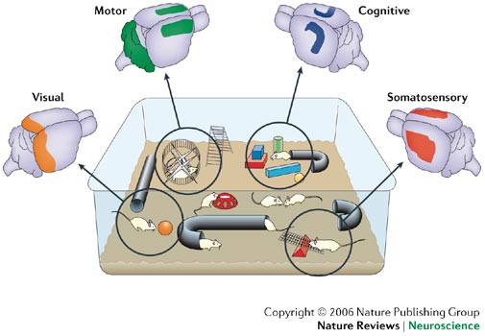
Effect of Learning on the Cortex Epigenome
No Treatment
Environmental Enrichment (EE)
Boring
Wild type
Stimulation:
Visual
Motor
Cognitive
Somatosensory
Notes:
16

Slide 17
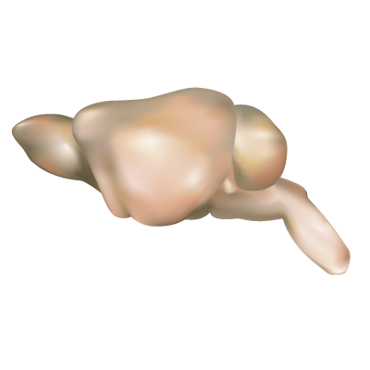
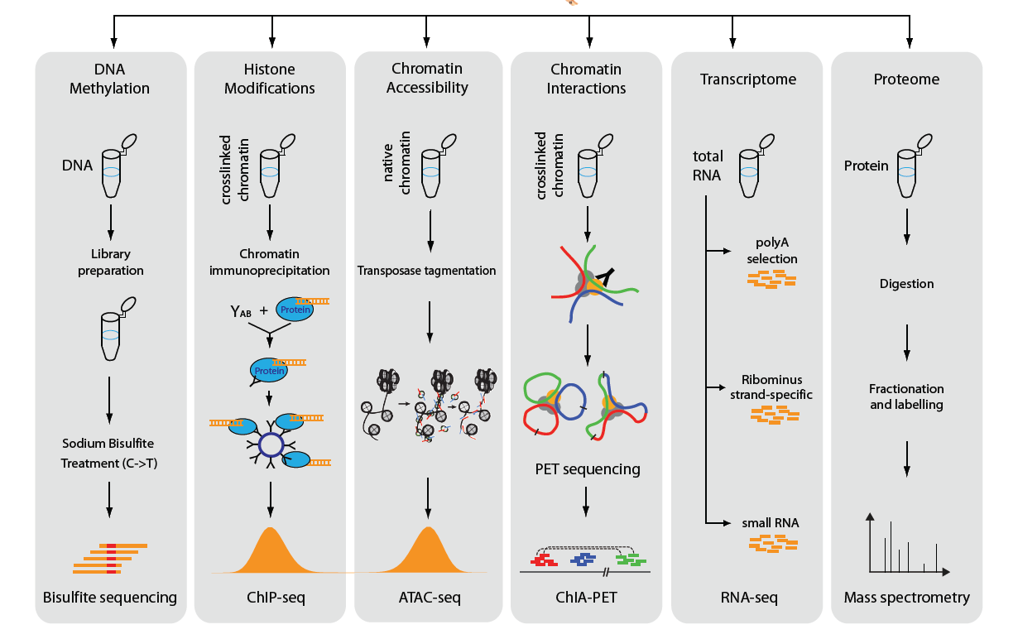
Studying the “Complete Epigenome” Using NGS
2 treated groups vs. 2 untreated groups
5 mice per group, pooled cortex tissue
Notes:
17

Slide 18
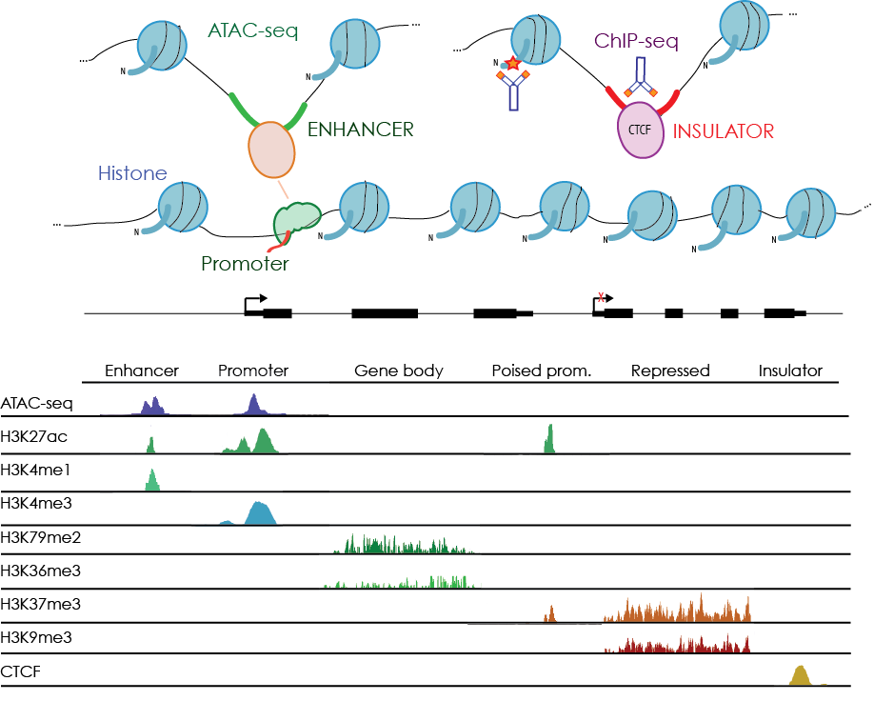
Studying the “Complete Epigenome” Using NGS
Notes:
18

Slide 19
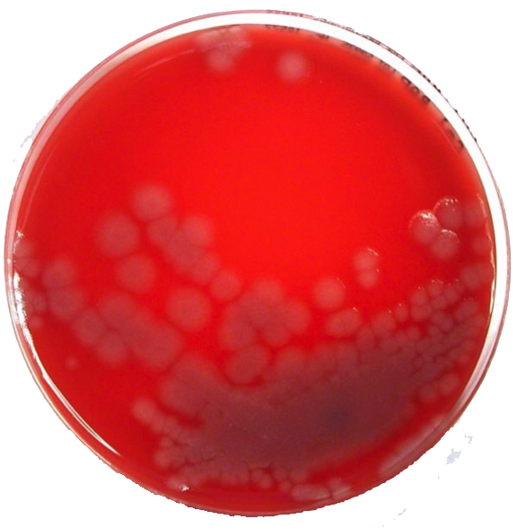
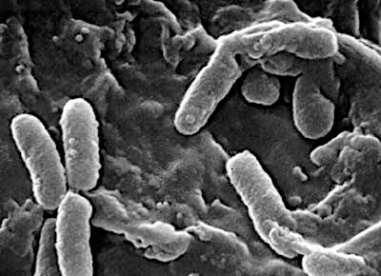


Multi-Antibiotic Resistant Bacteria Strains in Hospitals
Molecular epidemiological study of a multi-antibiotic Pseudomonas aeruginosa outbreak in a clinic
Notes:
19
Today I will discuss one specific disease model we have studied using NGS, chronic lymphocytic leukemia. Leukemias are cancers of white blood cells, and there classification is closely connected to the hematopoiesis, i.e. the differentiation of the different white blood cell types from hematopoietic stem cells. There are two major progenitor cells differentiated from the stem cells, the myeloid and the lymphoid progenitors. Similarly leukemias are divided into myeloid and lymphoid or lymphocytic leukemias. Furthermore we distinguish between acute leukemias with rapid progression and short survival vs chronic leukemias with slow progression and long survival. The main model leukemia used in my group is B-cell CLL.

Slide 20
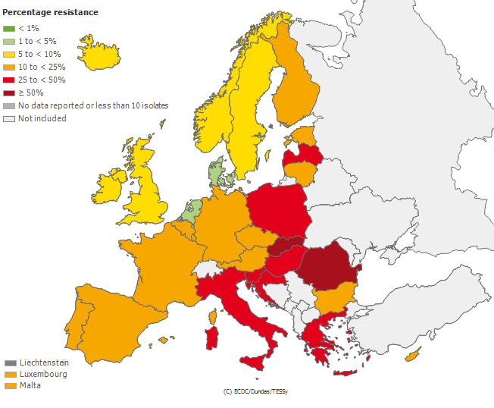
Multi-Antibiotic Resistant Bacteria Strains in Hospitals
Carpapenem-resistent P. aeruginosa occurrence
http://ecdc.europa.eu/en/healthtopics/antimicrobial_resistance/database/Pages/map_reports.aspx
Notes:
20
Today I will discuss one specific disease model we have studied using NGS, chronic lymphocytic leukemia. Leukemias are cancers of white blood cells, and there classification is closely connected to the hematopoiesis, i.e. the differentiation of the different white blood cell types from hematopoietic stem cells. There are two major progenitor cells differentiated from the stem cells, the myeloid and the lymphoid progenitors. Similarly leukemias are divided into myeloid and lymphoid or lymphocytic leukemias. Furthermore we distinguish between acute leukemias with rapid progression and short survival vs chronic leukemias with slow progression and long survival. The main model leukemia used in my group is B-cell CLL.

Slide 21

Sequencing of Hundreds of Multi-Antibiotic Resistant Strains
Air condition
&
light installations
Personnel
&
patients
Bed, sheets,
towels
Neighboring
rooms
&
food kitchen
Sink and
Water
Notes:
21
Today I will discuss one specific disease model we have studied using NGS, chronic lymphocytic leukemia. Leukemias are cancers of white blood cells, and there classification is closely connected to the hematopoiesis, i.e. the differentiation of the different white blood cell types from hematopoietic stem cells. There are two major progenitor cells differentiated from the stem cells, the myeloid and the lymphoid progenitors. Similarly leukemias are divided into myeloid and lymphoid or lymphocytic leukemias. Furthermore we distinguish between acute leukemias with rapid progression and short survival vs chronic leukemias with slow progression and long survival. The main model leukemia used in my group is B-cell CLL.

Slide 22
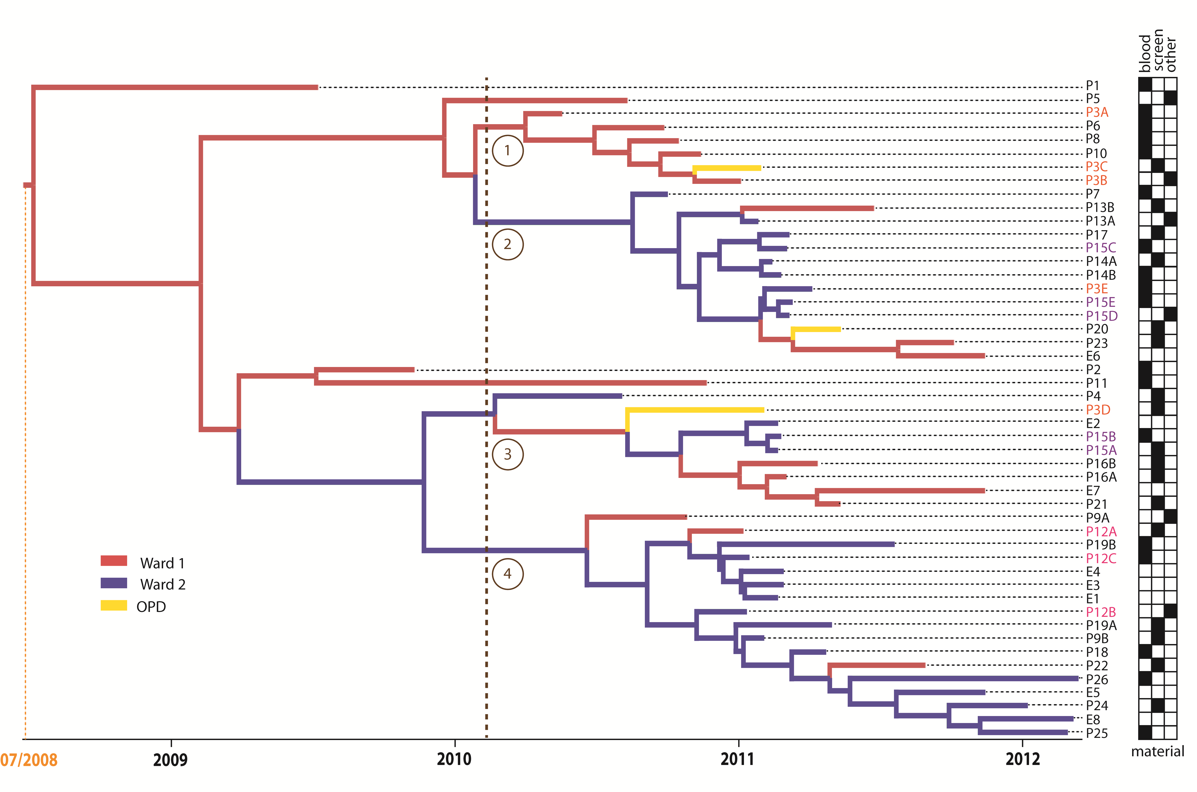
Phylogenetic Analysis of resistant P. aeruginosa strains
Notes:
22
Today I will discuss one specific disease model we have studied using NGS, chronic lymphocytic leukemia. Leukemias are cancers of white blood cells, and there classification is closely connected to the hematopoiesis, i.e. the differentiation of the different white blood cell types from hematopoietic stem cells. There are two major progenitor cells differentiated from the stem cells, the myeloid and the lymphoid progenitors. Similarly leukemias are divided into myeloid and lymphoid or lymphocytic leukemias. Furthermore we distinguish between acute leukemias with rapid progression and short survival vs chronic leukemias with slow progression and long survival. The main model leukemia used in my group is B-cell CLL.

Slide 23
Patients Carrying the Pseudomonas Strain
Notes:
23
Today I will discuss one specific disease model we have studied using NGS, chronic lymphocytic leukemia. Leukemias are cancers of white blood cells, and there classification is closely connected to the hematopoiesis, i.e. the differentiation of the different white blood cell types from hematopoietic stem cells. There are two major progenitor cells differentiated from the stem cells, the myeloid and the lymphoid progenitors. Similarly leukemias are divided into myeloid and lymphoid or lymphocytic leukemias. Furthermore we distinguish between acute leukemias with rapid progression and short survival vs chronic leukemias with slow progression and long survival. The main model leukemia used in my group is B-cell CLL.

Slide 24
Transmission Route of the Outbreak
Few „Superspreaders“ are responsible for initial dynamics of the outbreak
But:
Environmental contamination perpetuated the outbreak and led to the endemic situation
Willmann, Bezdan et al JAC 2015
Notes:
24
Today I will discuss one specific disease model we have studied using NGS, chronic lymphocytic leukemia. Leukemias are cancers of white blood cells, and there classification is closely connected to the hematopoiesis, i.e. the differentiation of the different white blood cell types from hematopoietic stem cells. There are two major progenitor cells differentiated from the stem cells, the myeloid and the lymphoid progenitors. Similarly leukemias are divided into myeloid and lymphoid or lymphocytic leukemias. Furthermore we distinguish between acute leukemias with rapid progression and short survival vs chronic leukemias with slow progression and long survival. The main model leukemia used in my group is B-cell CLL.

Slide 25
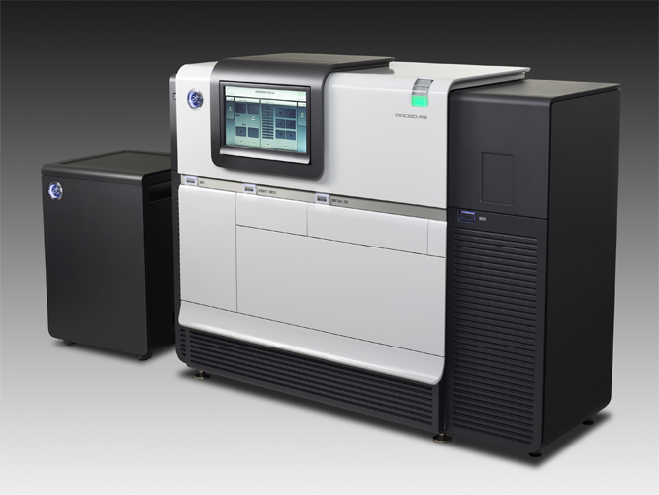

Improving de-novo Assembly of Bacteria with Long Reads
Reads
Contigs
Scaffolds
Genome
HiSeq 2 x 125
MiSeq 2 x 300
Mate-Pair 10kb
Raw reads
HGAP- Preassembly
Raw reads
MiSeq corrected reads
Notes:
25
Today I will discuss one specific disease model we have studied using NGS, chronic lymphocytic leukemia. Leukemias are cancers of white blood cells, and there classification is closely connected to the hematopoiesis, i.e. the differentiation of the different white blood cell types from hematopoietic stem cells. There are two major progenitor cells differentiated from the stem cells, the myeloid and the lymphoid progenitors. Similarly leukemias are divided into myeloid and lymphoid or lymphocytic leukemias. Furthermore we distinguish between acute leukemias with rapid progression and short survival vs chronic leukemias with slow progression and long survival. The main model leukemia used in my group is B-cell CLL.

Slide 26

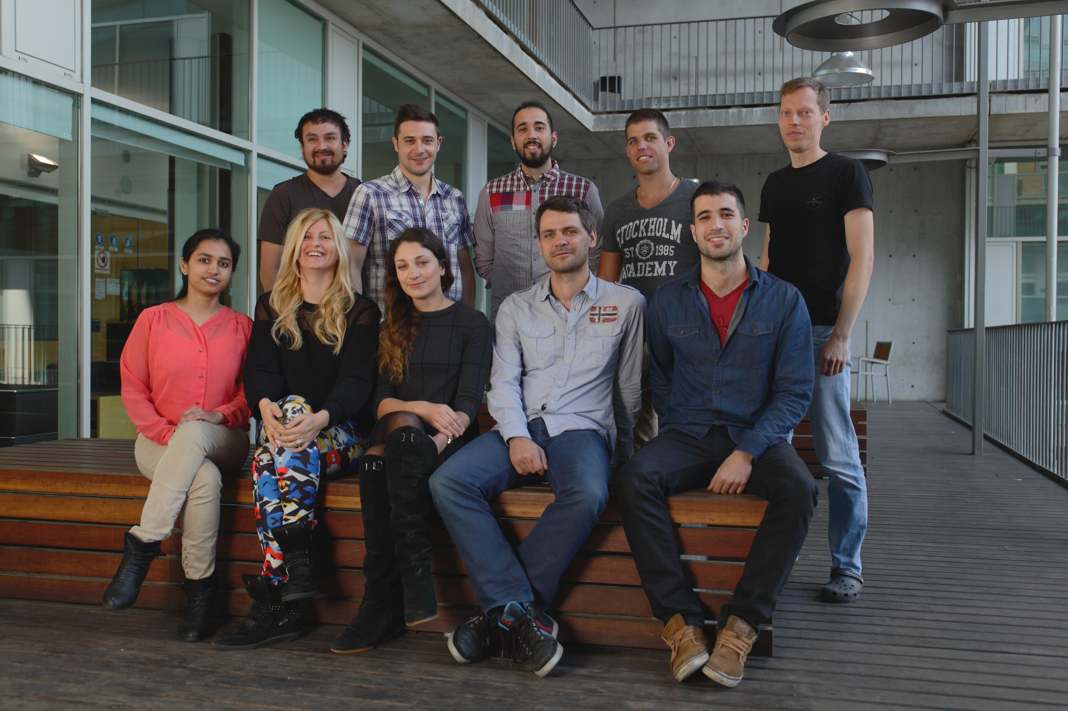

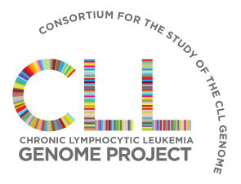


Genomic and Epigenomic Variation in Disease Group
Ossowski lab:
Daniela Bezdan
Hana Susak
Shalu Jhanwar
Oliver Drechsel
Luis Zapata
Sergio Espeso
Mattia Bosio
Francesc Muyas
Michael Berry
Stephan Ossowski

