Slide 1
Overview of Promega's Science and Business June 2015 Tom Livelli, VP Life Sciences

Slide 2
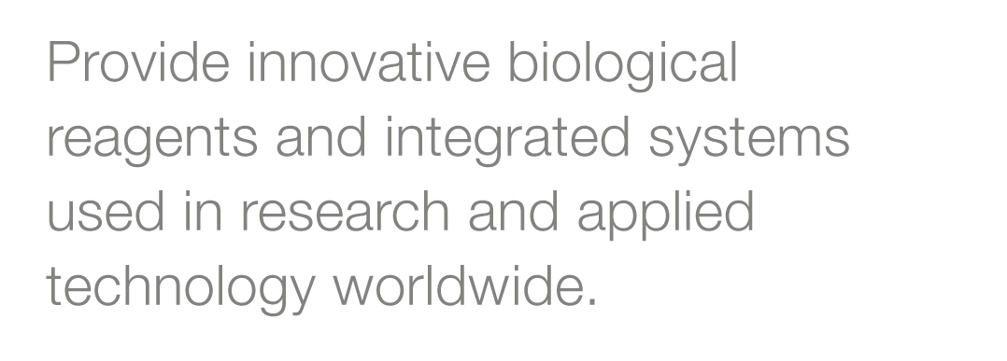
Our Mission

Slide 3
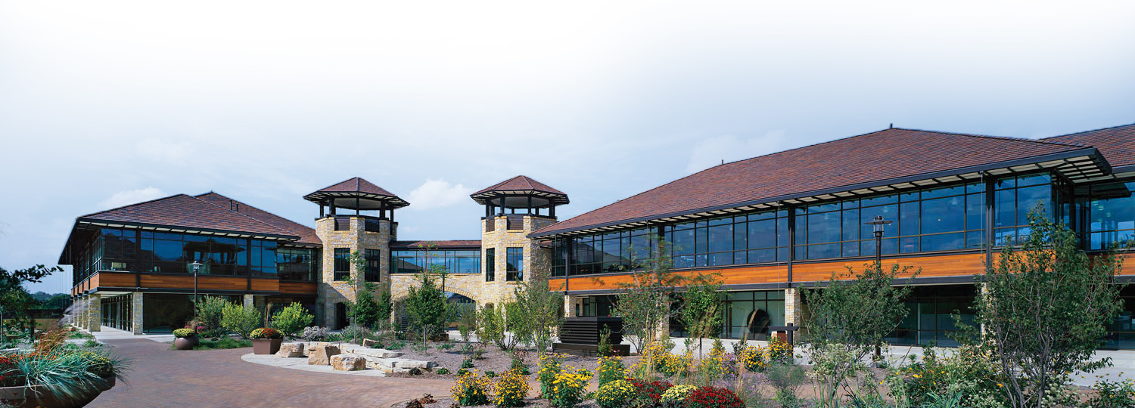
Highlights
Founded in 1978
Headquartered in Madison, Wisconsin
Calendar Year 2014 Revenues ~$380M USD
~1,350 employees in 16 countries
Over 3,500 products for life science research and applied science distributed in >100 countries

Slide 4
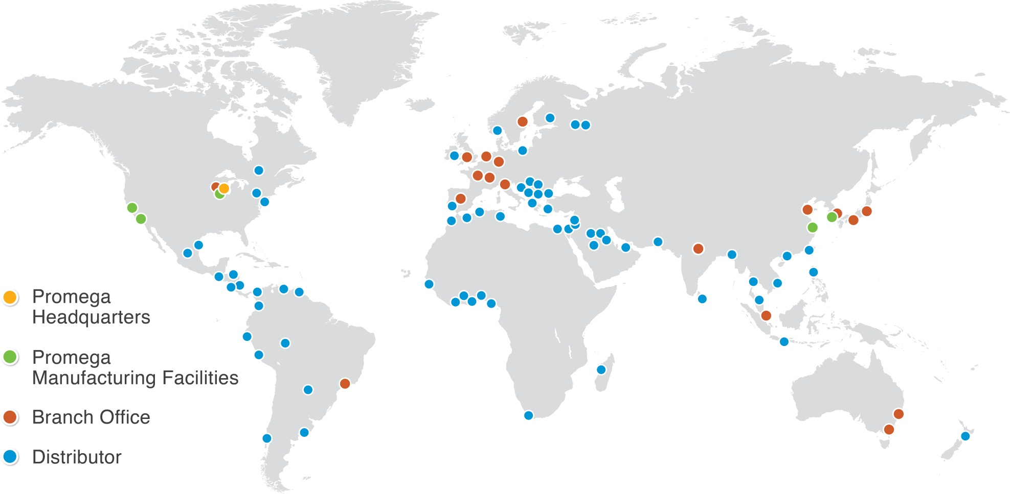
Commercial and Manufacturing Sites

Slide 5
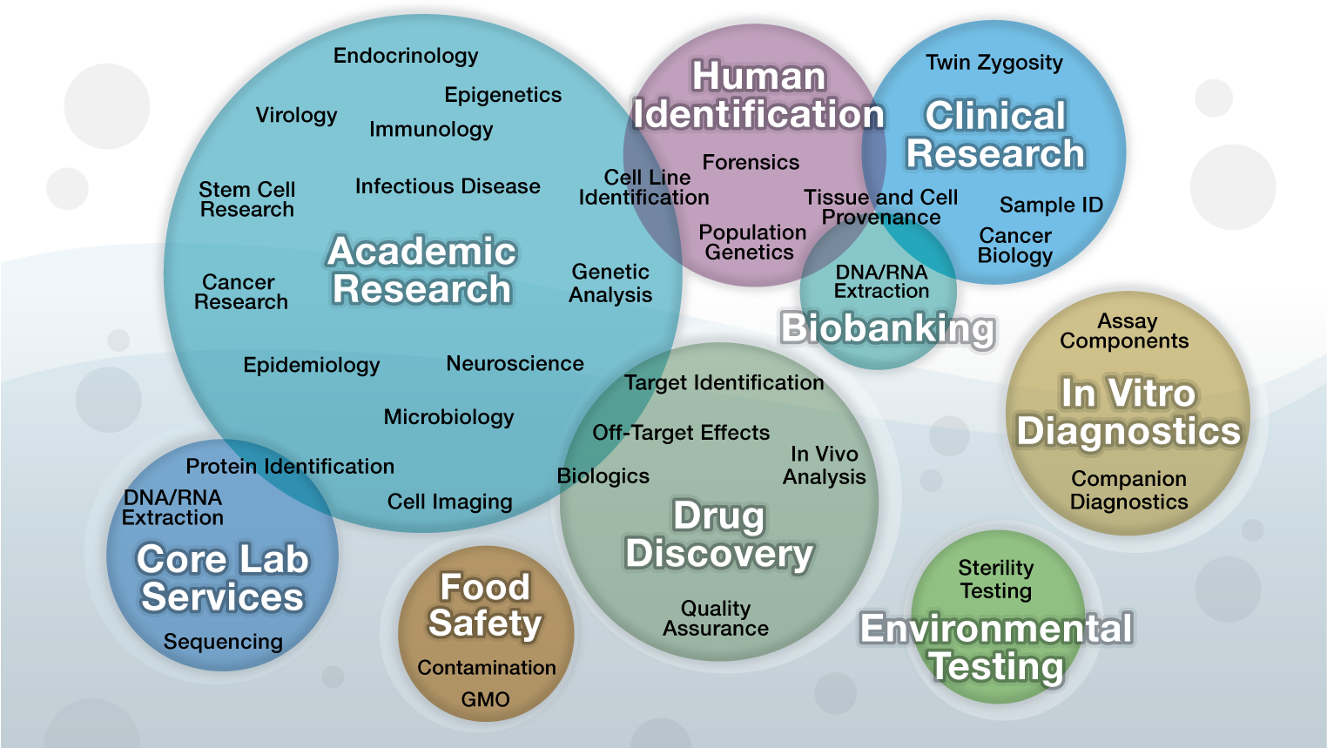
Breadth of Support

Slide 6
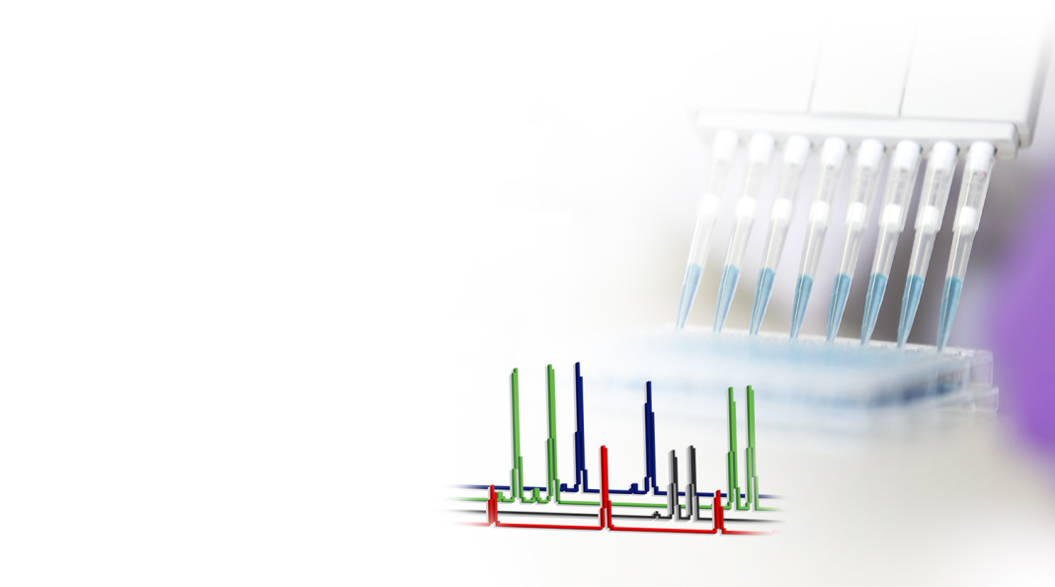
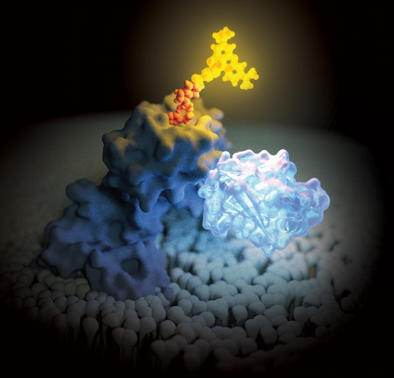
Core Technologies
Cellular and Biochemical
Assay Design (including custom design)
Integrated Cellular Biology
Macromolecular Design
Protein Analysis
Organic Chemistry
Nucleic Acid Technologies
Purification
Amplification
Detection
Human Genetic Identity

Slide 7
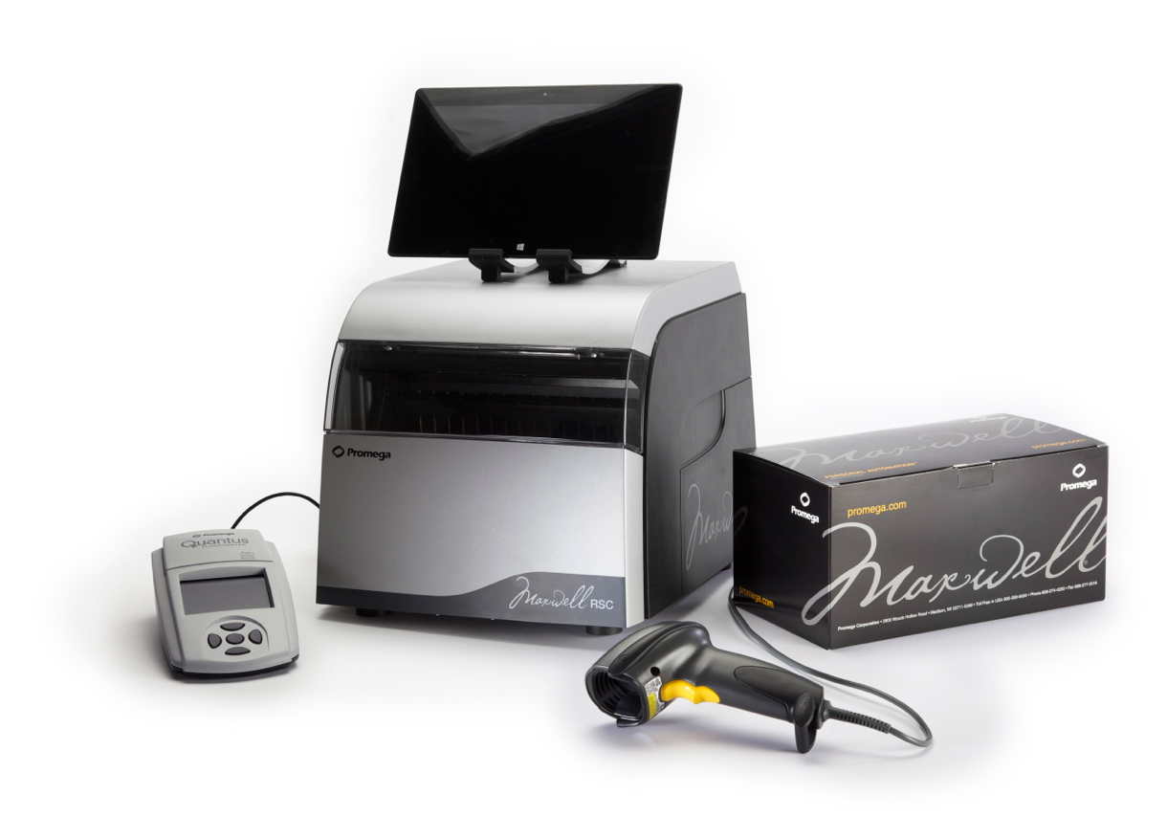
Core Technologies
Integrated Automation
Instrumentation
Reagents
Software
Services

Slide 8
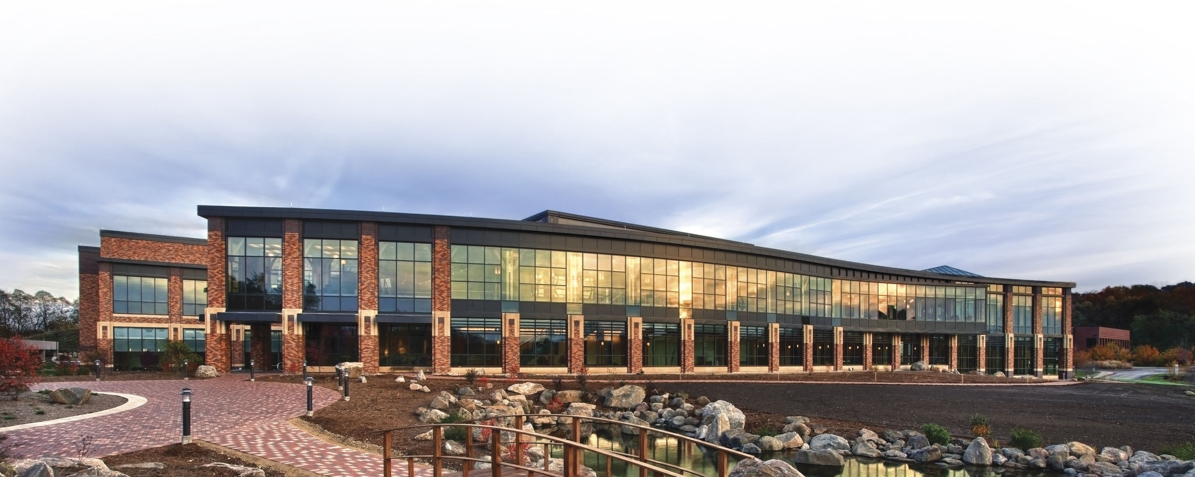
cGMP Manufacturing
Contract-manufacture products and components for IVD, applied markets or medical device manufacturers, including:
Clinical sample concentrator kits (DNA and RNA)
Components for laboratory-developed tests
Amplification reagents and master mixes for diagnostic assays

Slide 9
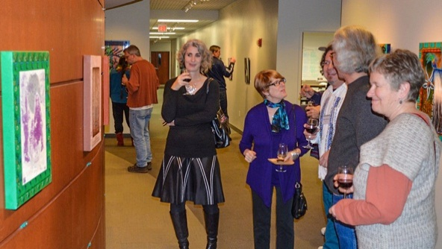
Corporate Responsibility Program
Program based on industry-standard Global Reporting Initiative Guidelines
Member of United Nations Global Compact since 2010
Environment
Reducing GHG emissions
Preserving natural capital
On target for 2014 goals
Employees
Wellness
Advancement
Work-Life Balance
Diversity
Community
Education
Wellness
Creativity/Arts

Slide 10
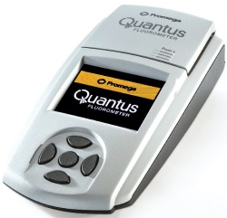
DNA Purification from Environmental Touch Samples
Application: Purify DNA from environmental touch samples from various locations inside and on the outside of an airplane
Analyses: Quantitate low level DNA amounts by fluorescent dye-based methods and confirm amplifiability by Real-Time PCR
Purification:
Maxwell® RSC Cell DNA
Purification Kit
Quantitation:
QuantiFluor® ONE
dsDNA System
Amplification:
GoTaq® qPCR Master Mix

Slide 11
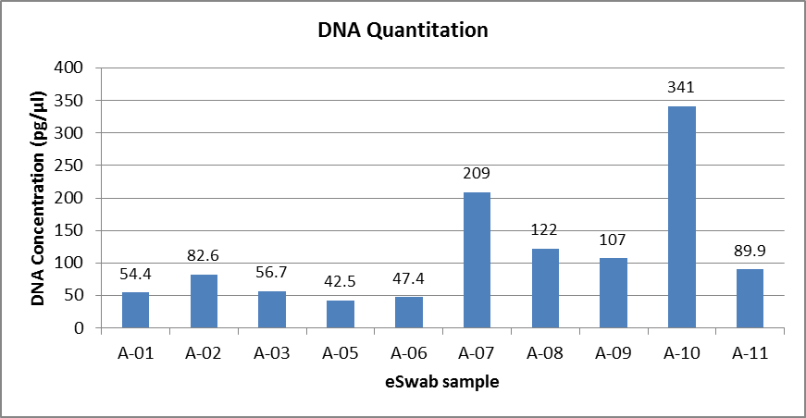
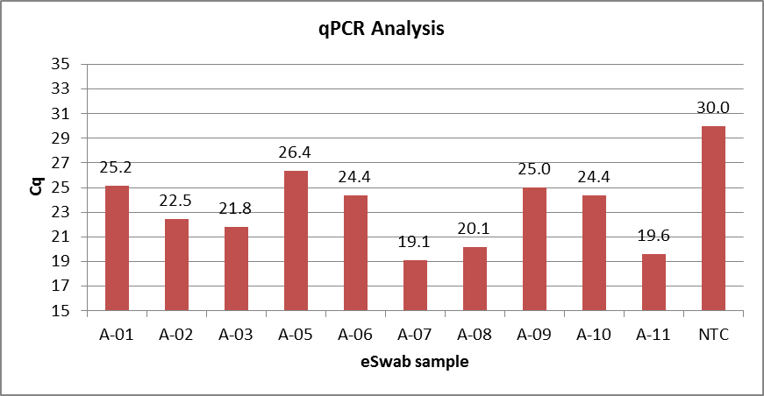
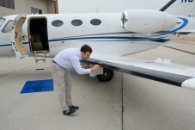
DNA Purification from Environmental Touch Samples

Slide 12
Thank you!

