Slide 1
Accurate functional annotation of metagenomics samples
A. Ugarte, J. Bernardes and A. Carbone
Paris
Hugues Richard, Laboratory of Computational and Quantitative Biology
Pierre and Marie Curie University

Slide 2
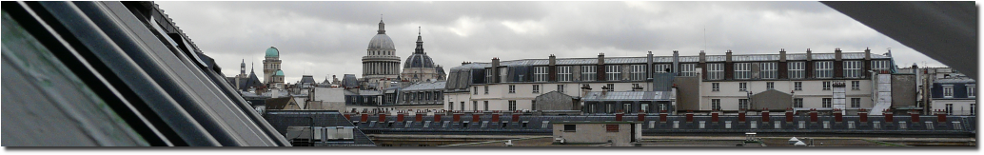
Lab. of Computational and Quantitative biology.
Head A. Carbone
In silico
In vivo
Analytical genomics
Genomic Physics
Statistical Genomics
Mathematical Modeling
Diatom genomics
Genetic networks
Biology of genomes
Pierre and Marie Curie University – Paris center, more than 30k students
Master program in Bioinformatics (2x, from Biology or Computer Science).
http://www.lcqb.upmc.fr/

Slide 3
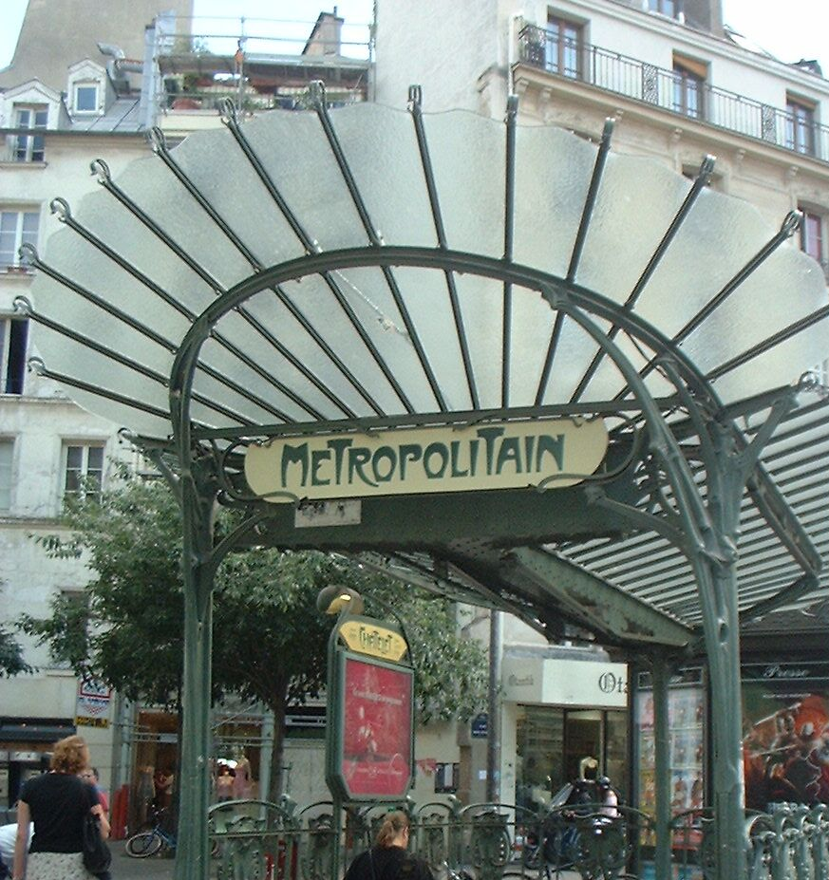
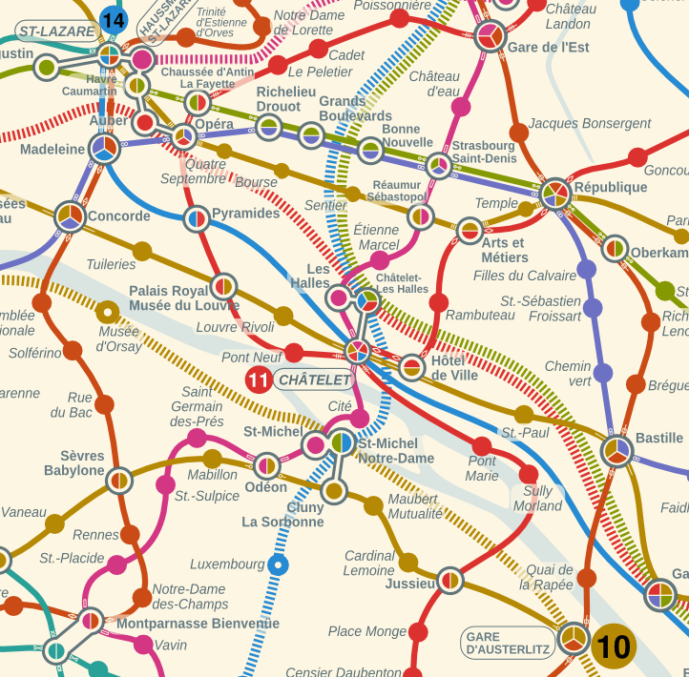
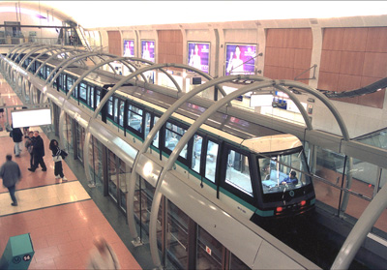
City of light

Slide 4
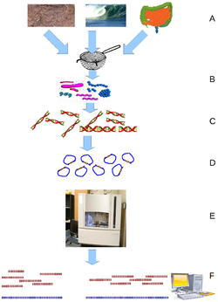
Microbial communities
Taxonomy
Biochemistry
(on CDS)
What is the structure of the community?
What is functionally done by the community?
What is functionally done by the subcommunities?

Slide 5
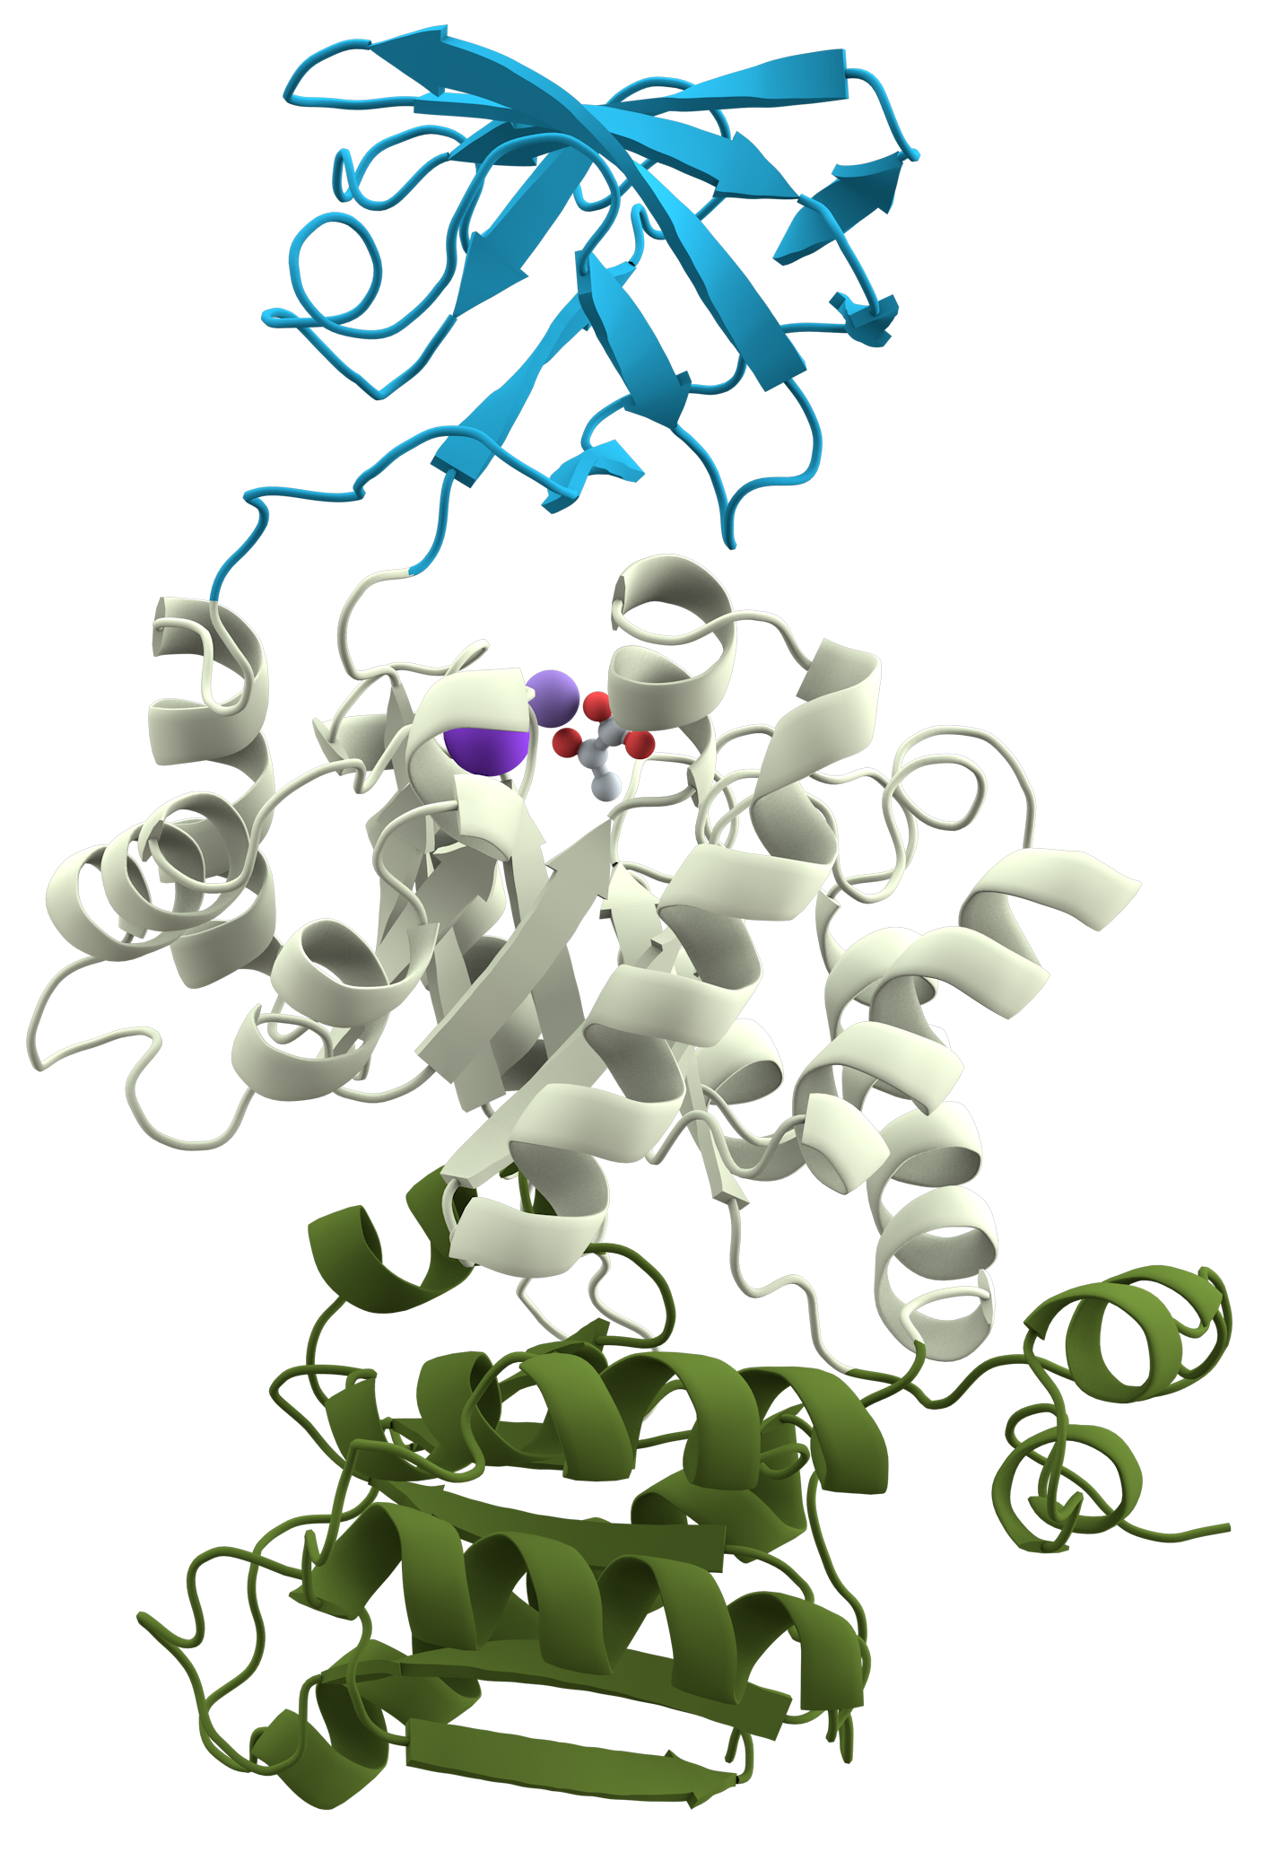
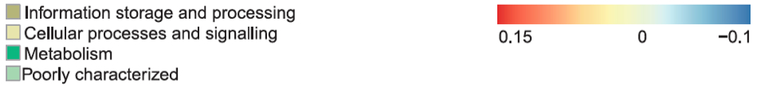
Domain annotation of CDS fragments
Individual structural domain: 36—692aa.
90% with < 200 residues,
average of approx 100 residues
Identification of the community metabolic preferences
Genetic information is fragmented, lost, isolated, new.

Slide 6
An improved annotation should provide a better resolution
of the functional activity of the community

Slide 7
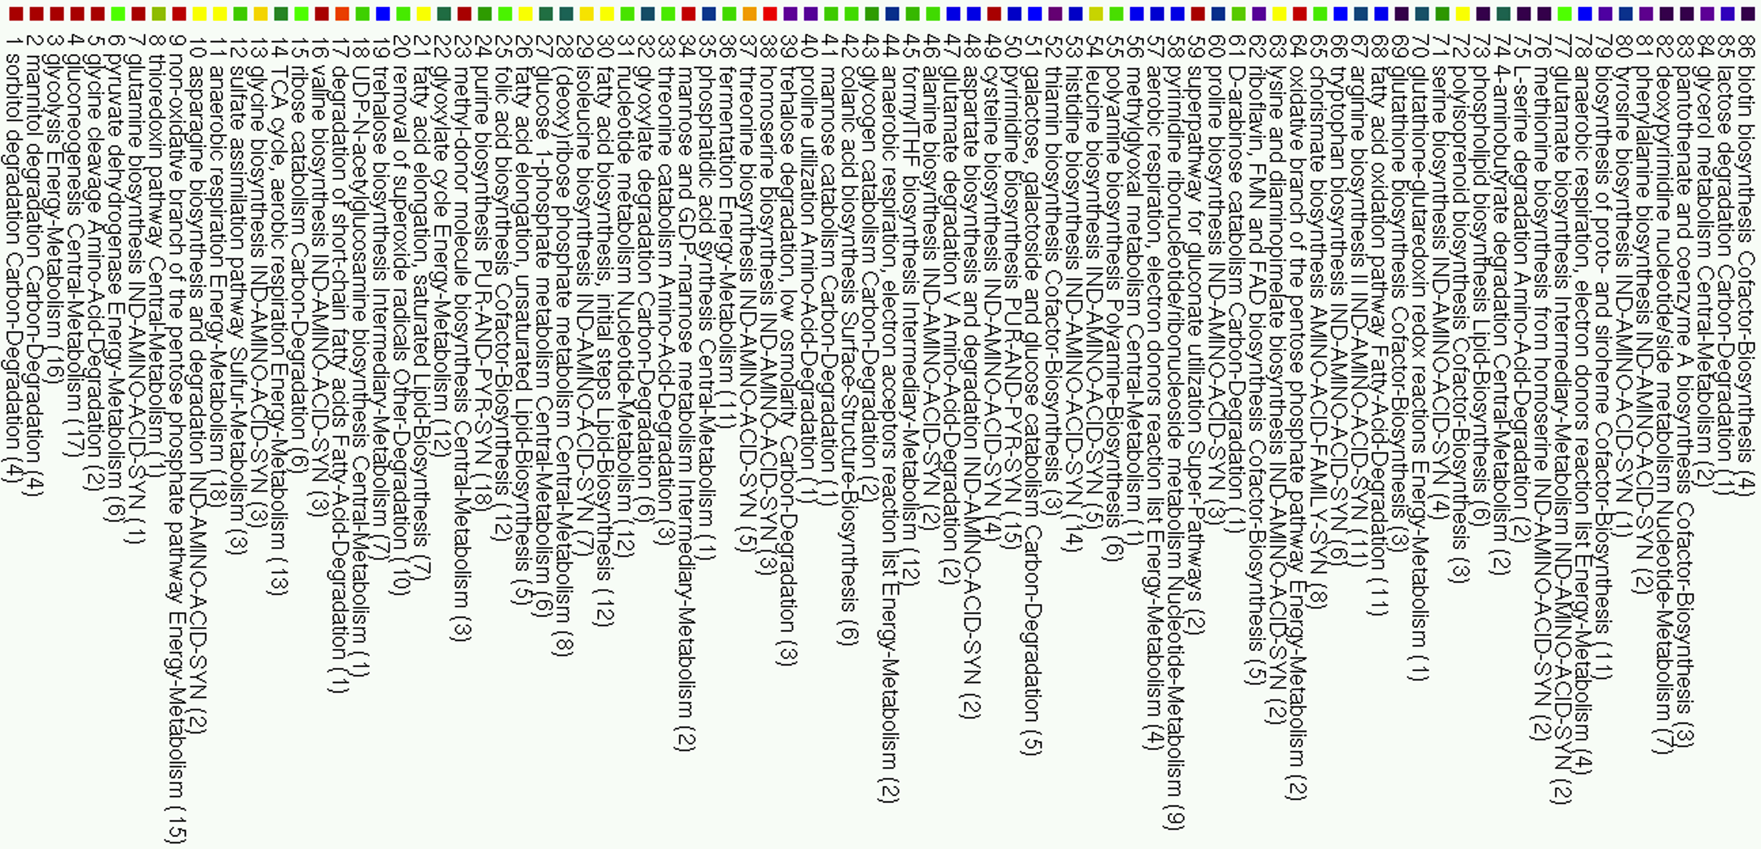


Slide 8
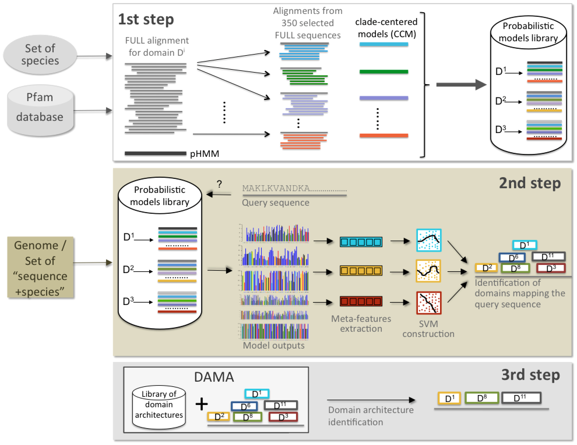
PFAM
PFAM
CLADE
(CLoser sequences for Annotation Directed by Evolution)
A large-scale pipeline applied to genomes and metagenomes
Bernardes, Zaverucha, Vaquero, Carbone, High performance domain identification in proteins explores a multitude of diversified profiles with grid computing, to be submitted 2015
Bernardes, Vieira, Zaverucha, Carbone, A multi-objective optimization approach accurately resolves protein domain architectures, under review, 2015.

Slide 9
Construction of the models
Identification of domains
Selection of domains

Slide 10
On Pfam27: 14831 domains.
We constructed 2 389 235 CCMs and 14831 pHMM domains.
Total= 2 404 066
250 nodes and 3.7 months of computer time
Annotation of whole genome sequence (P. falciparum):
Protein Coverage (>1 domain)
PlasmoDB
52%
Pfam v27
63%
CLADE
72%
29% more domains in total

Slide 11
A.
PF3D7 1122900 (PF11 0240)

Slide 12
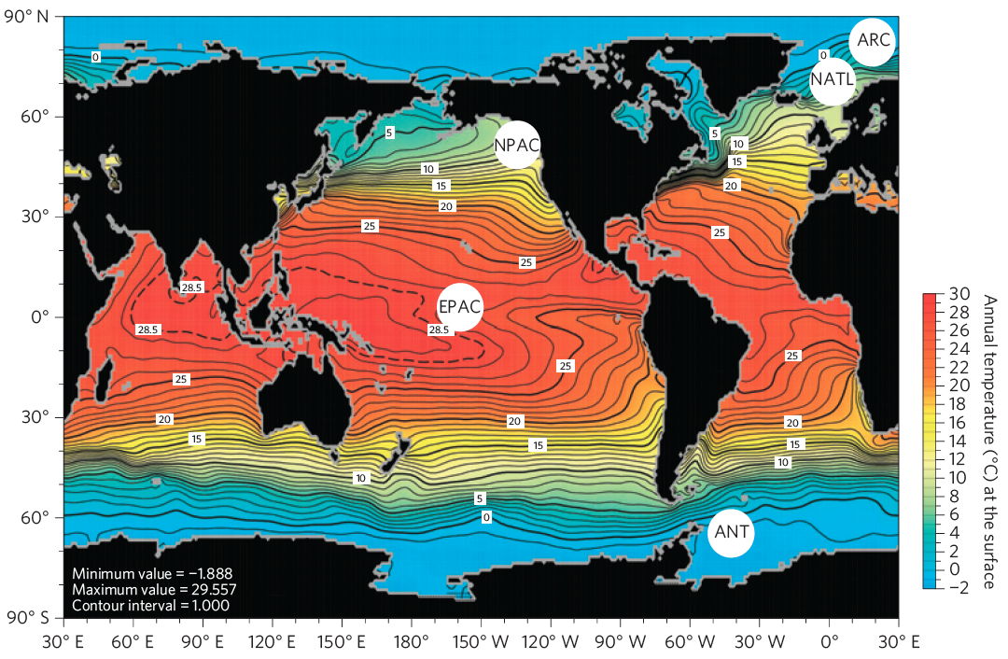
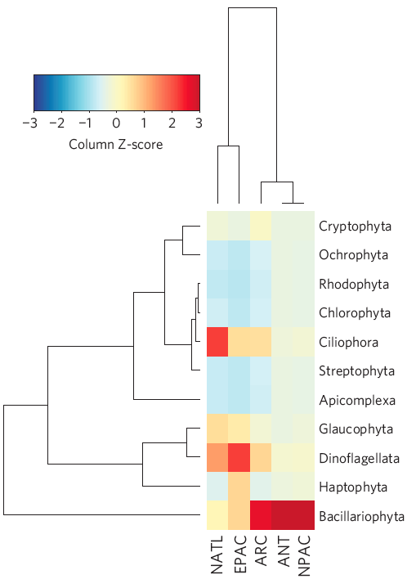
CLADE on metatranscriptomics data
Marine eukaryotic phytoplankton metatranscriptomes
Taxonomic composition
1.5M high quality cDNA sequences, average length of 242bp
Toseland et al. Nature Climate Change, 2013

Slide 13
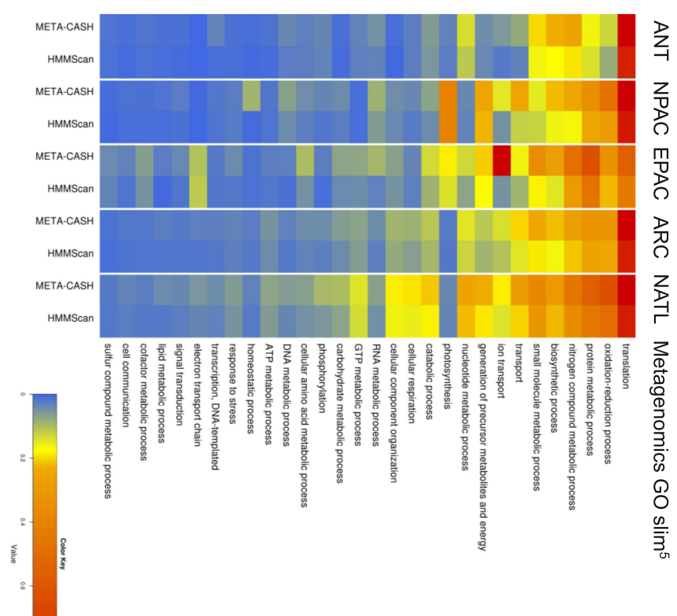
CLADE
HMMScan
ANT
CLADE
HMMScan
NPAC
CLADE
HMMScan
EPAC
CLADE
ion transport
HMMScan
ARC
CLADE
HMMScan
NATL
Go Slim

Slide 14
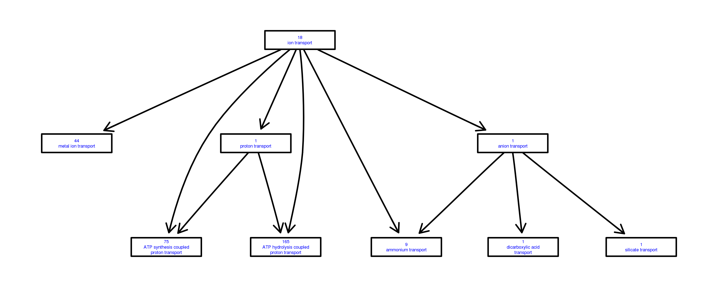
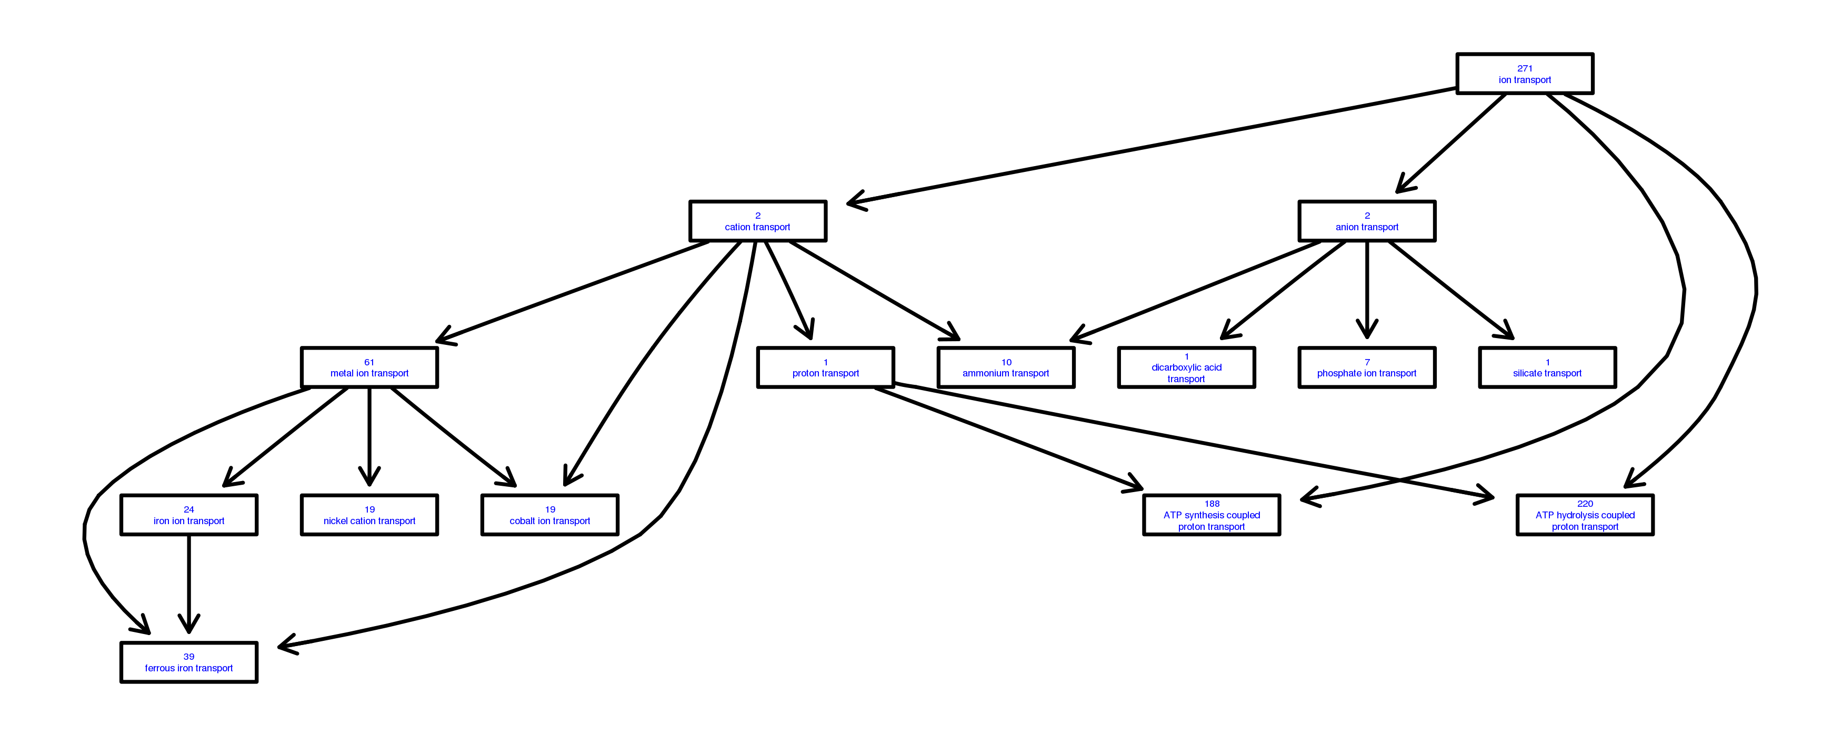
Fitting the predicted
domains into GO classification:
HMMScan
- More domains
- Better functional accuracy
CLADE

Slide 15
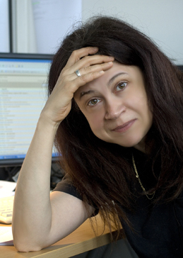
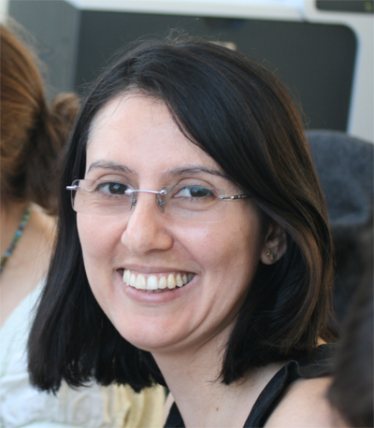
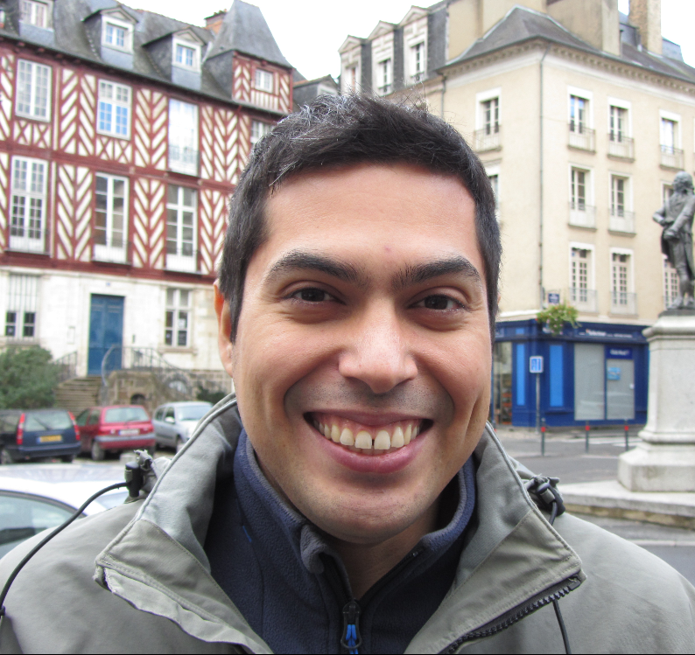




Acknowledgments
Juliana Bernardes
PhD/Postdoc
Genomics
Ari Ugarte
PhD student
Metagenomics
Alessandra Carbone
Your
name
here
Postdoc position available
Contact us:
alessandra.carbone@upmc.fr
Tina Alaeitabar (Master student UPMC, IR at INRA)
Jinxin Wang and Jodie Gauvain (Master students, UPMC)
Angela Falciatore (Diatom Functional Genomics, LCQB)
Maurizio Ribeira d’Alcalà (SZ A.Dorhn, Italy)
Thomas Mock (University of East Anglia, UK)

