Slide 1
Environmental Exposure Assessment in the UDN
Catherine Brownstein
The Undiagnosed Disease Network
Boston Children’s Hospital
June 20, 2015

Slide 2

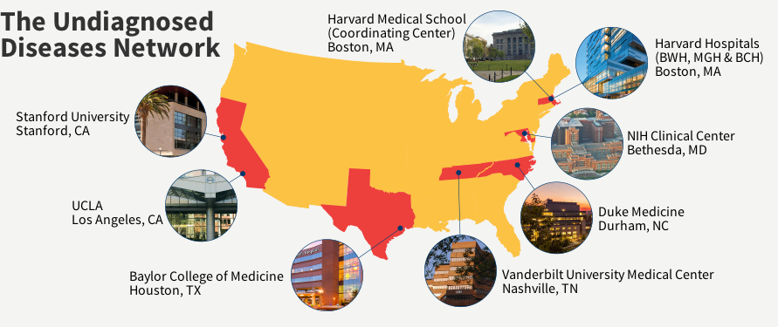
The UDN is a new initiative that expands on the NIH Undiagnosed Diseases Program (UDP)
The UDP has reviewed 3300 medical records, seen 750 patients with rare and undiagnosed conditions, and identified more than 70 rare diseases and several new conditions.
GOALS OF THE UDN:
Facilitate diagnosis of currently undiagnosed diseases and conditions
Encourage collaboration
Enhance research experience for patients and families with undiagnosed diseases
UDN PLANS TO:
Use self-phenotyping surveys
Collect phenotypic data using HPO
Issue RFAs and gene function collaboration candidate lists
Use an environmental survey to collect exposure data
Assess non-genetic causes of undiagnosed conditions

Slide 3
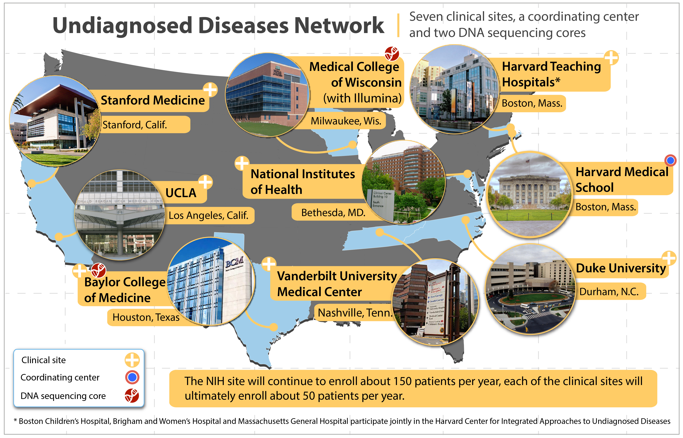

Slide 4
Rationale for Environmental Exposure Assessment in the UDN
Environmental exposures likely cause or modify the development of a subset of undiagnosed diseases
Identification of a key environmental exposure could suggest effective treatment for an undiagnosed disease
Comprehensive environmental assessment is often not performed in the evaluation of patients with unusual clinical presentations

Slide 5
Goals of Environmental Exposure Assessment in the UDN
Develop a screening questionnaire that could be used to identify potentially important environmental exposures contributing to a patient’s undiagnosed disease
Pertinent positive responses on screening questionnaire would need to be followed up by an occupational medicine/environmental health physician
Primary purpose of the questionnaire would be clinical, but could also be used for research
Questionnaire would be completed by all patients accepted into the UDN after signing consent form (data would be Above The Line)
General environmental screening question has been added to the application form to identify patients who may have had important environmental exposures

Slide 6
Procedure for Environmental Exposure Questionnaire Development
Review of existing questionnaires: CDC Environmental Exposure History, PhenX (multiple domains), American Academy of Clinical Toxicology, NHANES, Food Frequency Questionnaire
Extraction and editing of relevant items from existing questionnaires
Obtaining advice on additional questions from content experts
  Infectious Disease (James Maguire)
  Teratogens (Lew Holmes)
Review by Harvard/UCLA investigators

Slide 7
Challenges in Environmental Exposure Questionnaire Development
Timing:
  Problem: Would like to focus on environmental exposures before the undiagnosed disease developed, but don’t know when that really is
  Solution: Focus on “ever” exposures for most items, and 5 year exposures for items most susceptible to recall bias
Target Group:
  Problem: UDN will include babies, children, young adults, and older adults
  Solution: Exclude irrelevant questions for children under age 12, and recognize that information on early life exposures will likely be less accurate for adults
Scope:
  Problem: Number of potentially relevant environmental exposures is vast
  Solution: Focus on exposures that seem most likely to be relevant, but recognize limitations of a screening instrument
Wording:
  Problem: Reasonable people can disagree about the best way to ask about questionnaire topics
  Solution: Accept that the final product requires compromises to keep it practical as a screening tool; everyone will be at least a little bit unhappy with some questions

Slide 8
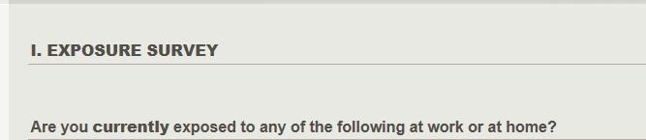
Part 1: Exposure Survey
Derived from CDC Exposure Survey
Asks about current and past exposures to broad categories then a specific list of exposures
Includes symptoms in family members, co-workers, and pets

Slide 9

Part 2: Work History
Derived from CDC Exposure Survey
Only for patients > 12 yrs old
Assesses timing of UDN symptoms related to work week
Extensive details about most recent job
Location and exposure information for all jobs
Asks about work-related illnesses

Slide 10

Part 3: Environmental History
Derived from CDC Exposure Survey
Asks about location of home relative to exposure sources (e.g., manufacturing facility, hazardous waste site)
Asks about other home environmental exposures

Slide 11

Part 4: Tobacco Exposure History
ATS-DLD Standard questions about cigarettes
Added COPDGene/SPIROMICS questions about e-cigarettes

Slide 12

Part 5: Alcohol Use
Derived from PhenX project
Top level question screens out non-exposed patients
Asks about alcohol dependence and related diseases

Slide 13

Part 6: Drug Use
Derived from PhenX project
Asks about key drugs of abuse (prescription and non-prescription)

Slide 14
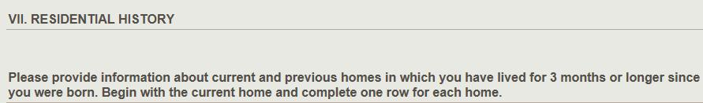
Part 7: Residential History
Derived from PhenX project
Asks about previous residences, including address for geocoding
Captures residential proximity to agricultural/industrial activity and drinking water information

Slide 15
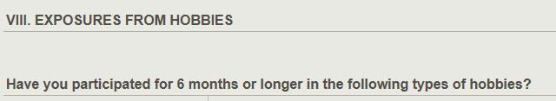
Part 8: Hobby Exposures
Derived from PhenX project
Asks about types of hobbies that provide potentially toxic exposures
Captures time frame and intensity of hobby exposures
Includes a general question about hobby-related illnesses

Slide 16

Part 9: Air Contaminants
in the Home Environment
Derived from PhenX project
Asks home renovations and mold exposures in the past five years

Slide 17

Part 10: Potential Exposures to Infection
Newly developed questions
Includes travel history nationally to regions with tick, endemic fungi, or other known infectious exposures
Captures international travel outside of US, Canada, and Western Europe
Includes exposures to animals and ticks
Includes dietary exposure to raw meat and raw fish

Slide 18

Part 11: Other Exposures
Newly developed questions
Includes dietary questions related to pica and a general unusual diet question
Includes traditional, herbal, and alternative medicines
Asks about blood exposures and STDs

Slide 19
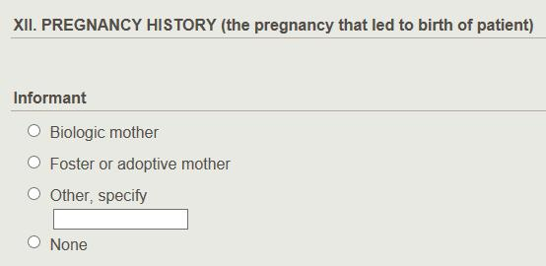
Part 12: Pregnancy History
Newly developed questions
Includes tobacco and alcohol exposure during pregnancy
Captures specific and all medication exposures during pregnancy
Includes maternal infections and radiation exposure during pregnancy
Includes assisted reproduction questions

Slide 20
Part 12: Pregnancy History (cont)
Includes maternal exposures to Environmental Exposure screening questions
Asks about maternal and paternal occupations and hobbies during pregnancy
Asks general question about other parental exposures during pregnancy

Slide 21
Part 13: Patient’s Guess
Includes general question for patient (or respondent) to speculate about key environmental exposures leading to the undiagnosed disease
Captures best guess for onset of undiagnosed disease symptoms

Slide 22
Unresolved Issues in Environmental Exposure Questionnaire Development
Which questions should be dropped for children under age 12?
  Cigarette smoking?
  Alcohol use?
Is the questionnaire too long?
Have we excluded key issues inappropriately?
  Second-hand smoke exposure: Quite common, hard to quantify
Limitations of Electronic Implementation
  Would like to have overall review option before submission
  Would like to be able to move back to specific locations in the questionnaire

Slide 23
Next Steps in Environmental Exposure Questionnaire Development
Final updates to current version
Pilot testing with volunteer patients
Need to decide if Spanish version of questionnaire will be developed
Do clinical centers have access to environmental health experts to follow-up pertinent positive responses from screening questionnaire?
Exploring funding options from NIEHS for the further development, validation, and analysis of questionnaire data

Slide 24
Conclusions
Undiagnosed diseases aren’t always genetic in origin
The Undiagnosed Disease Network is expanding upon typical medical data collection methods through the use of an environmental survey
UDN is open to collaborations- please inquire:
  Contact Catherine.Brownstein@childrens.harvard.edu

