Slide 1
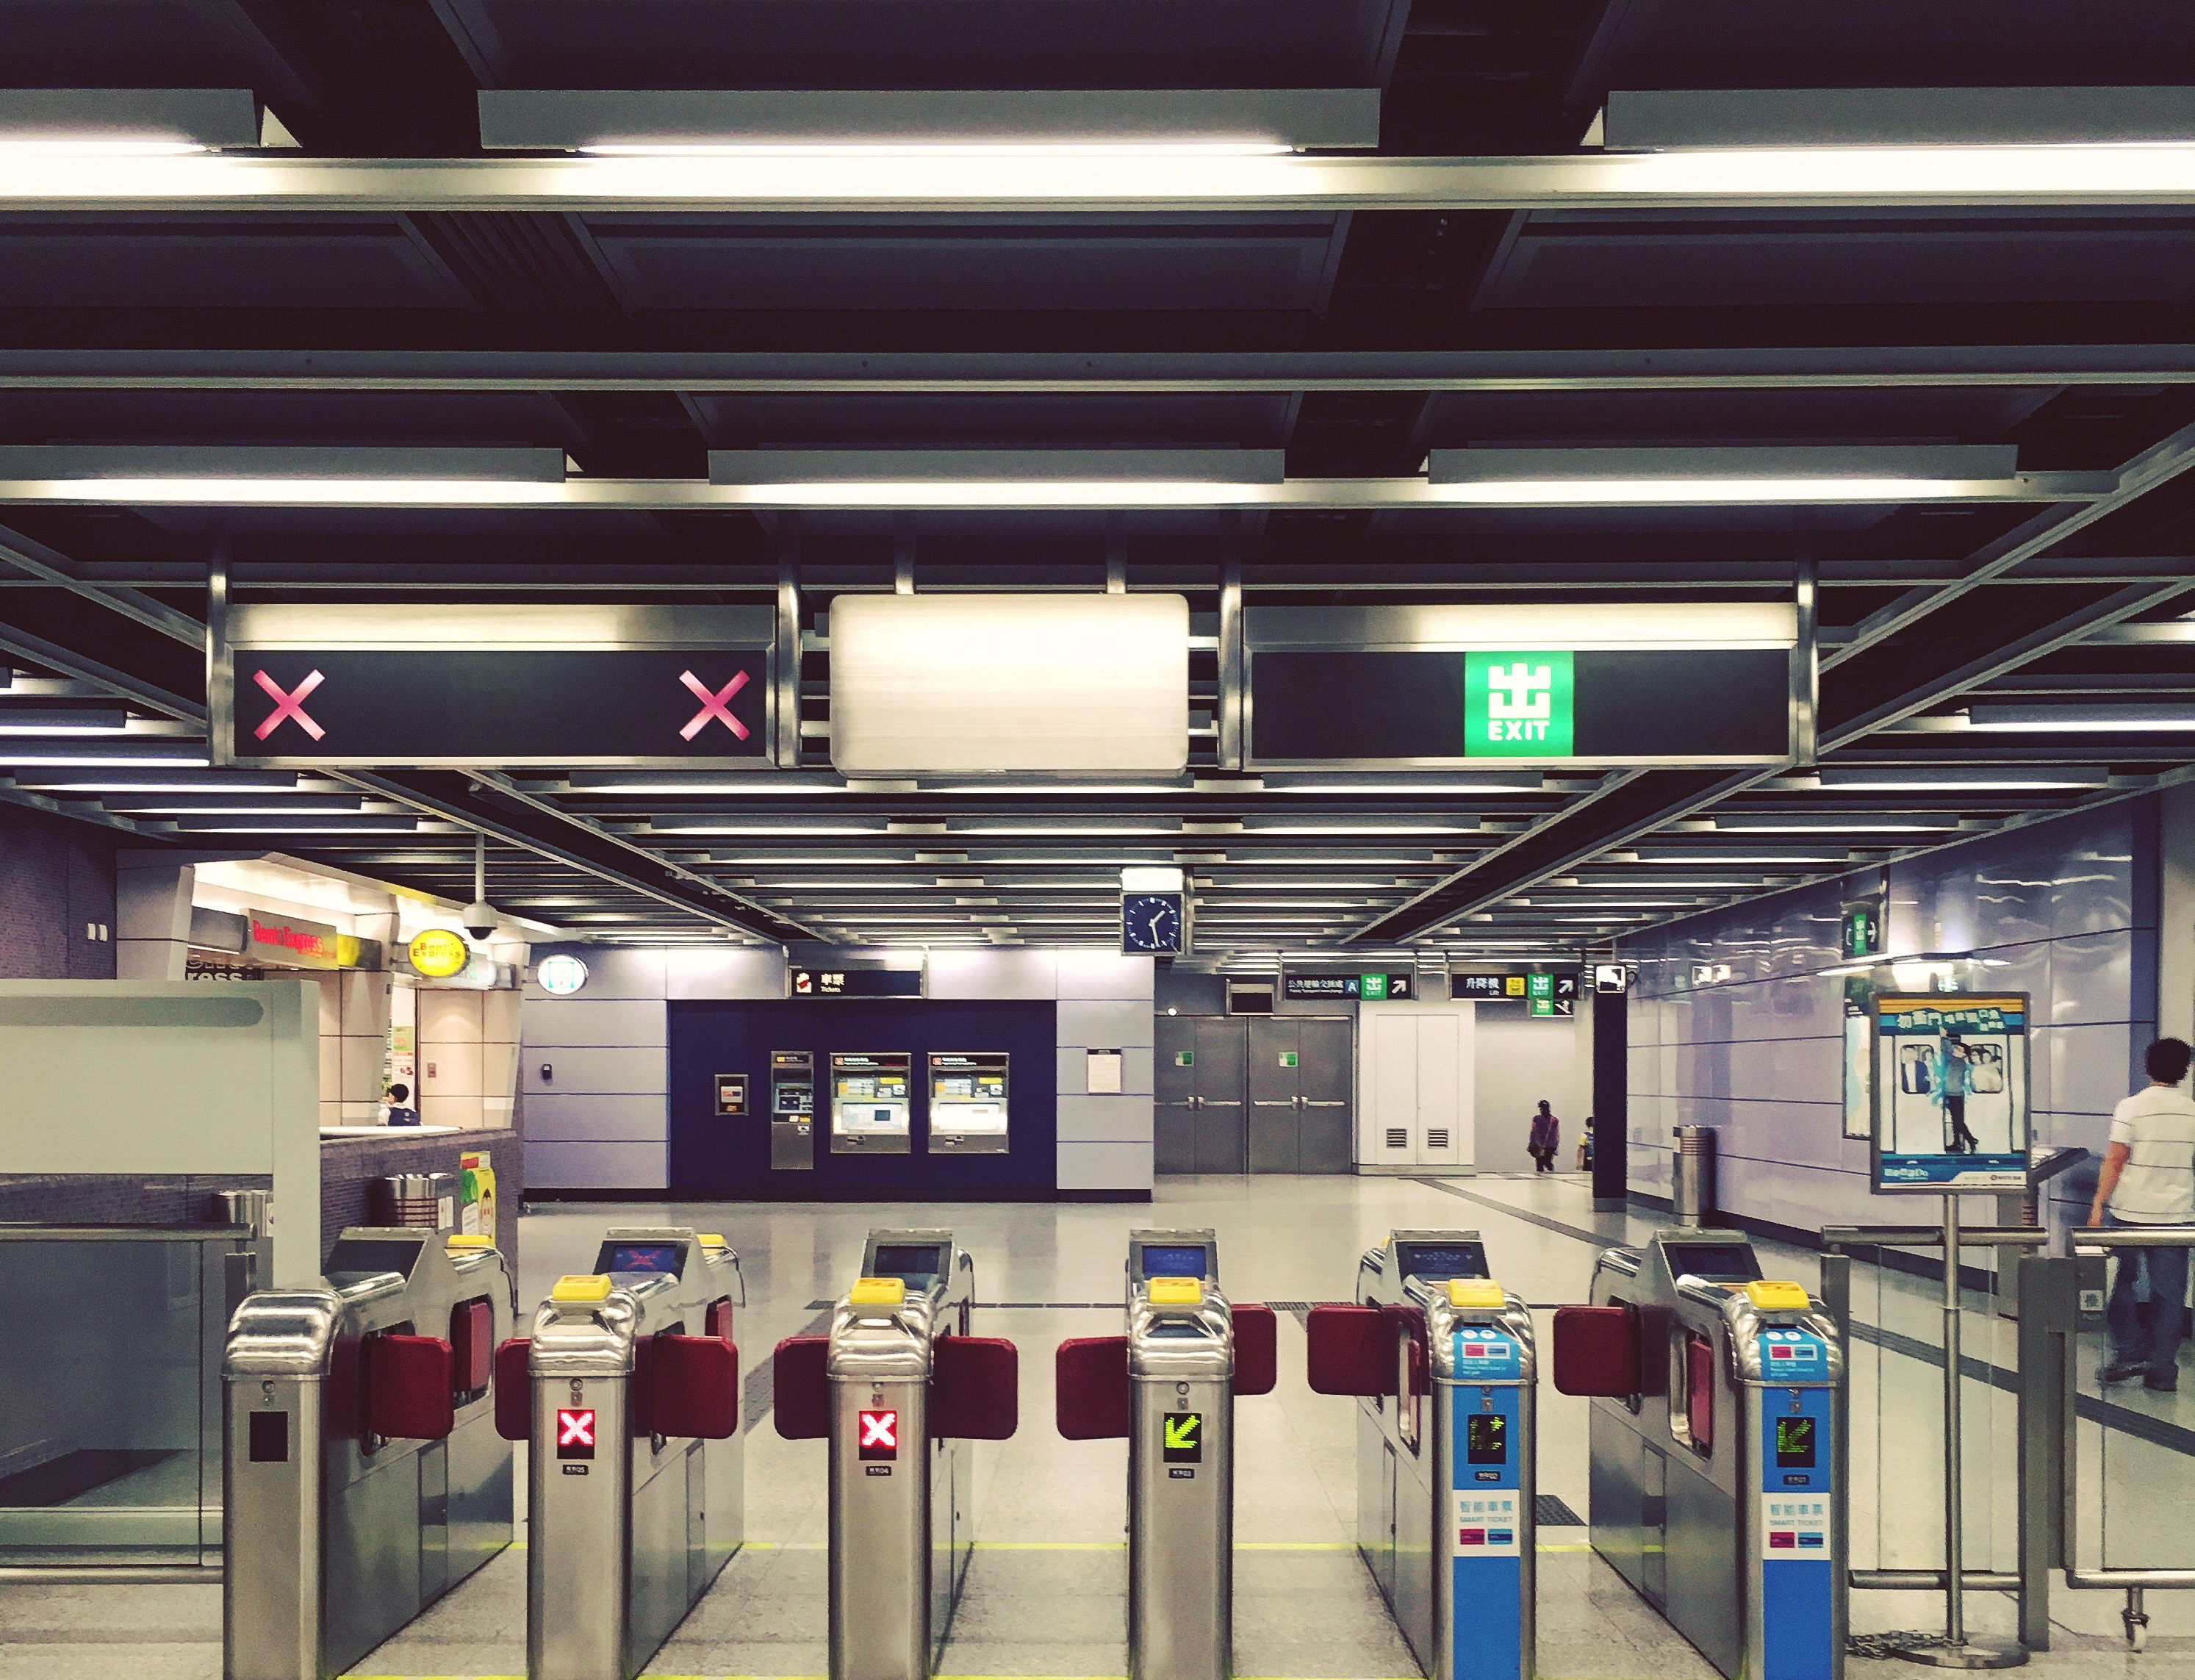
MetaSUB Hong Kong City-Wide Assessment of the Microbiome
in Metro & Other Built Environments
Marcus H. Y. Leung - @leungmarcus
Dr. Patrick Lee Lab
School of Energy and Environment, City University of Hong Kong
MetaSUB Meeting: 1st July, 2016
Shanghai, China

Slide 2
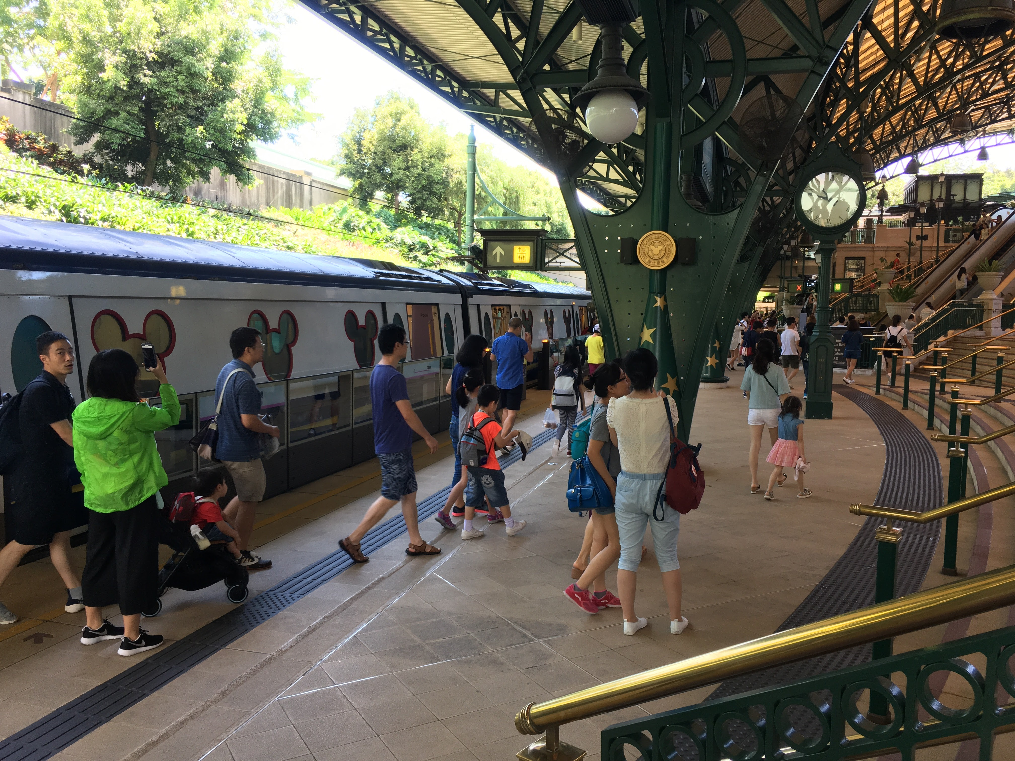
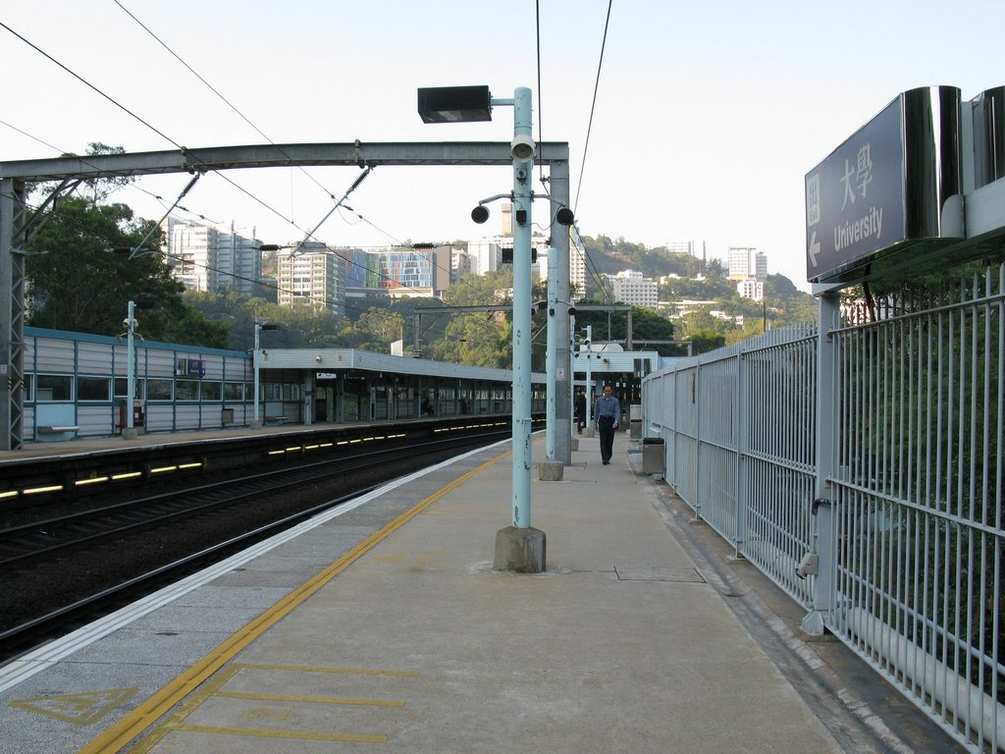
North Point Station
Disneyland Resort Station
University Station
Architectural design
> indoor/outdoor
> screen doors or gates or open
> above/underground
Mass Transit Railway (MTR) - Hong Kong metro
> 10 lines, 87 stations, 200+ km tracks across city
> ridership: 4.6 million / day, amongst the busiest in the world
> popular mode of transport in Hong Kong

Slide 3
Subway Sampling
Outdoor
27.2°C-35.2°C
51-84% RH
Indoor
25.1°C-30.9°C
50-75% RH
© MTR

Slide 4
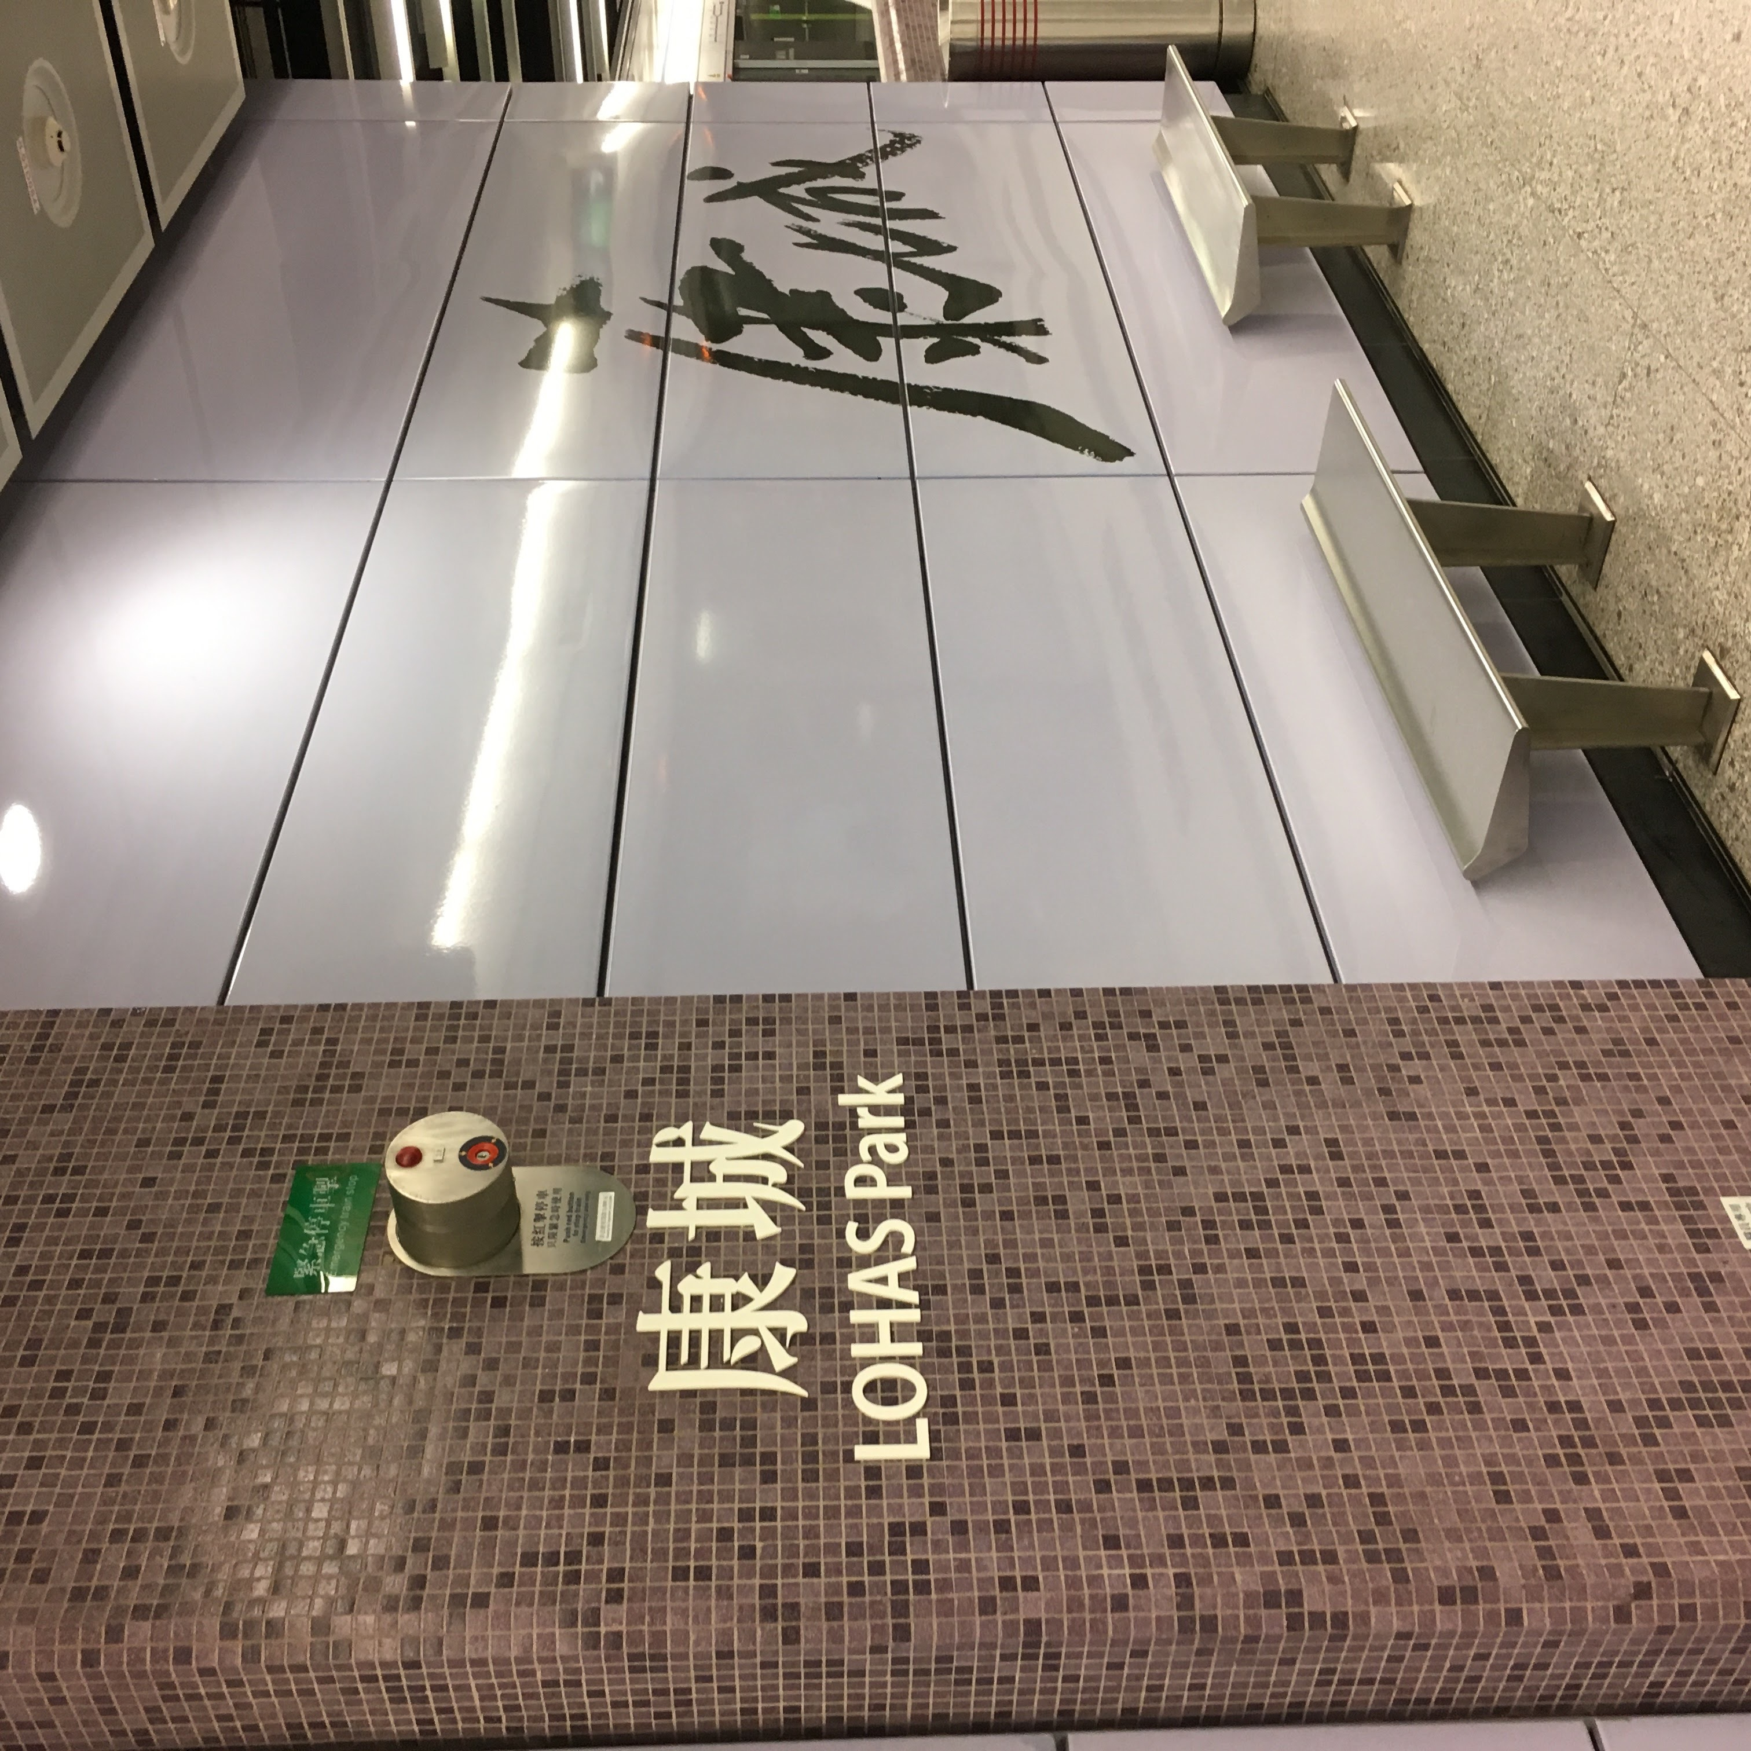
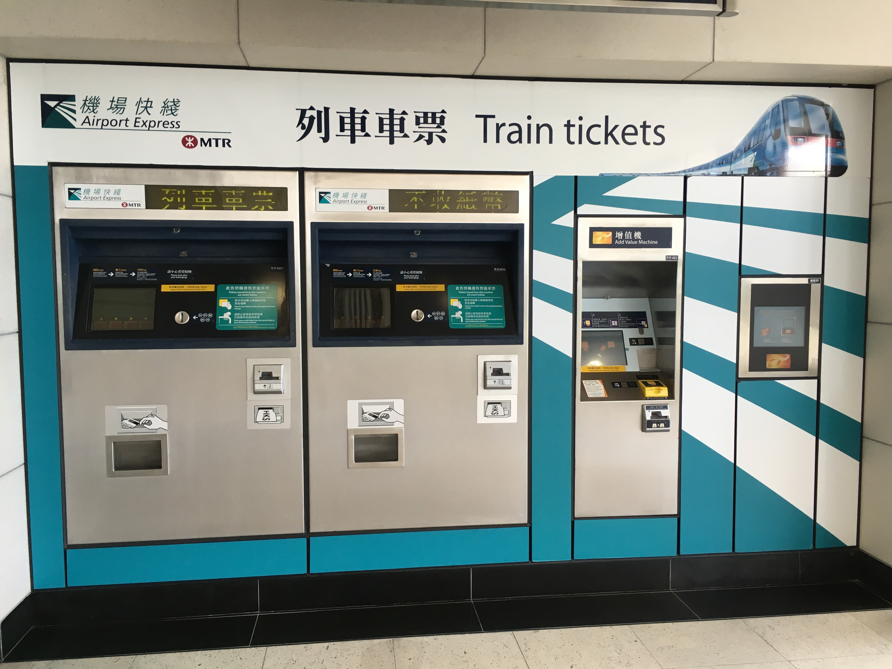
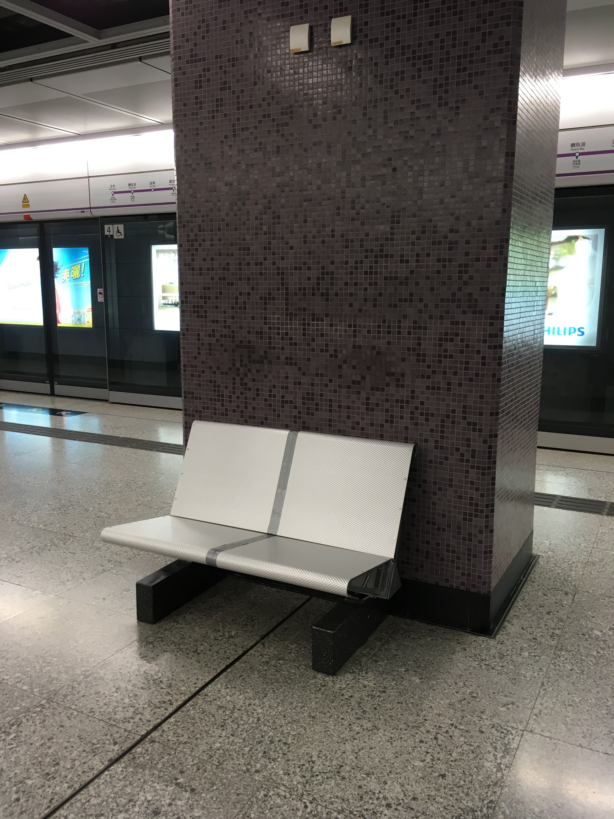
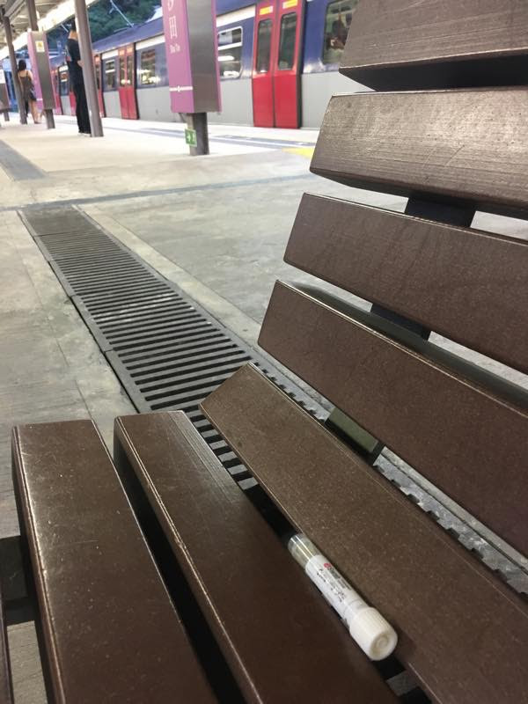
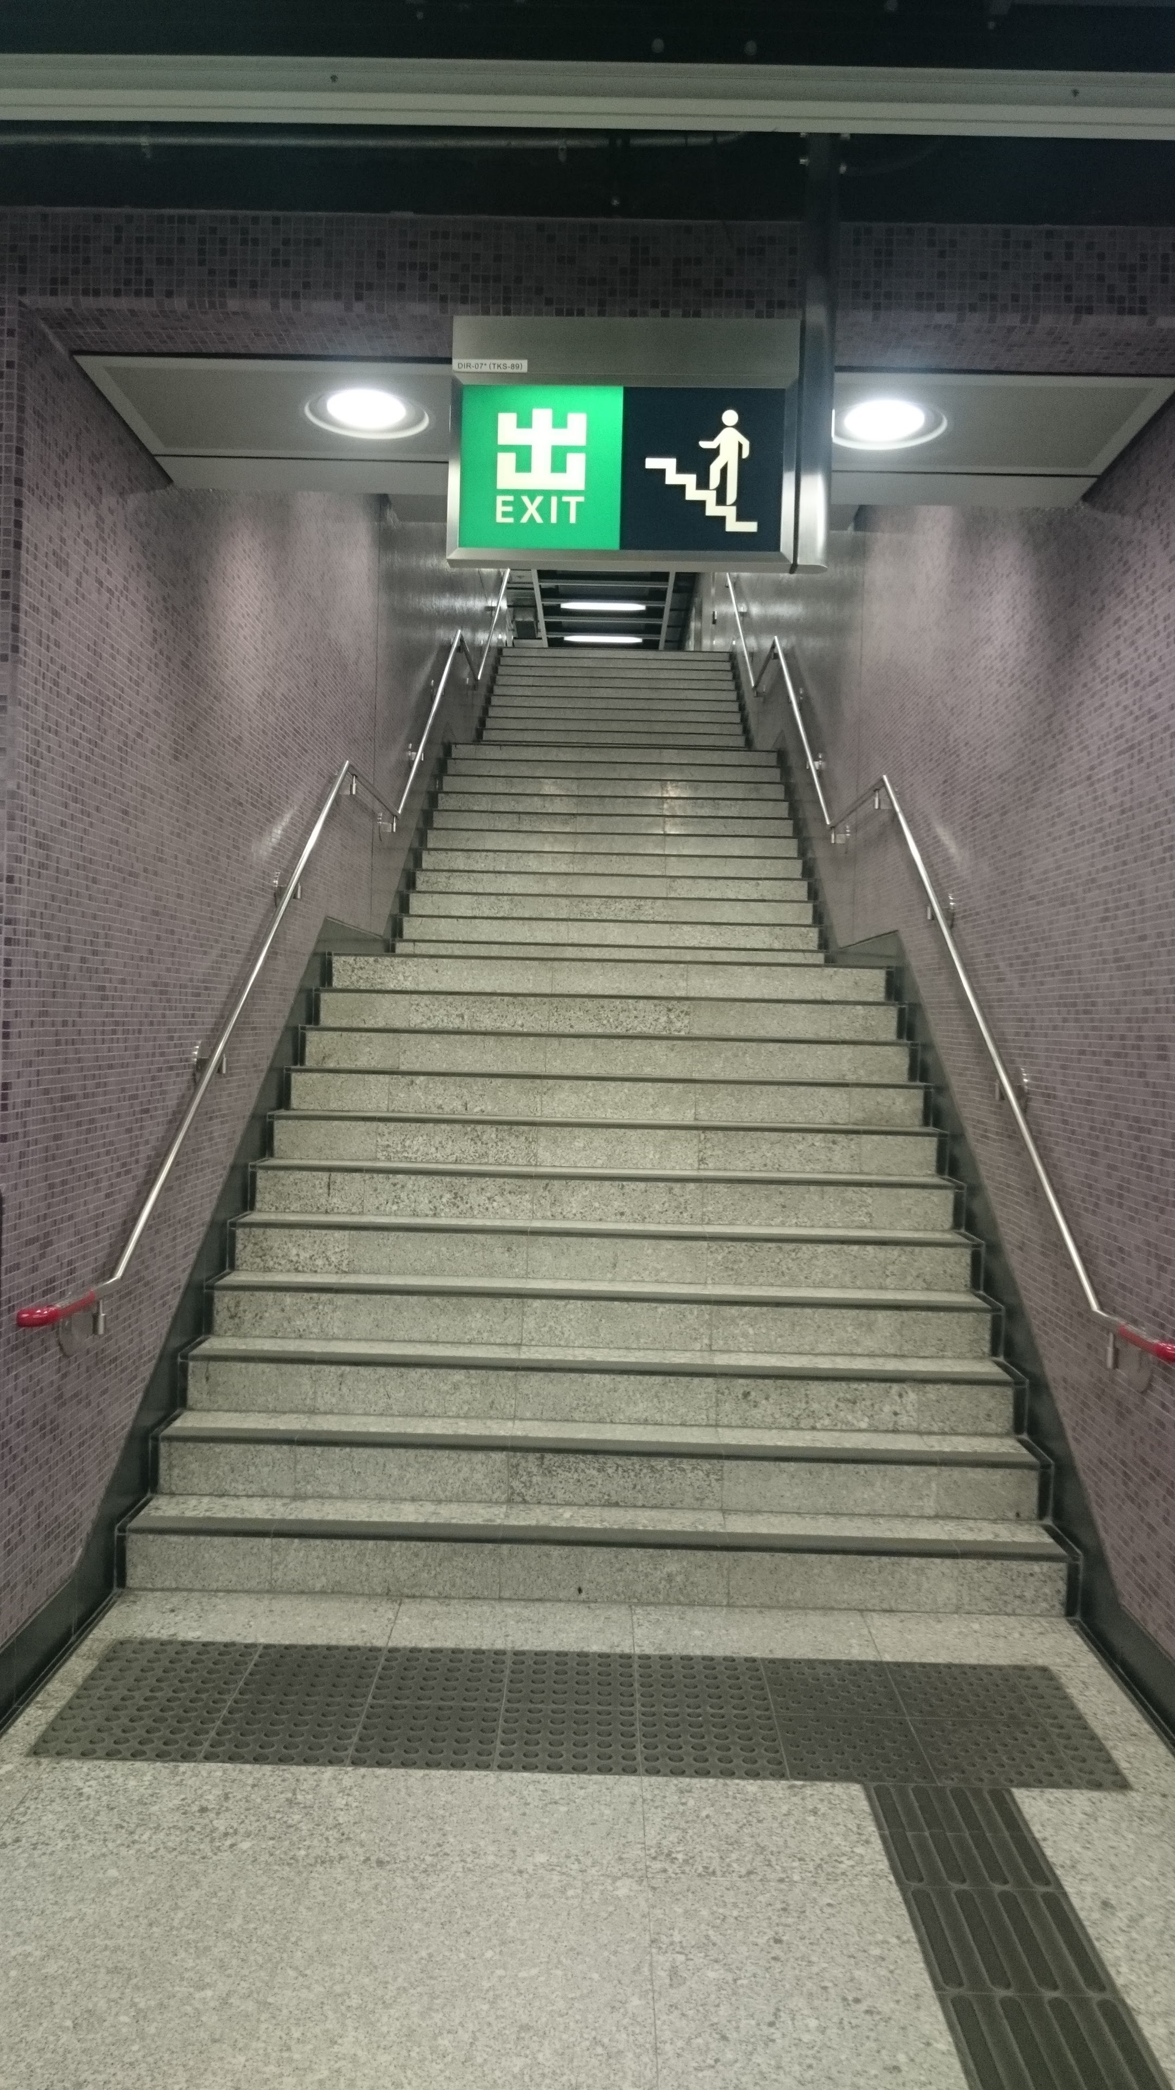
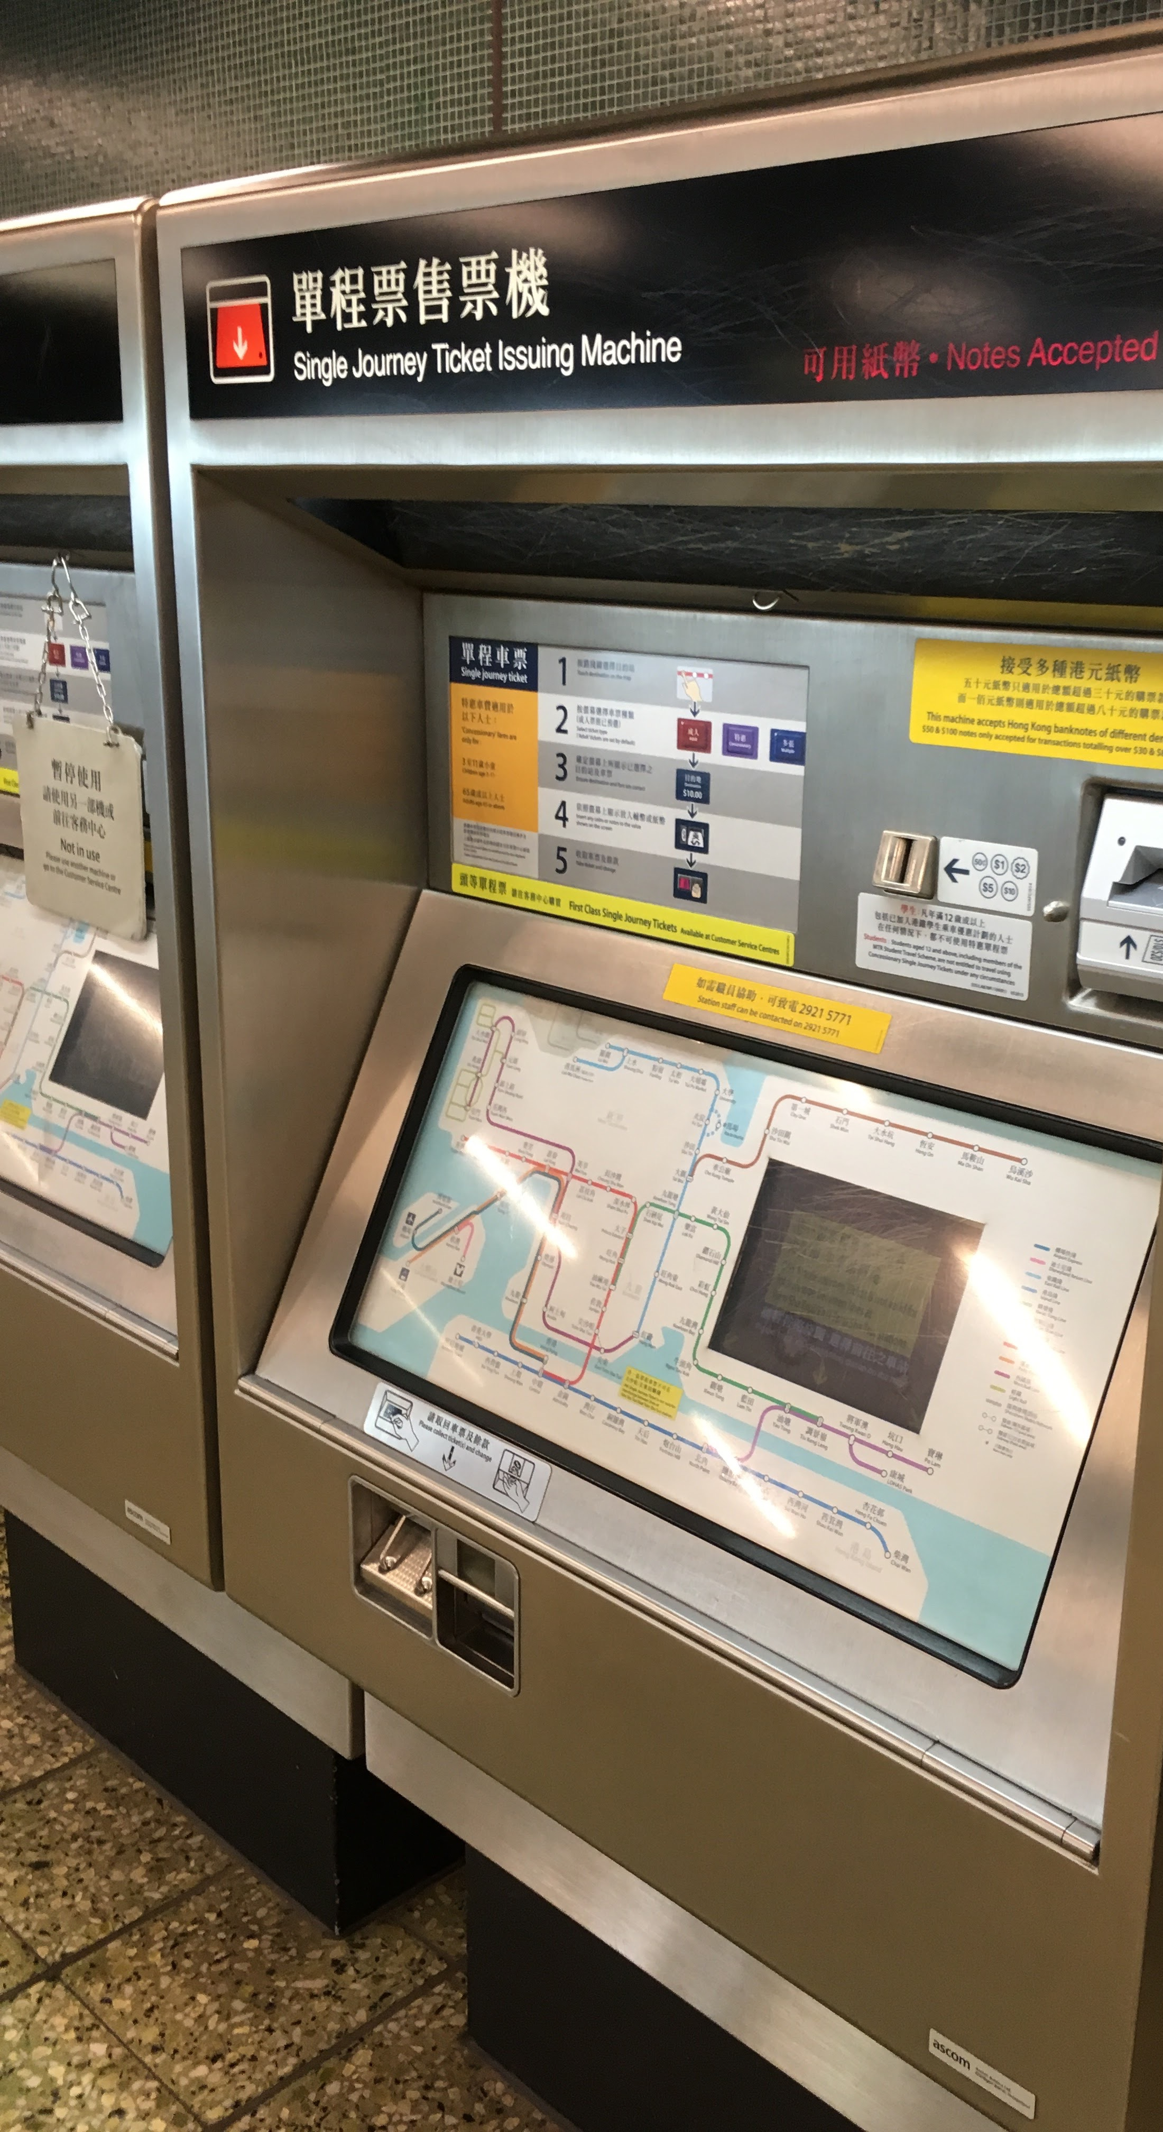
City Sampling - Metro
Ticket Kiosks
Railings
Platform Seats

Slide 5
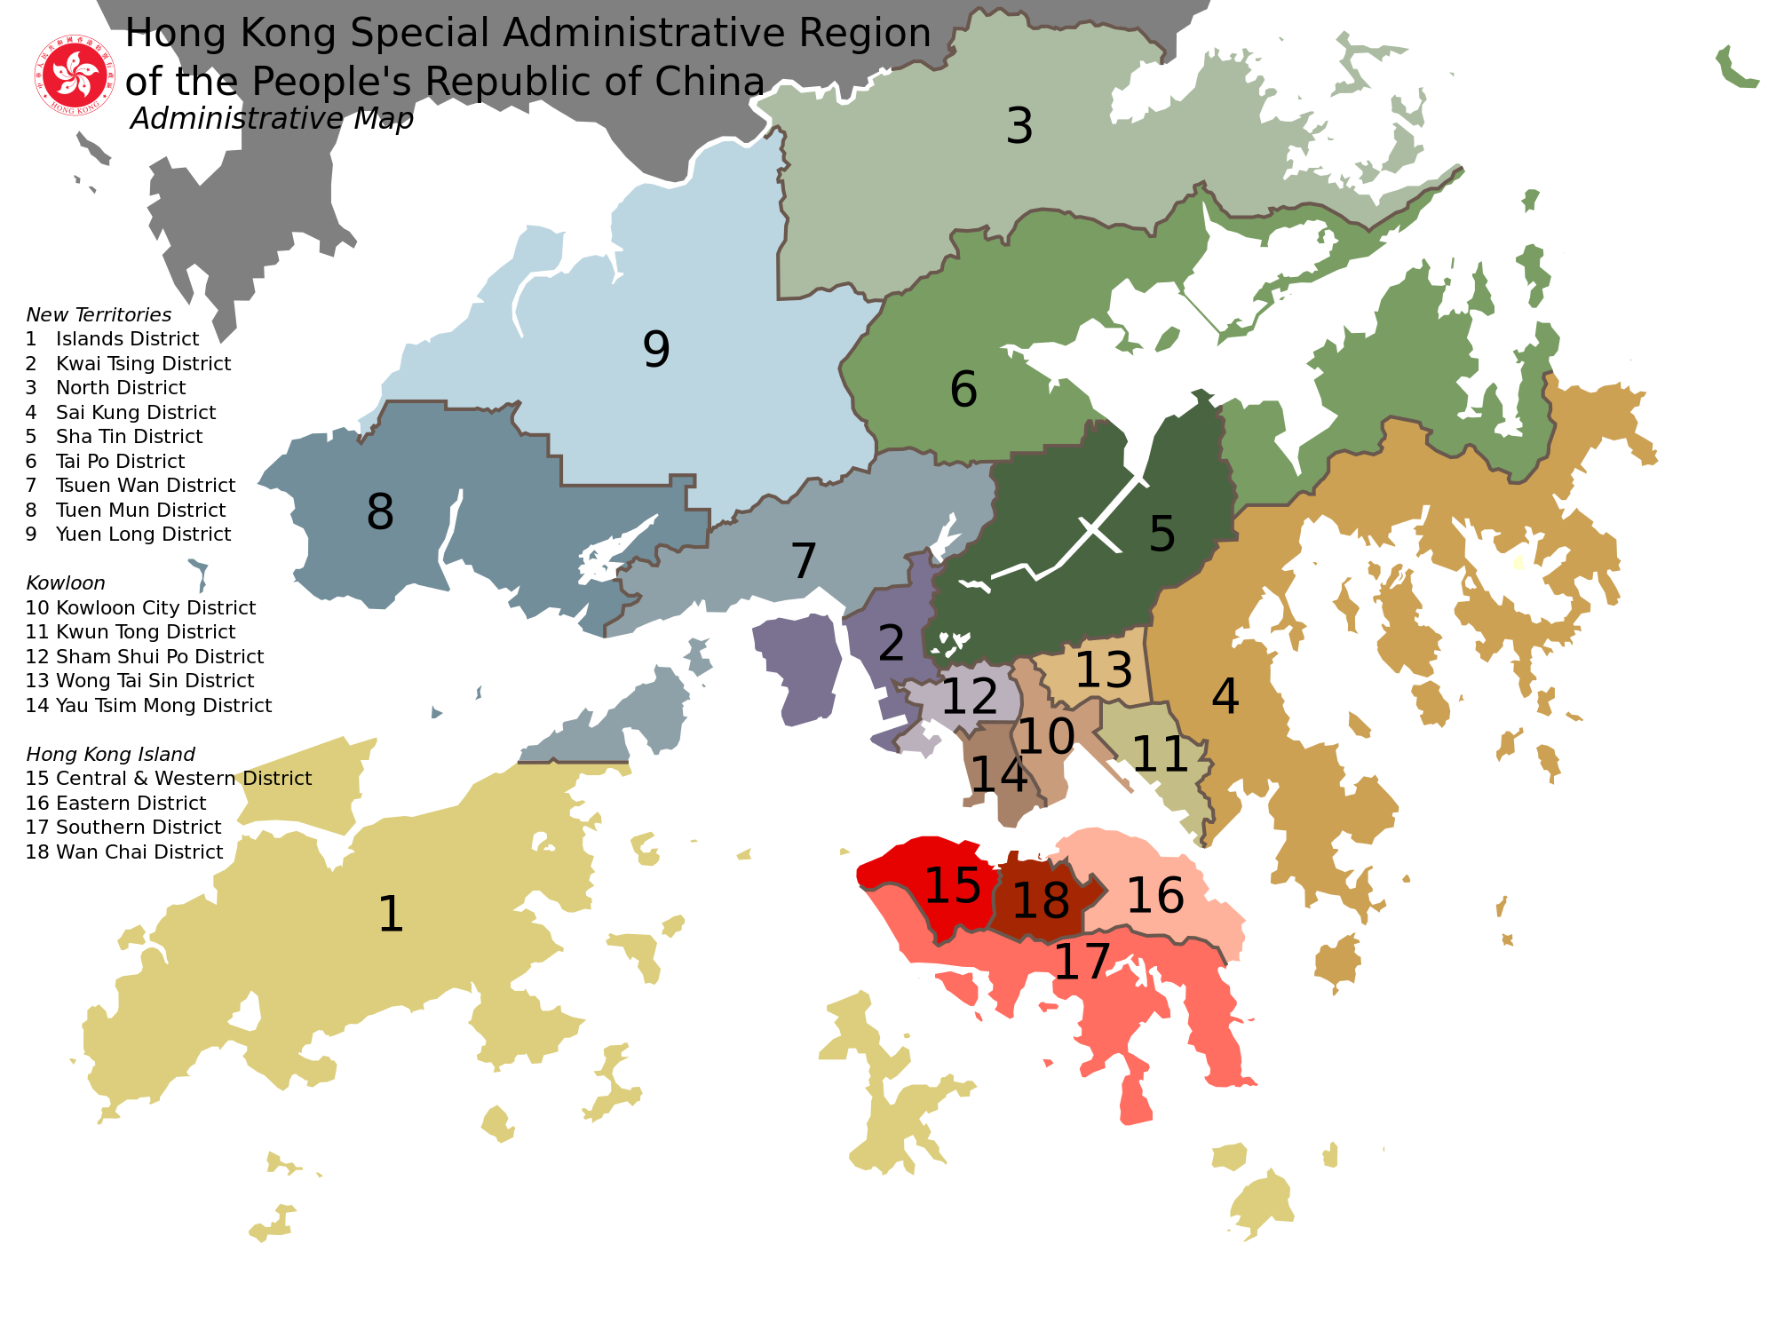

Slide 6
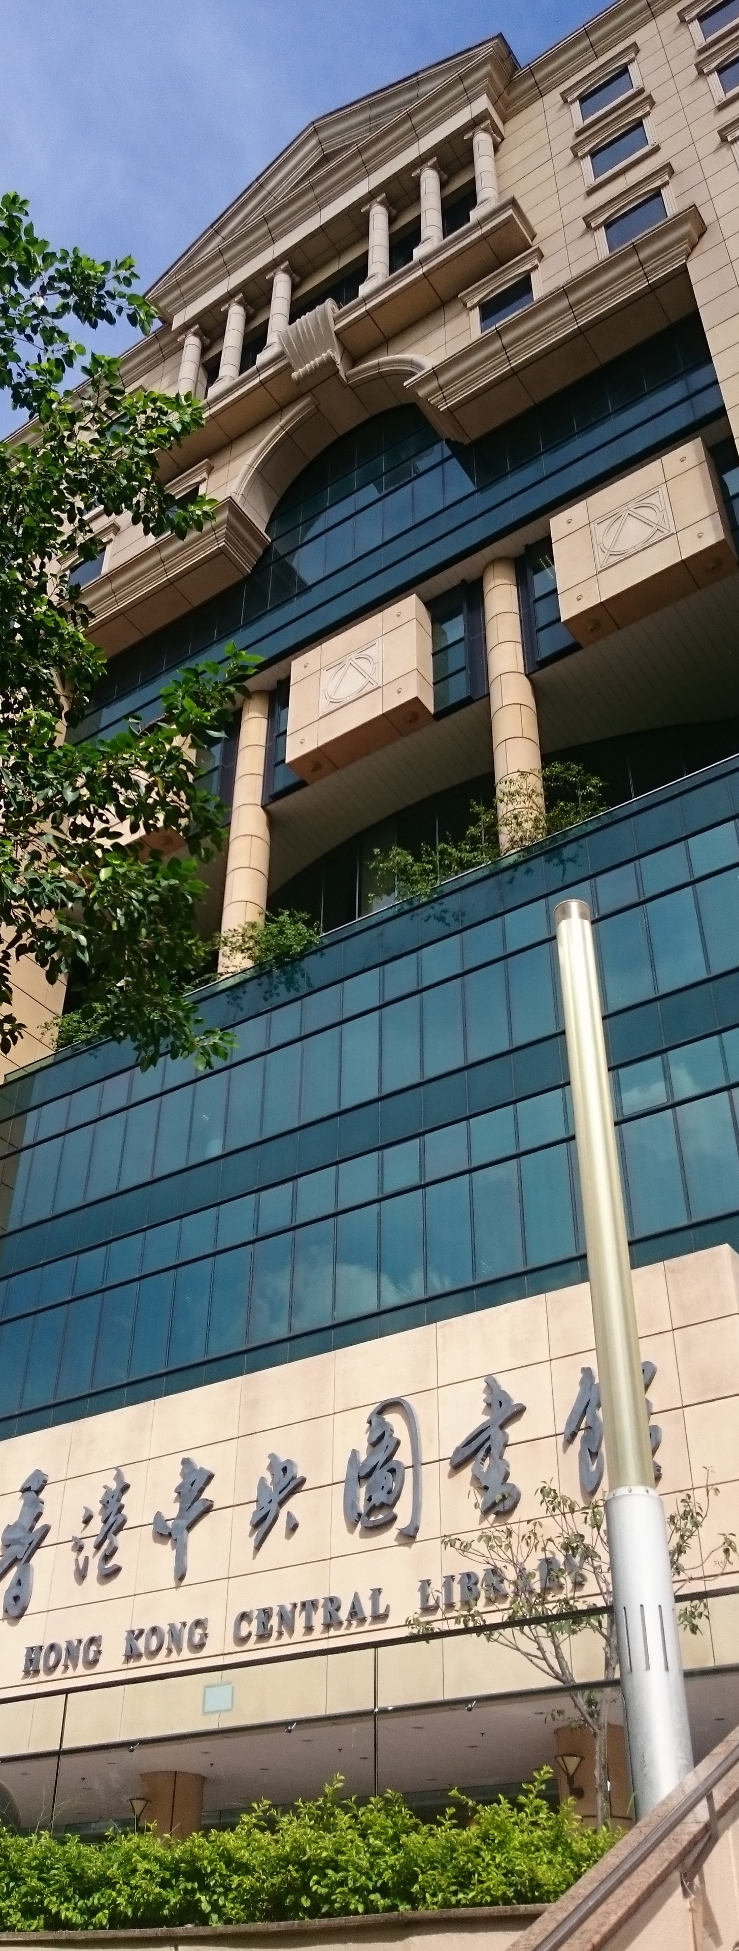
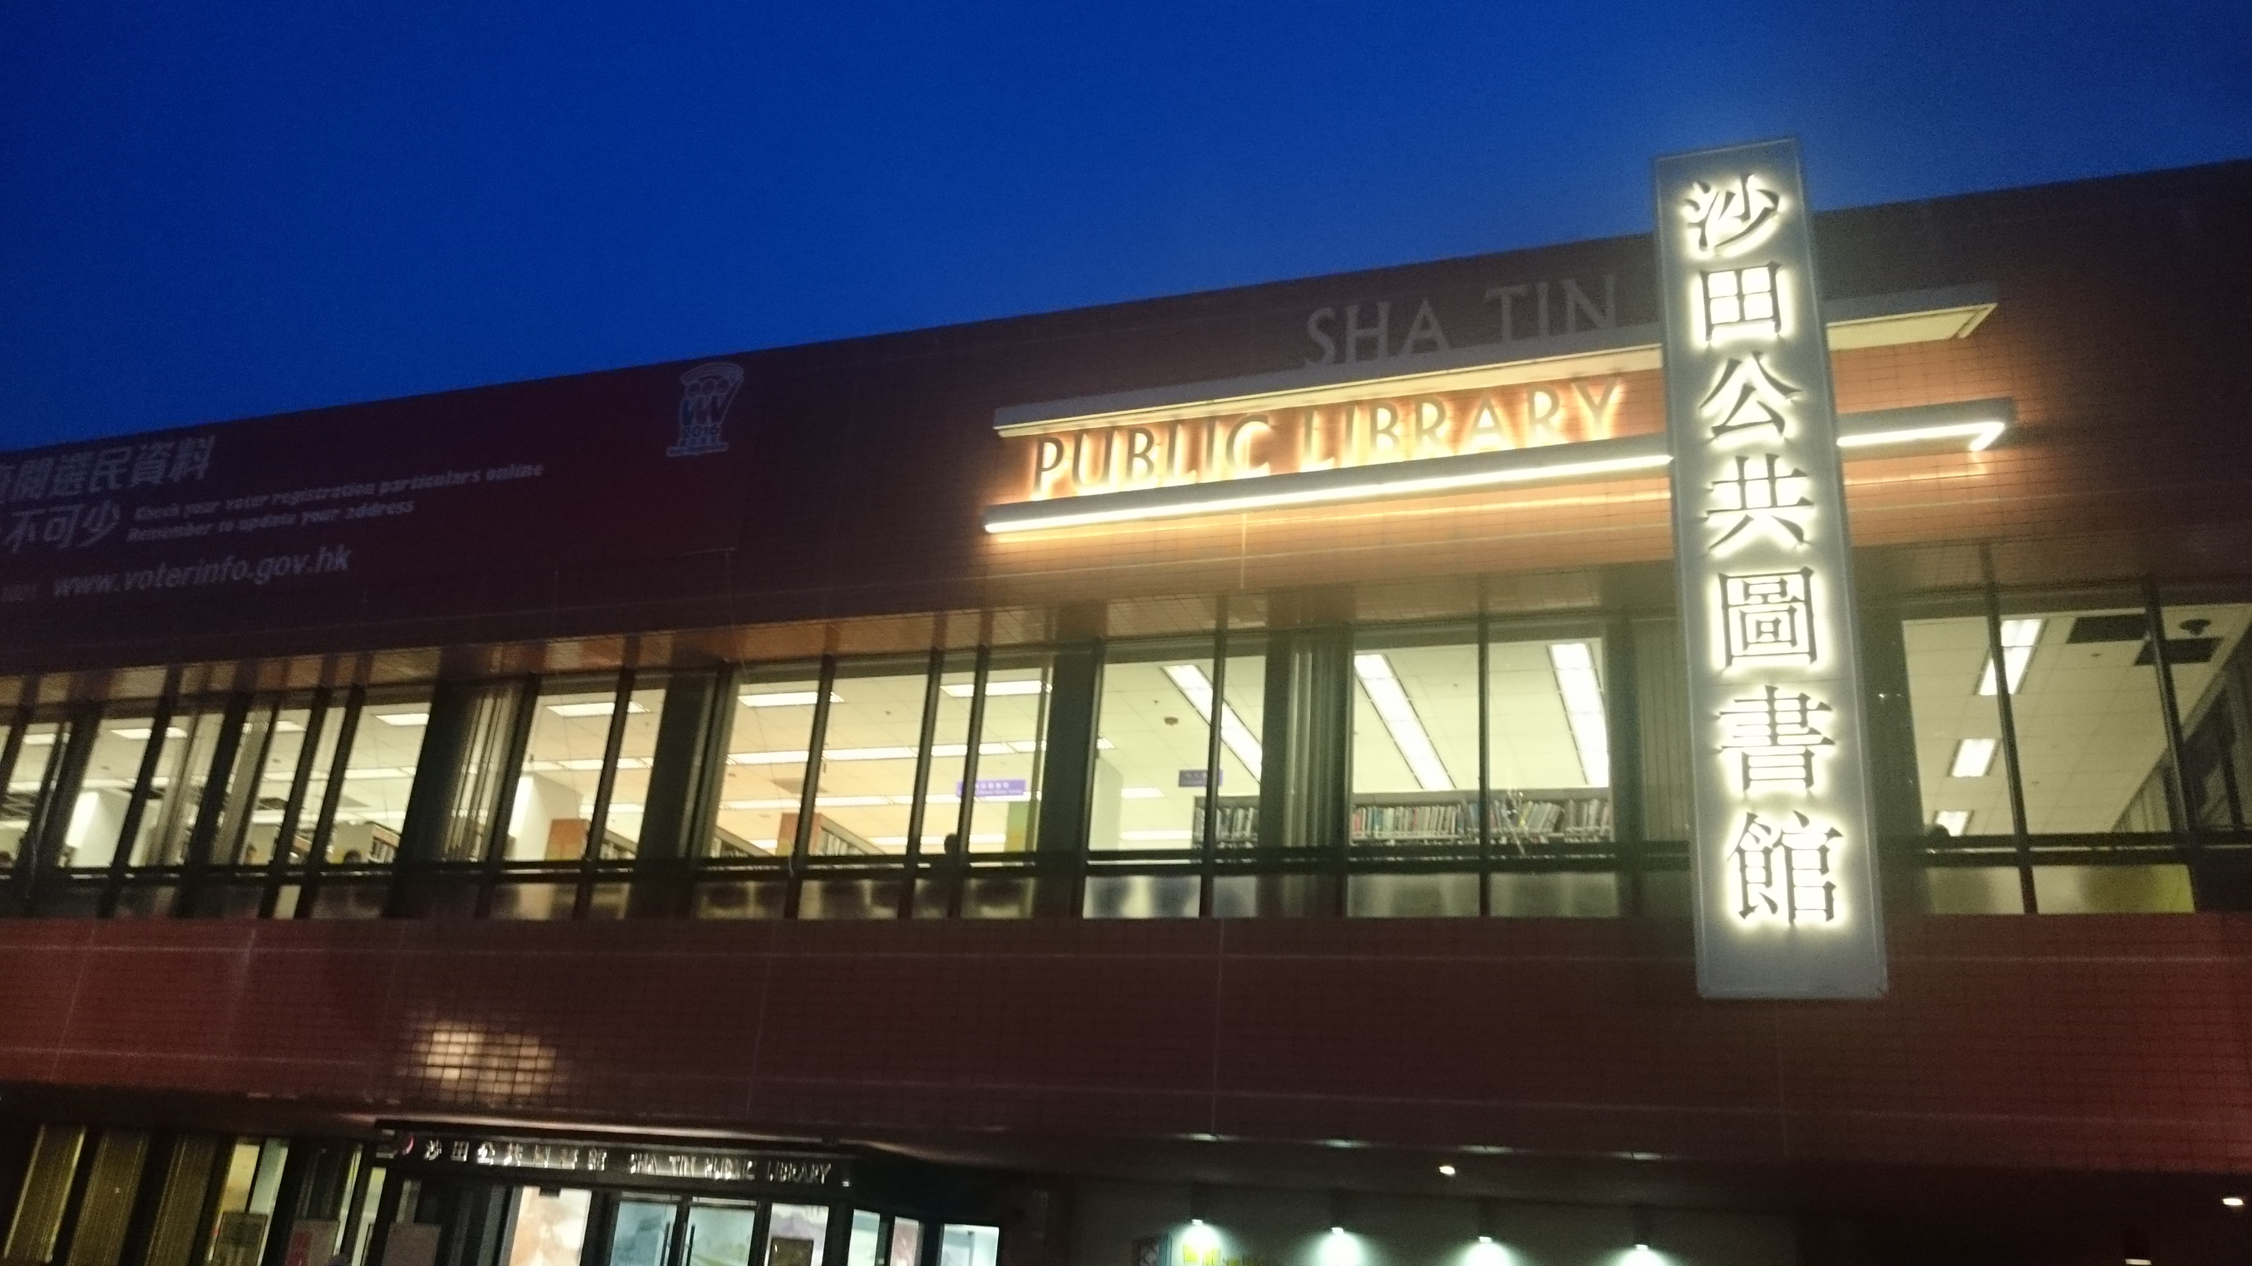
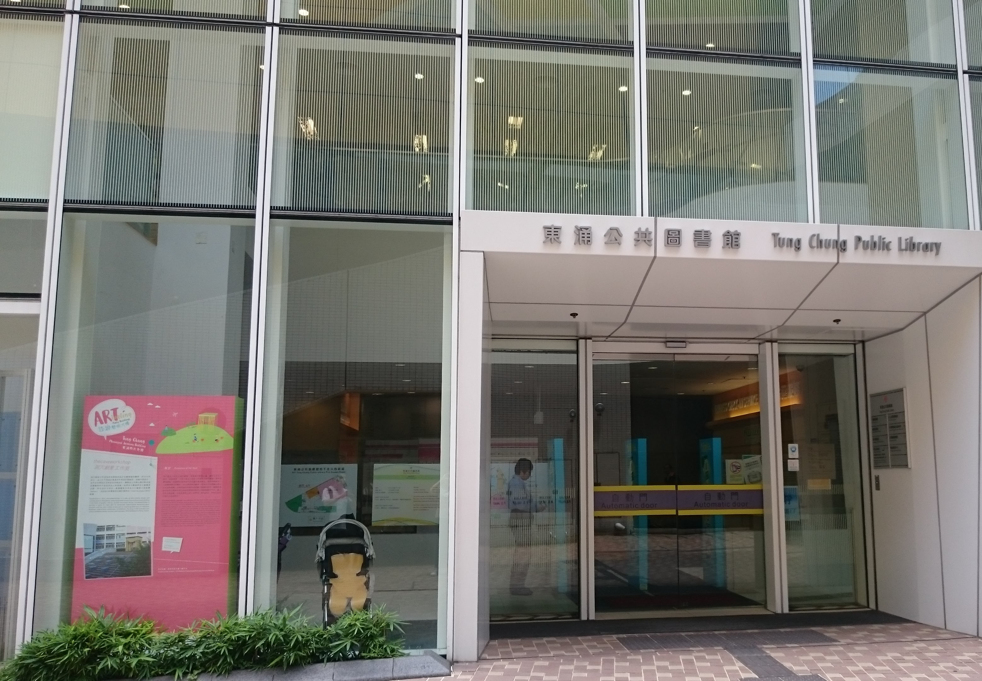
> bookshelf
> computer desk
> computer chair
> lounge sofa
> indoor environment with different activity
Library sampling
four surfaces/site

Slide 8
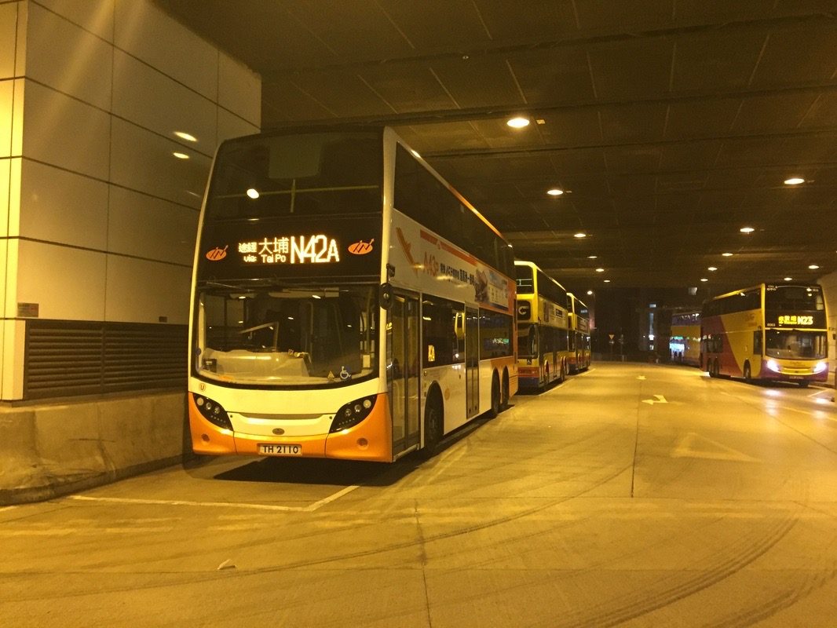
> air vent
> bus stop sign
> wall
Bus terminus sampling
three surfaces/site

Slide 9
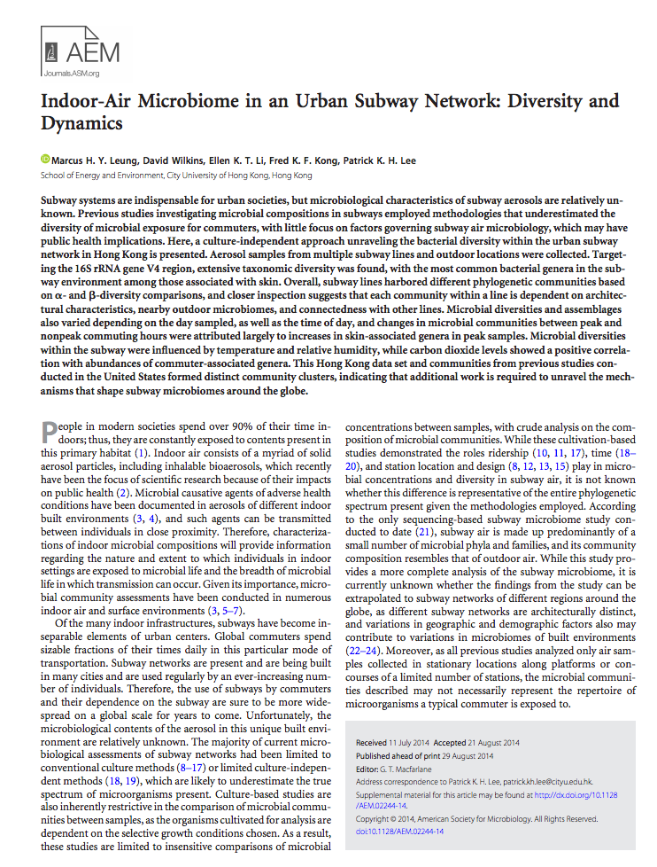
Preliminary Considerations
Leung et al. (2014) Appl. Environ. Microbiol. 80: 6760-6770
> total: 242 samples
> compare data with previous air metro work
> changes in microbiome as result of:
> surface type
> usage patterns and commuter traffic
> architectural designs
- indoor/outdoor
- screen doors
- interchange stations
> shotgun air metagenomic data!!
> relate subway data with local indoor/occupant microbiome information
> comparison with other subway systems
> potential global subway “pan-microbiome?”
Leung et al. (2015) Sci. Rep. 5: 11845
Wilkins et al. (2016) Environ. Microbiol. 18: 1754-1763
Leung and Lee (2016) Microbiome 4: 21

Slide 10
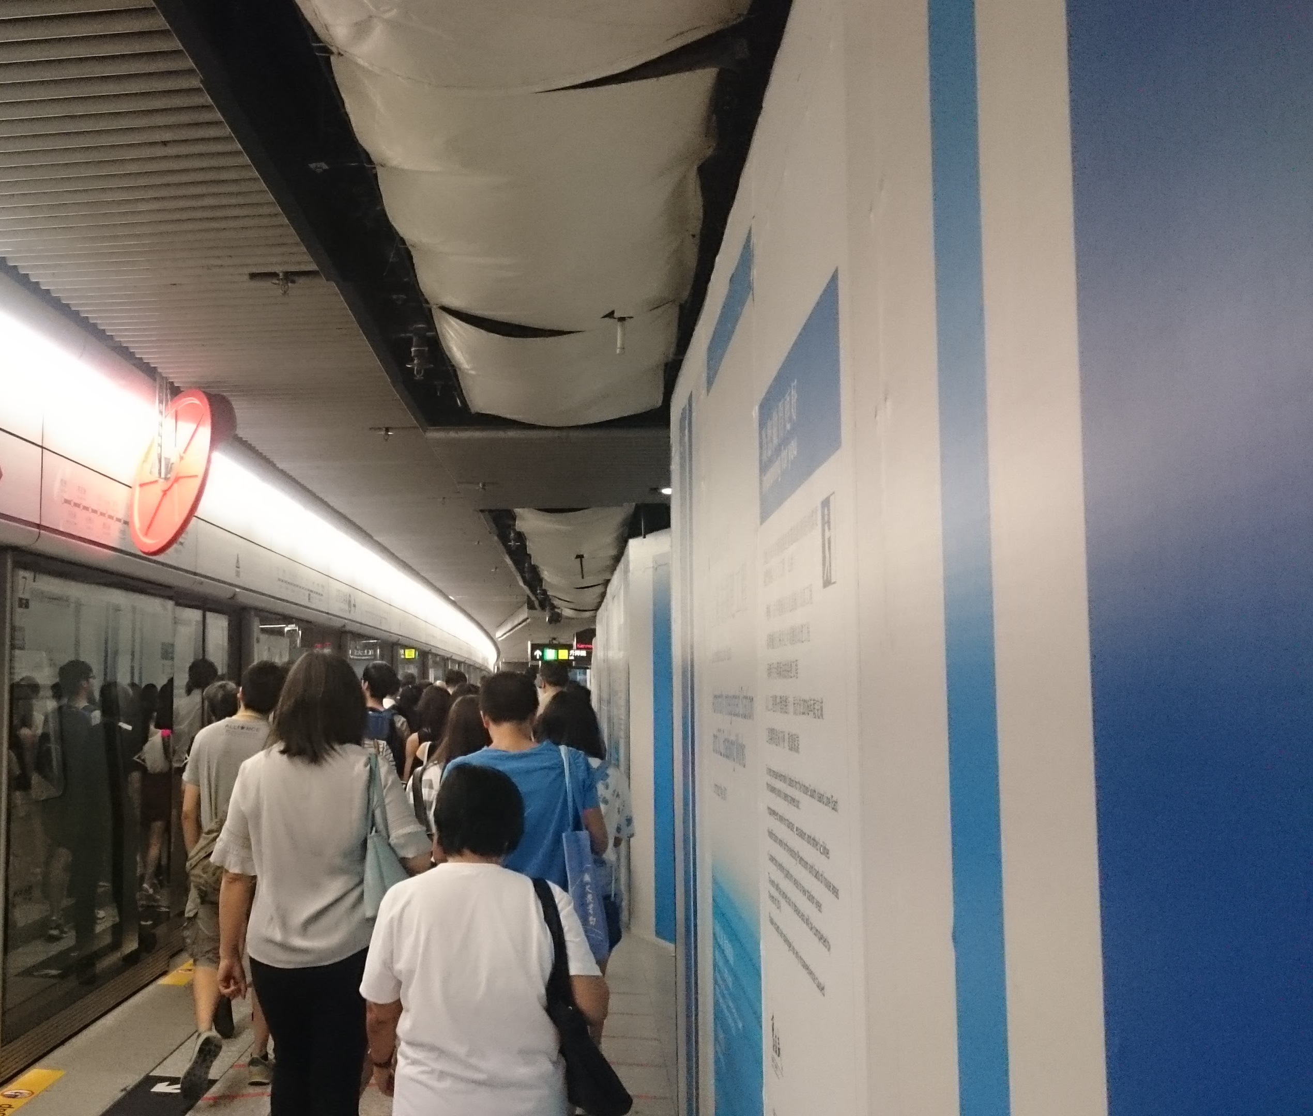
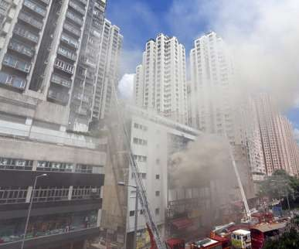
Case Studies
Admiralty Station
Kennedy Town Station (SCMP.com)
Fire near Kowloon Bay Station (SCMP.com)
> Admiralty Station: site of expansion project, two new subway lines
> completion: ~2022
> Kennedy Town Station: new station, in operation December 2014
> Kowloon Bay Station: adjacent to site of massive building fire
> 21-24 Jun

Slide 11
Acknowledgements
MetaSUB Hong Kong
> Dr. Patrick K. H. Lee
> Miss Xinzhao Tong
> Miss Hedwig Cheung

