Slide 1
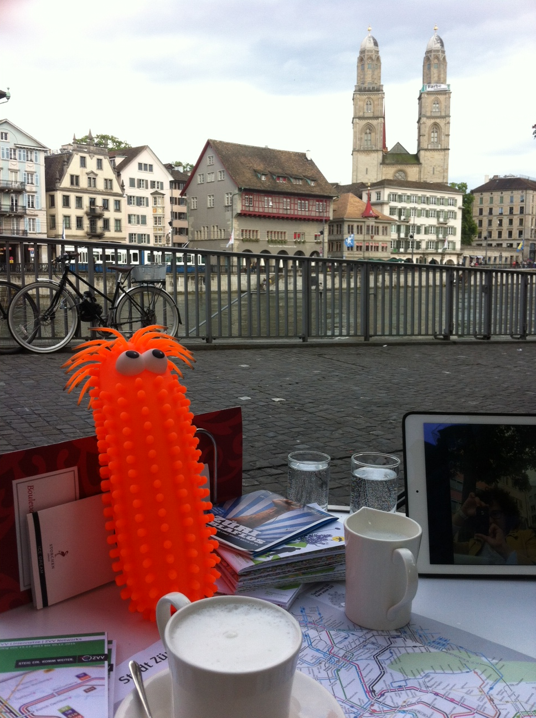
The Zurich Chronicles
July 1, 2016
Olga Nikolayeva
MetaSub Zurich Team

Slide 3
Zurich Transportation System
Population ~ 400k
Dense network: trams, buses, water taxies
Majority of stops above ground, exposed to the elements
Considerations
Tickets bought online, using phones
Few people touch the door buttons

Slide 4
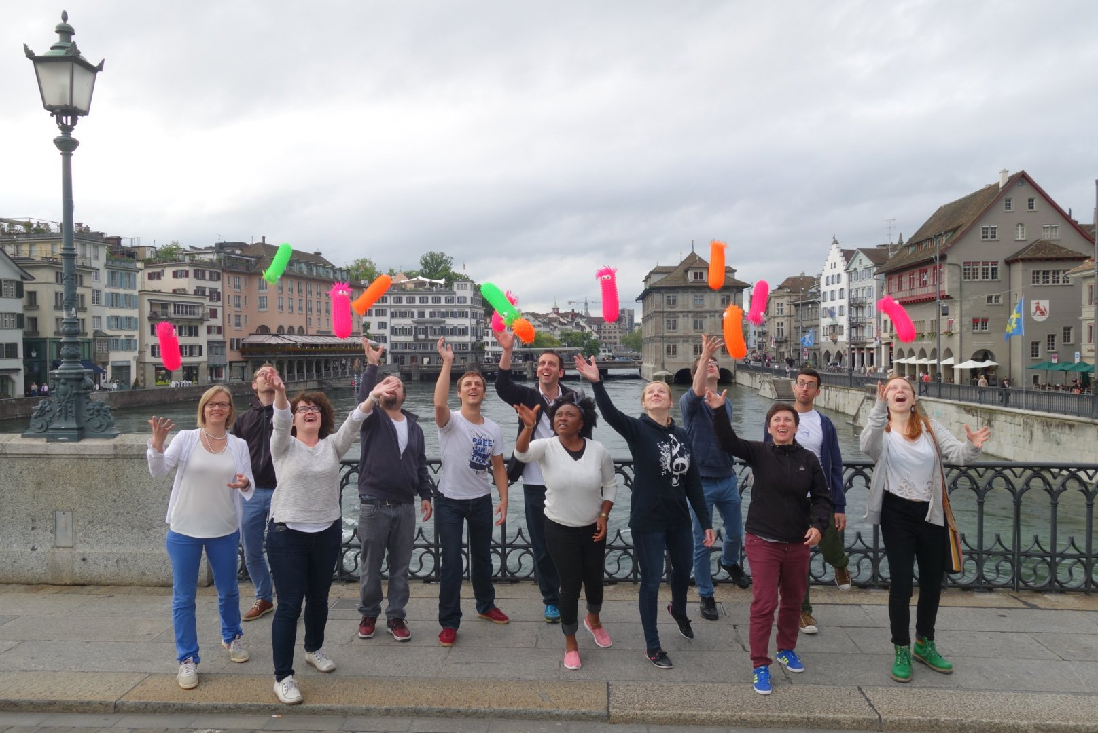

Slide 5
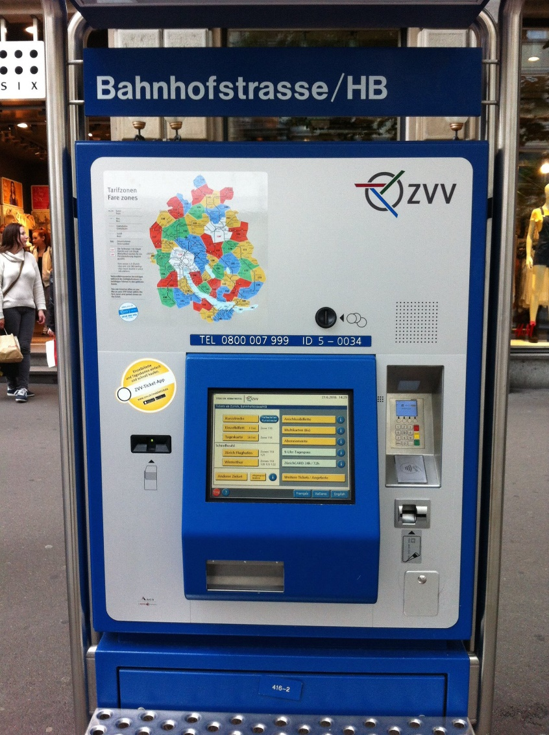
What to swab?
1. Tram Stops
ticket machines and benches
selection criteria: throughput (hubs + less busy),
# of tram lines and # bus lines
~ 30 samples
2. Inside Trams
hand railings and seats
15 tram lines, 2 trams per line
~ 60 samples

Slide 6
Kalkbreite Depot Team

Slide 7
Things we learned
Passengers not scared by gloves
Very friendly reaction and curiosity
Several people shared stories of similar studies/ experiences
Ticket machines are still in use, especially at hub stops
It helps to have a mascot and a midnight bbq

Slide 8
Acknowledgements
Tanya Nikolayeva
ETH Zurich
Gunnar Rätsch
Andre Kahles
Chris, Sofia and Ebrahim
FGCZ
Ralph Schlapbach
Catharine Aquino
Maria Domenica Moccia
VBZ (Zurich Transportation Authority)
Andreas Uhl
Markus Ullmann
Special thanks to our volunteers!
Tina, Dagmara, Andrea, Michael, Roy, Nora, Eric, Christian, Elsy, Kasia, Kevin, Roland, Christian, Sandra & Oli

