Slide 1
Metagenomics of Subways in Tehran Metro
Shaadi Mehr, PhD
Assistant Professor
American Museum of Natural History
SUNY College at Old Westbury, Biological Sciences
Kambiz Banihashemi, MD
Academic Member, IIER and ATU, Departement of Medical Sciences
June 2016

Slide 2
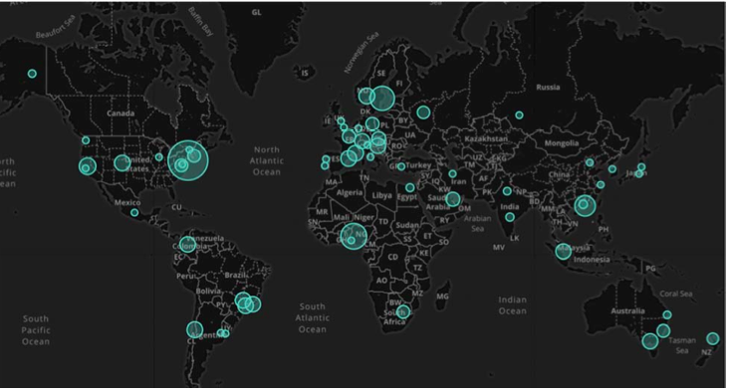

Slide 3
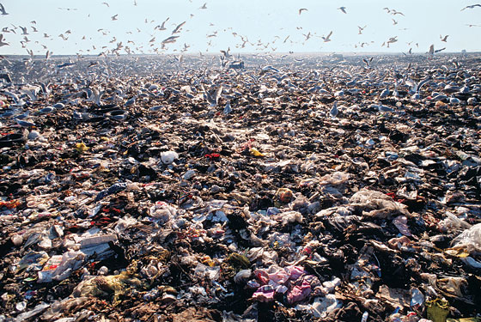
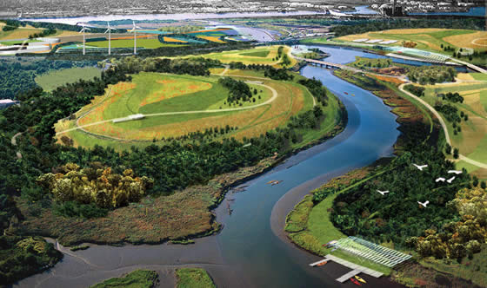
Freshkills landfill in the 1990’s (left) and planned site transformation (right). Photo credits: Freshkills Park.
Urban:
East Freshkills Park
North- Mariners Marsh
Wild:
High Rock Park
Clay Pit Park
Long Pond Park
Central Freshkills Park
A
Notes:
***Until recently, Freshkills Park on Staten Island was the largest landfill in the world. **** It is now undergoing the process of being transformed into a park. *** **This map of Staten Island showing the Urban and Wild sites which will be sampled for bacterial metagenomics.
*** I will provide the bioinformatics support for metagenomics workflow of the samples collected from 2 Urban and 2 wild sites as the first phase of the project.

Slide 4
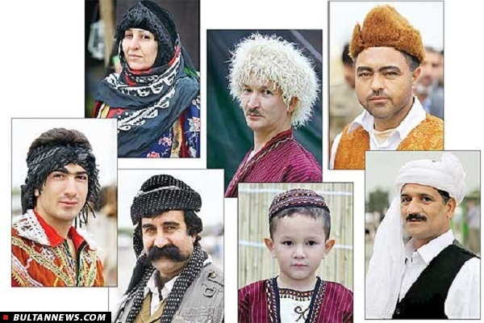
Iran Population diversity
Iran has a diverse combination of ethnicities all over the country namely; Kurds, Lors, Turks, Fars , Baloch.

Slide 5
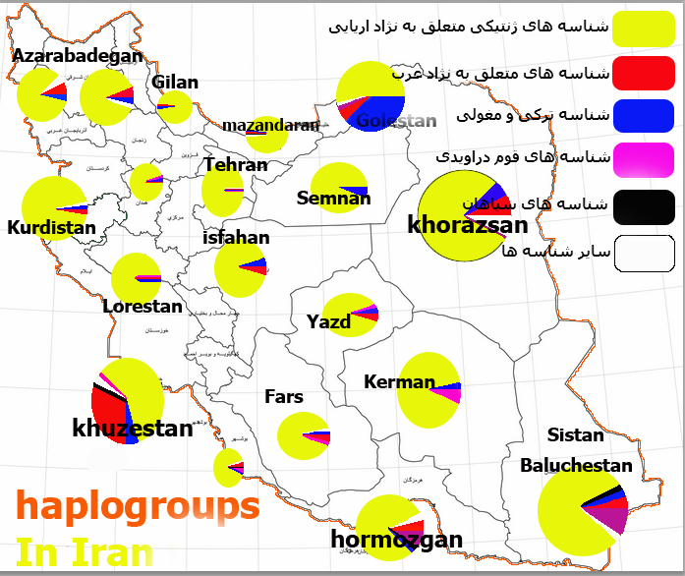
Haplogroups in Iran
Arians
Arab
Turks
Darivadi
Sepahan
Others

Slide 6
Linguistic composition of Iran
Notes:
According to a a 2004 study about 28 dialect are being spoken in Iran. About %60 speaks Farsi and the rest speak Arabic, Turkish , Kurdish and otthers.

Slide 7
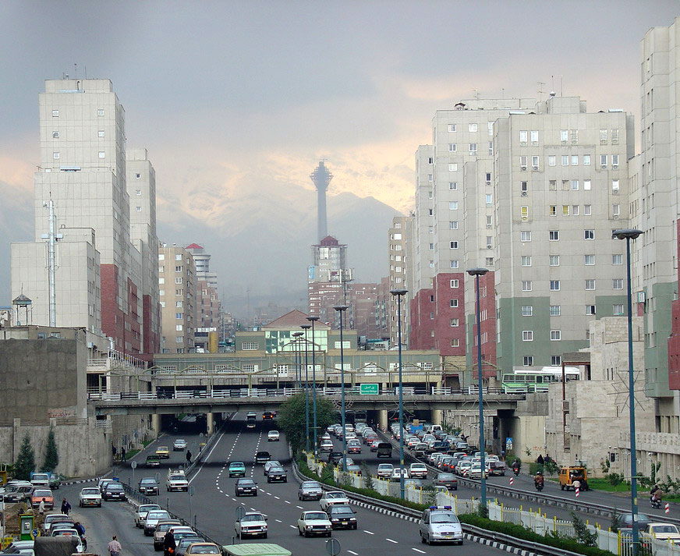
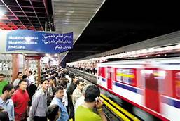
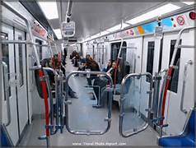

Slide 8
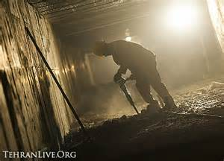
History and facts about Subway in Tehran
The Tehran Metro consists of four operational metro lines (and a fifth commuter rail line) begun in 2007.
The Tehran Metro carries more than 3 million passengers a day.
In 2014, 815 million trips were made on Tehran Metro.
As of 2015, the total system was 178 kilometers long. It is planned to have a length of 430 kilometers with 9 lines once all construction is complete by 2028.
Hour of operation: 05:30 am to 11:00 pm.
Notes:
Tehran has 4 operational metro lines and one commuter rail line. It carries more than 3 million passenger per day. In 2014, 815 million trips were made using Tehran subway

Slide 9
Specifications of Tehran Subway
Line | Opening | Length | Stations | Type
1 | 2001 | 47.5 km (29.5 mi) | 30 | Metro
2 | 2000 | 26 km (16 mi) | 22 | Metro
3 | 2012 | 37 km (23 mi) | 16 | Metro
4 | 2007 | 24.5 km (15.2 mi) | 22 | Metro
Metro Subtotal: |  | 135 km (84 mi) | 90
5 | 1999 | 43 km (27 mi) | 11 | Commuter rail
GRAND TOTAL: |  | 178 km (111 mi) | 101

Slide 11
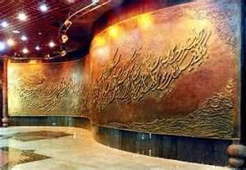
Previous studies
Previous study by Hosseini et al (2010) has shown some relationship between population density and bacterial and fungal concentration in the central location namely Imam khomeini station plat.

Slide 12
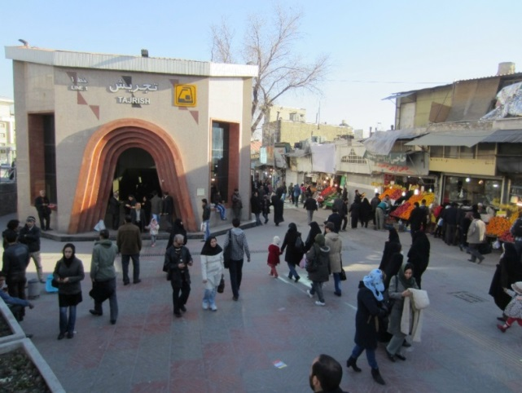
Contributing Factors Influencing the Metagenomics Profile
Time of the sampling
Temp and humidity and ventilation
Season
Ethnicities
Occasional events

Slide 13
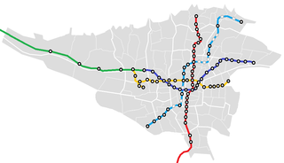
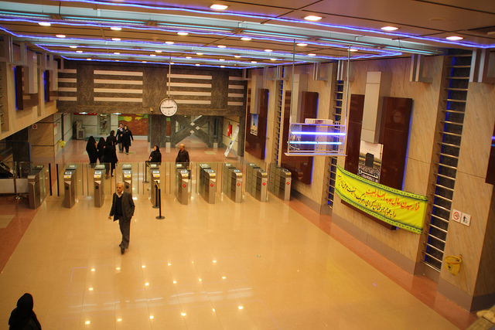
Sampling Sites For the First Phase
Tajrish( North)
Tehran Pars( East)
Sadeghye( West)
Molavi( South)
Imam Khomeini ( Central)

Slide 14
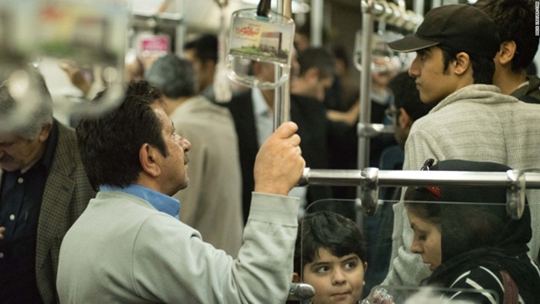
Collection, Storage and Processing the Samples
The Sampling Process will be done with extreme caution in selected areas and locations within the station and also at the entrances plus technical sites

Slide 15
Analysis 1. DNA extraction and purification 2. Sequencing 3. Species abundance, alpha and beta diversity 4. Metabolic pathway annotaiton

Slide 16
Acknowledgements

