Slide 1



MetaSUB at Guangzhou
Zhi Xie
Zhongshan Ophthalmic Center,
Center for Precision Medicine,
Sun Yat-sen University,
Guangzhou, China

Slide 2
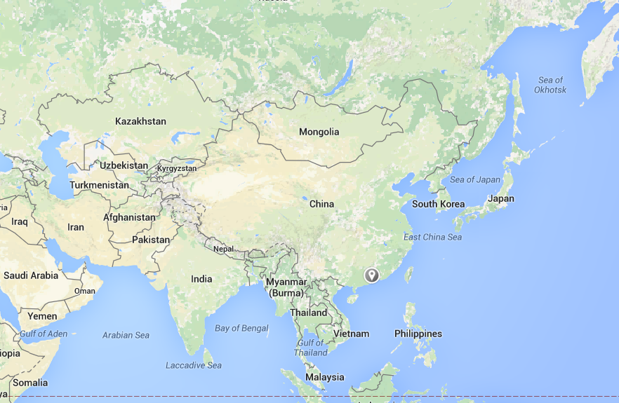
Where we are
Beijing
Shanghai
Guangzhou

Slide 3
Overview of Guangzhou
Guangzhou, also known as Canton, is the third largest city in China and the fourth largest metropolitan area in the world
Climate
  Subtropical monsoon climate
  Warm and moist
  Annual precipitation is about 1720mm

Slide 4
Number of stations: 164
Length: 240 km
Riders per annum: 1.992 billions

Slide 5
Pilot Study 1
16s microbiome sequencing on 50 stations
(The results came out 2 days ago)

Slide 6
Study design
9 lines: 50 stations
3 swabs per station: bench and station railing
Sampling time: April (4.8 ~ 4.14)
Weather: rainy and moist

Slide 7
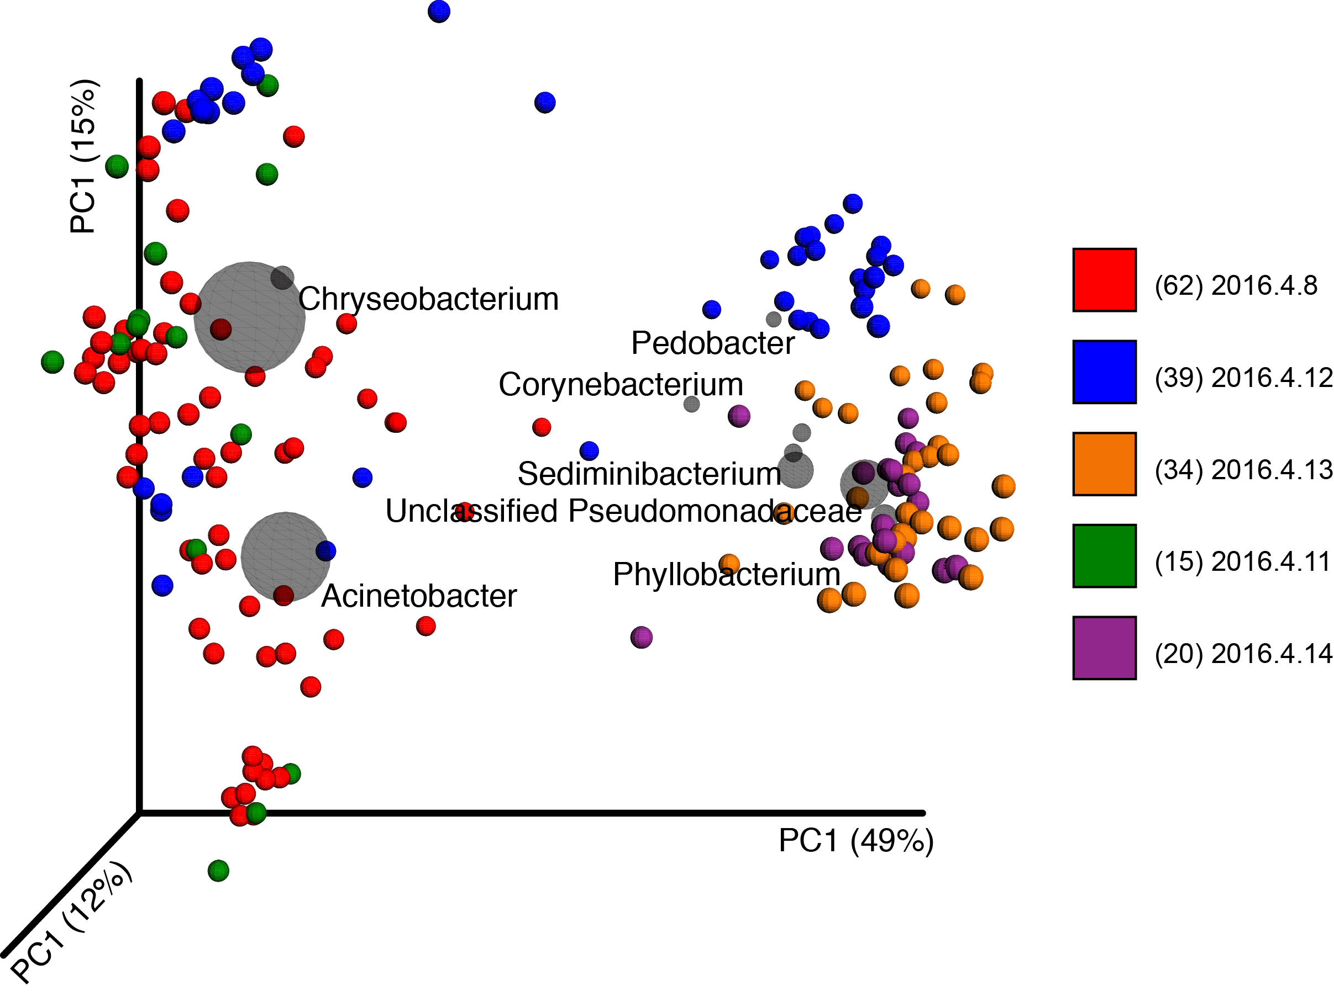

Slide 8
Pilot Study 2
Shotgun metagenomics sequencing on 6 stations
(The results came out at 11 pm last night)

Slide 9
Study design
Handles on 3 lines + station railings of 3 stations
2 swabs per station
DNA Extration: Powerlyzer powersoil DNA Isolation Kit(MOBIO)
Library Prep: TruePrep DNA Library Prep kit V2 from Illumina（Vazyme Biotech）
Sequencing by Hiseq 2500

Slide 10
Challenges
Suspect of terrorists
DNA inputs vary a lot after stations being cleaned, and cleaners are working hard

Slide 11

National Supercomputer Center – Tianhe II
The world's fastest supercomputer from June 2013 to
June 2016, now the second
33.86 petaflops, preceded Titan by 17.59 petaflops
16,000 computing nodes, 3.12 million computing cores

Slide 12
Metagenomics Analysis
Platform on Tianhe II
Raw data
QC
Filtered data
Distributed memory
ncRNA
Assembly individually
Pool-assembly
Multi-node paralle
Contigs/
scaffold
16S rRNA
Gene prediction
Geneset
KEGG
ARDB
Classification
Functional
annotation
NCBI_NR
eggNOG
PHI
Silva
VFDB
CAZy

Slide 13
Analysis Platform on Tianhe II
24 cores, 64G/96G RAM / Node
1000 nodes-> 1000 tasks

Slide 14
Statistics of assembly based on pooled sample

Slide 16
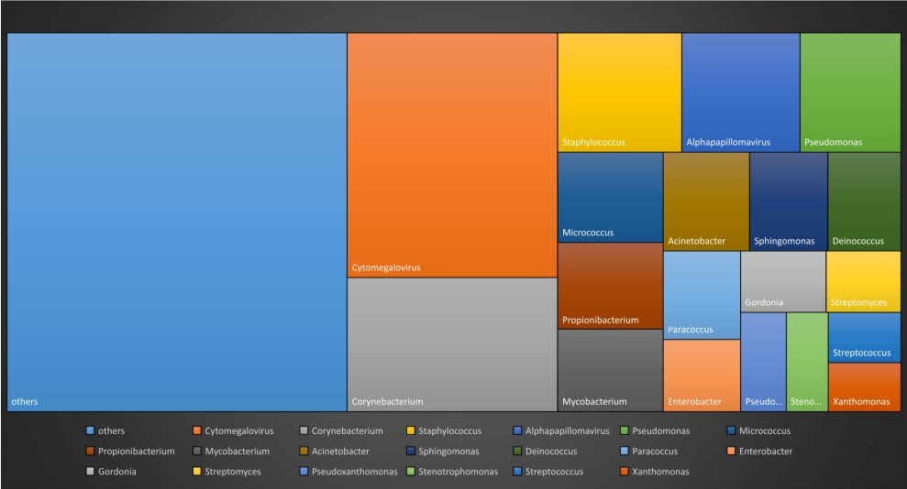
Contig distribution at Genus level

Slide 17
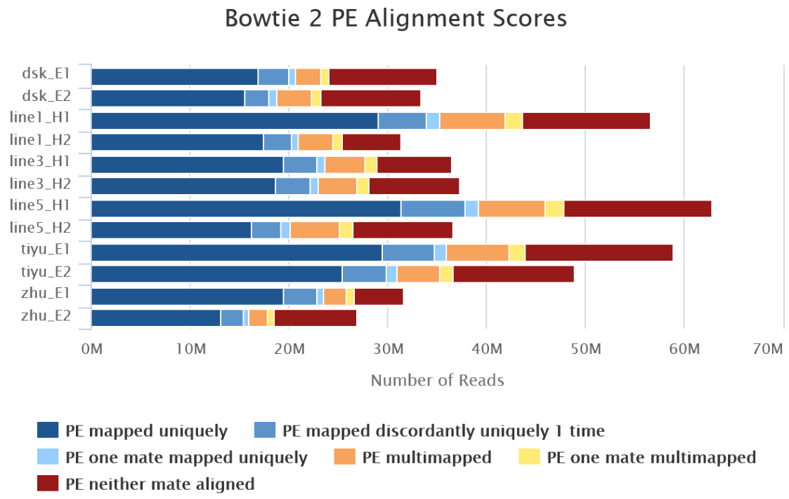
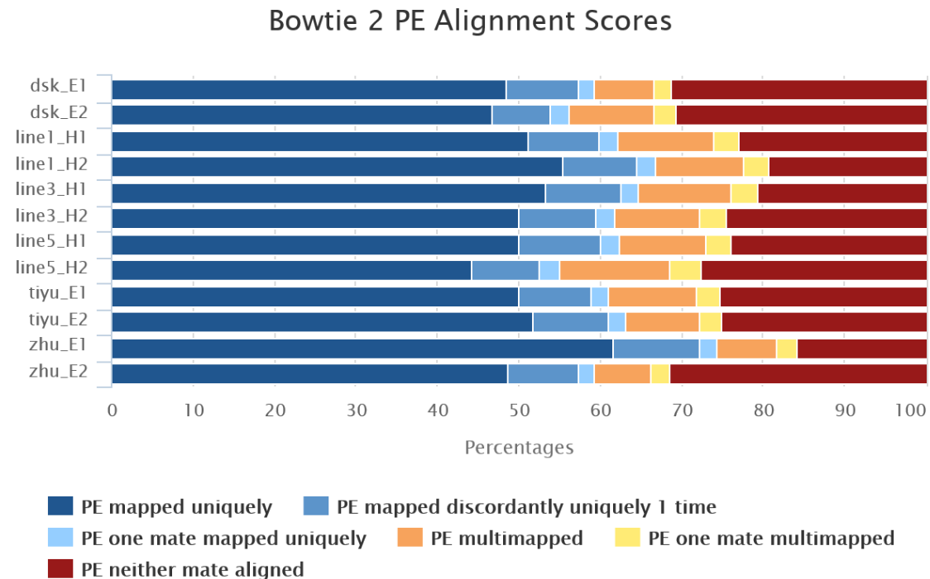
Mapping rate of different samples

Slide 18
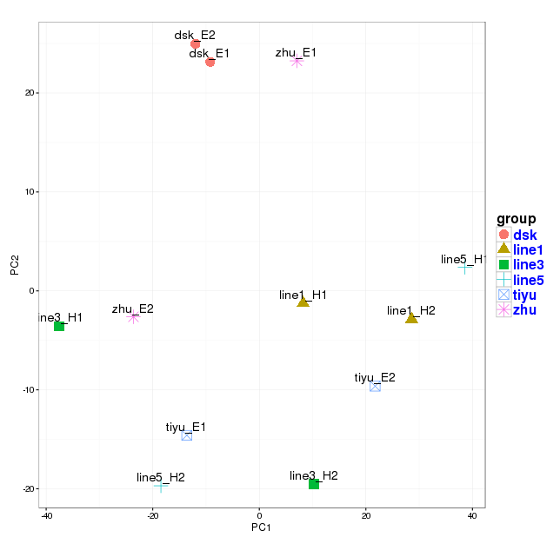
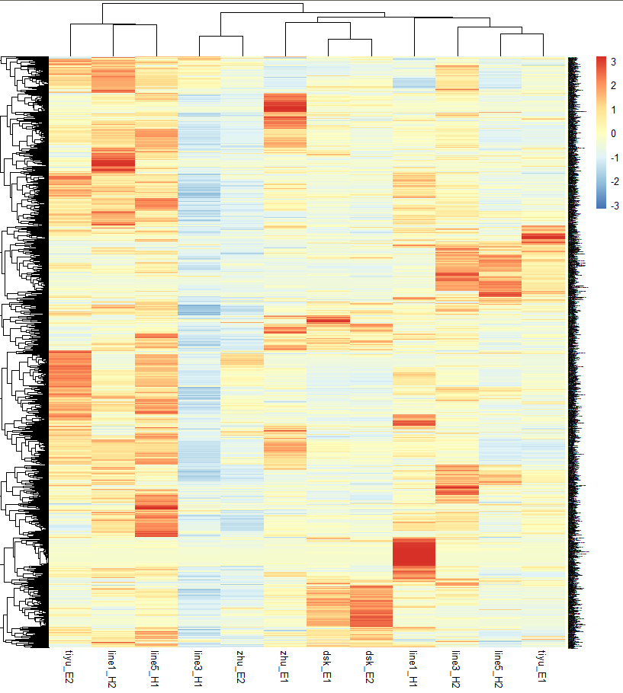
Hierarchical Clustering
&PCA analysis based on binning result

Slide 19
Classification of metagenomic reads at Genus level

Slide 20
Acknowledgement
Medical University of Southern China
  Hongwei Zhou
  Daisy Zheng
  Yan He
Sun Yat-sen University
  Jiaqi Yang
  Qi Zhao

Slide 21

Thanks!

