Slide 1
Investigation of community based microbiome and antibiotic resistance
Soojin Jang
Antibacterial Resistance Research Laboratory

Slide 2
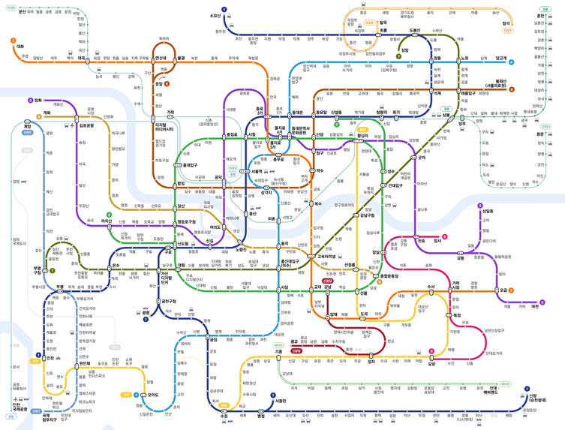
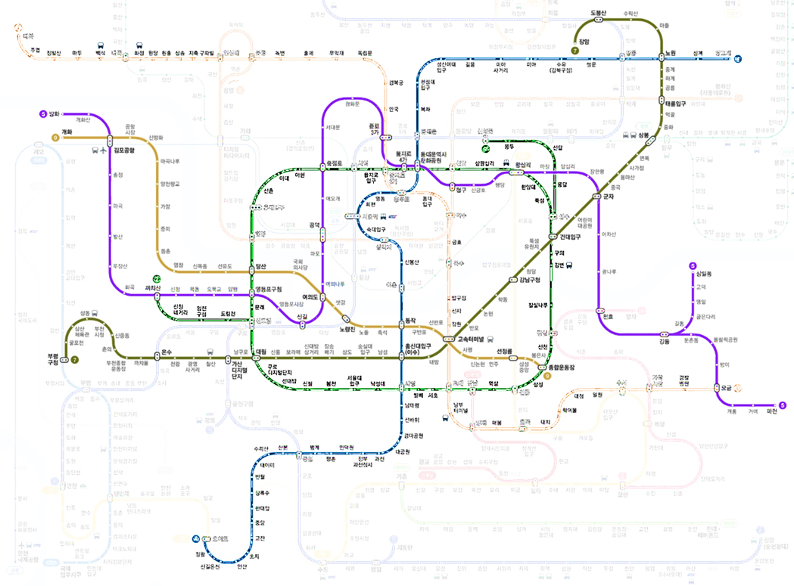
Seoul Sampling Day (June 29th)
❑ Seoul Subway System
Total 18 lines
9 lines (in Seoul) + 9 lines (outside Seoul but connected to the main lines)
Total 541 stations
Line | The number of stations | Area
2 | 51 (43) | Seoul
3 | 44 | Seoul
4 | 48 | Seoul
5 | 50 (46) | Seoul
7 | 51 | Seoul
9 | 30 | Seoul
Total | 274 (262)

Slide 3
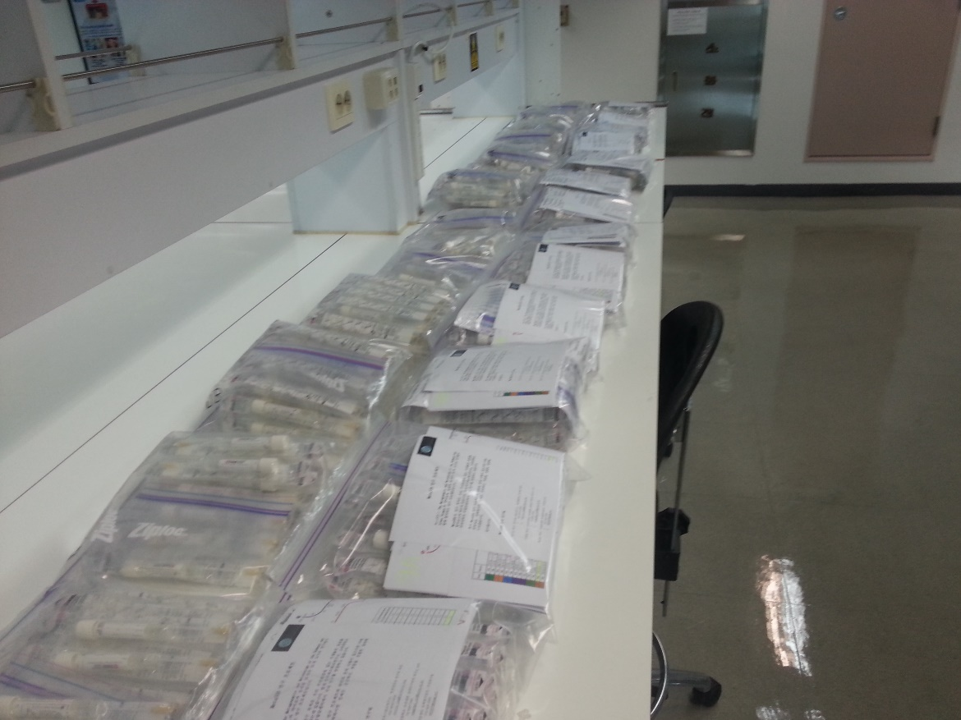
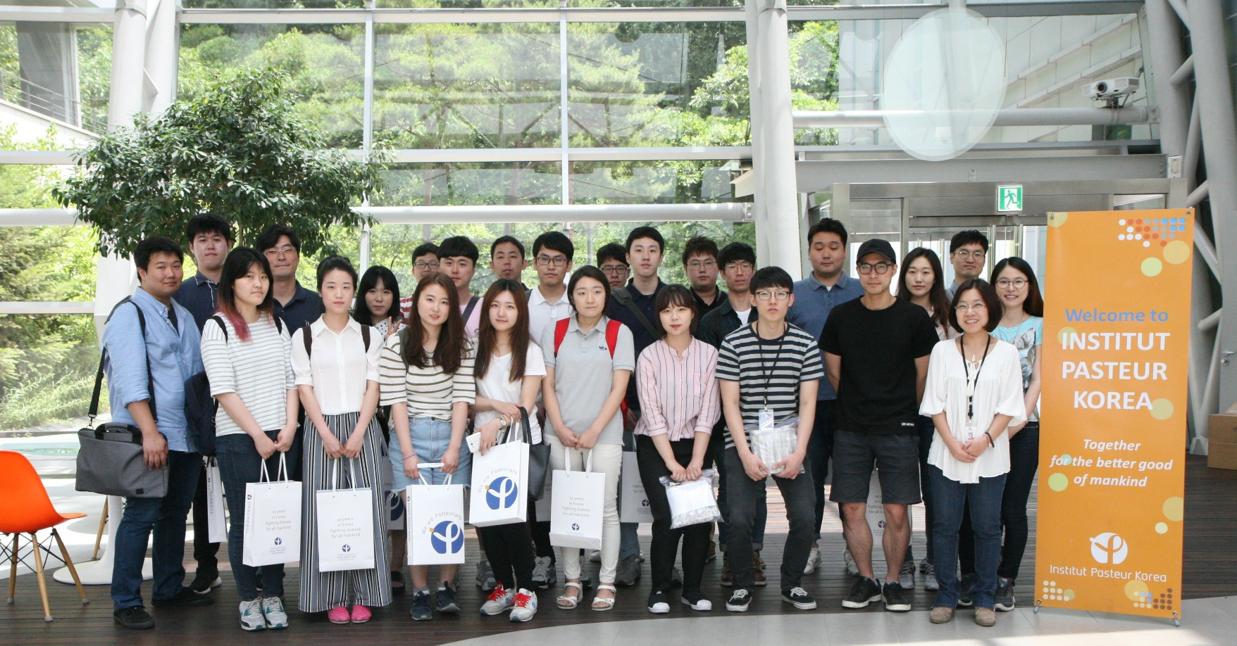
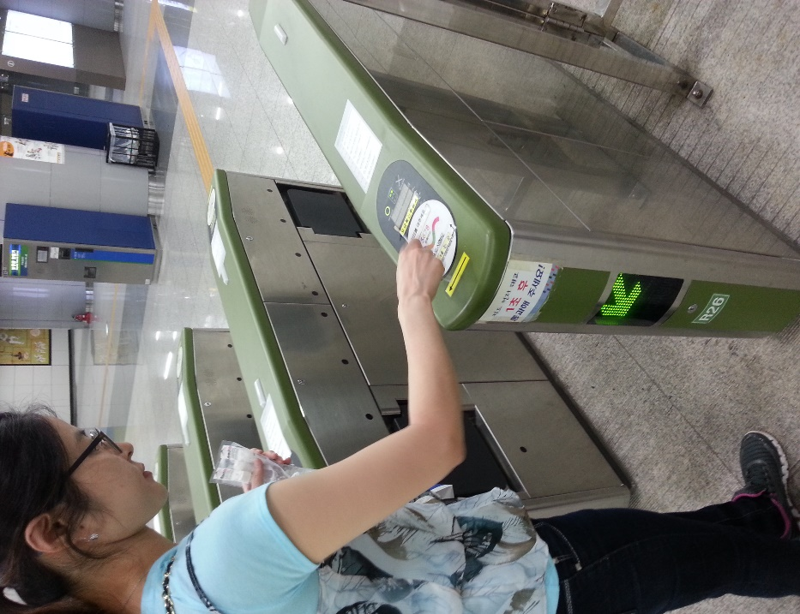
Seoul Sampling Day (June 29th)
❑ Seoul Subway System
26 people (13 teams)

Slide 4
Surveillance of antibiotic resistance in community
Pilot study
: Analysis of culturable bacteria and antibiotic resistance
in a small community
• Elevator buttons
• Door handles
• Surface of tables . . .

Slide 5
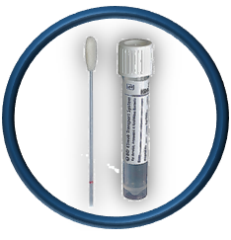
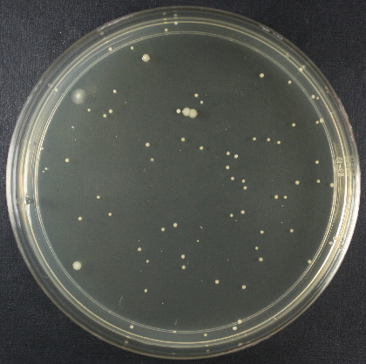
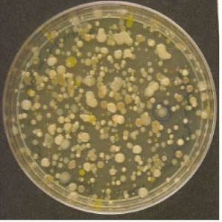
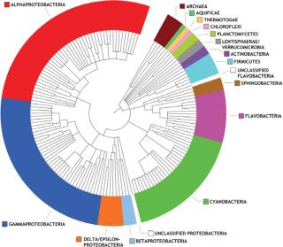
The study process
Sample collection
Cultivation of bacteria
Analysis of bacterial species profile
(16s rRNA sequencing)
Antibiotic susceptibility test
Identification of resistant strains (whole genome sequencing)

Slide 6
Analysis of the culturable bacterial community
❑ Average composition of the bacterial community

Slide 7
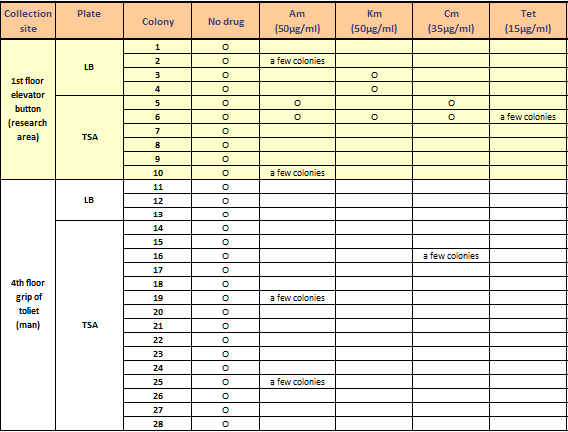
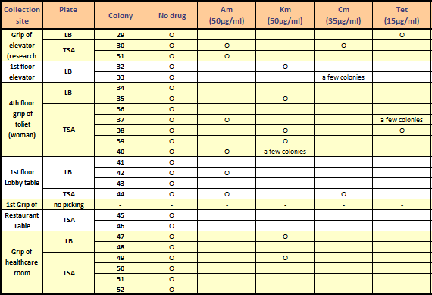
Analysis of the culturable bacterial community
❑ Antibiotic susceptibility test of selected 52 colonies
Resistance to at least one antibiotic
17/52 (33%)
Multidrug resistance
5/52 (10%)

Slide 8
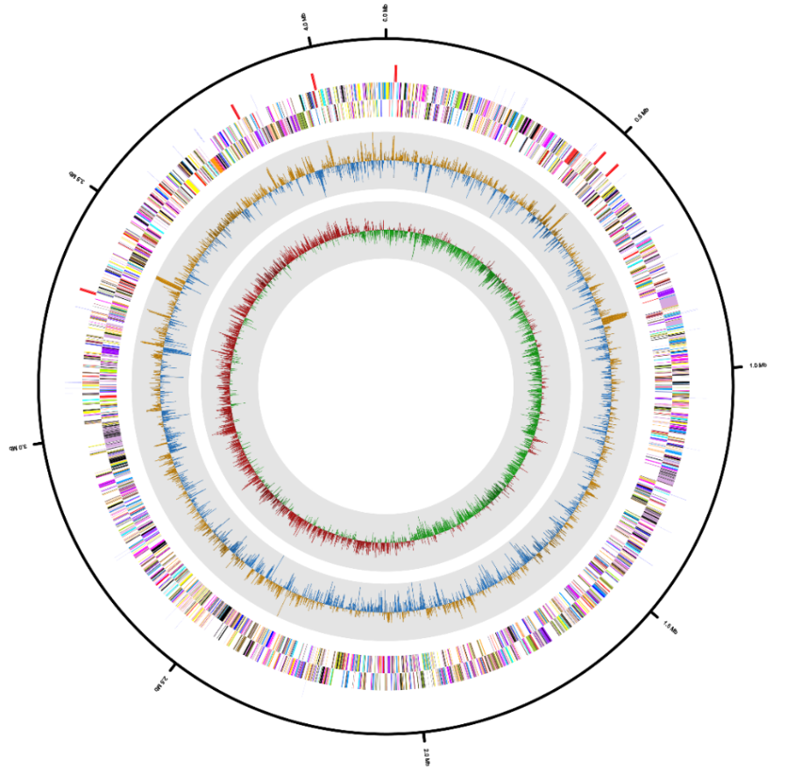
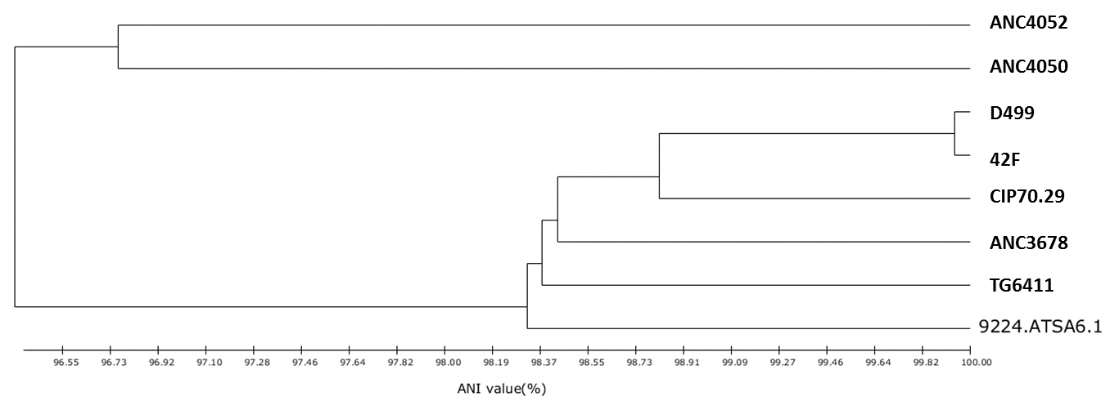
Identification of strains
❑ TSA6.1 whole genome analysis
Isolated from the elevator button
Grew on TSA plate containing Ampicillin (50 ug/ml) or Chloramphenicol (35 ug/ml)
Identified as Acinetobacter pittii by whole genome sequencing
Total 4,143,470 bp (increased genome size by 30 ~300 kb)
TSA6.1

Slide 9
Identification of strains
❑ Potential antibiotic resistant genes in TSA6.1
: Growth on TSA plates containing Ampicillin (50 ug/ml) or Chloramphenicol (35 ug/ml)
Genes | BlastP Hit in CARD | Pathogen | Antibiotic Resitance Ontology | BitScore | PercentIdentity
TSA6.1_00833 | AdeK | Acinetobacter baumannii AYE |  | 159 | 31.1
TSA6.1_00834 | AdeJ | Acinetobacter baumannii SDF | adeG | 734 | 41.9
TSA6.1_00835 | AdeI | Acinetobacter baumannii SDF |  | 154 | 32.2
TSA6.1__00915 | multidrug efflux protein AdeB | Acinetobacter baumannii SDF |  | 622 | 37.91
TSA6.1__00968 | multidrug efflux protein AdeB | Acinetobacter baumannii AB0057 | adeB | 870 | 43.93
TSA6.1__01190 | ampC protein | Salmonella enterica subsp. enterica serovar Enteritidis |  | 280 | 37.96
TSA6.1__01190 | class C extended-spectrum beta-lactamase ADC-18 | Aeromonas dhakensis |  | 345 | 47.13
TSA6.1__01348 | putative Outer membrane efflux protein | Acinetobacter baumannii AYE | adeH | 859 | 92.68
TSA6.1__01349 | multidrug efflux protein AdeH | Acinetobacter baumannii SDF | adeG | 2007 | 97.83
TSA6.1__01350 | multidrug ABC transporter | Acinetobacter baumannii SDF | adeF | 750 | 95.07
TSA6.1__01356 | putative multidrug resistance efflux protein | Acinetobacter baumannii AYE | abeS | 206 | 96.33
TSA6.1__01696 | AdeN | Acinetobacter baumannii | adeN | 364 | 78.8
TSA6.1__02202 | beta-lactamase OXA-213 | Acinetobacter calcoaceticus | OXA-213 | 500 | 91.19
TSA6.1__02732 | penicillin-binding protein 2' | Staphylococcus aureus |  | 150 | 25.92
TSA6.1__03368 | MacA | Neisseria gonorrhoeae | macA | 264 | 39.34
TSA6.1__03369 | MacB | Neisseria gonorrhoeae | macB | 700 | 52.58
TSA6.1__03386 | cfr* protein (23S rRNA (adenine(2503)-C(2))-methyltransferase RlmN ) | Staphylococcus sciuri | cfrA | 171 | 32.87
TSA6.1__03492 | multidrug efflux pump AbeM | Acinetobacter baumannii | abeM | 872 | 97.54
TSA6.1__03729 | aminoglycoside resistance protein | Acinetobacter baumannii AYE |  | 150 | 40.36
McArthur et al. 2013. The Comprehensive Antibiotic Resistance Database. Antimicrobial Agents and Chemotherapy, 57, 3348-3357. http://arpcard.mcmaster.ca

Slide 10
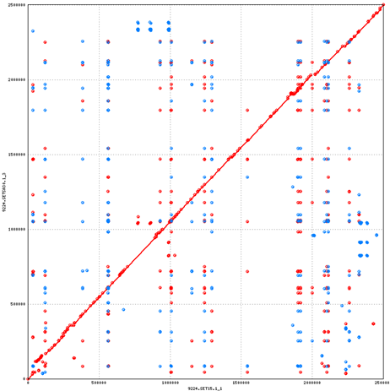
Identification of strains
❑ TSA15 & TSA30
Grew on TSA plate containing ampicillin (50 ug/ml) and kanamycin (50 ug/ml) for TSA15 and ampicillin, kanamycin and tetracycline (15 ug/ml) for TSA30
Identified as Staphylococcus epidermids
TSA 15 has 2,499,996 bp genome
with 30,607 bp plasmid
TSA 30 has 2,501,949 bp genome
with 21,246 bp plasmid
97 % of average nucleotide identity
by BLASTn

Slide 11
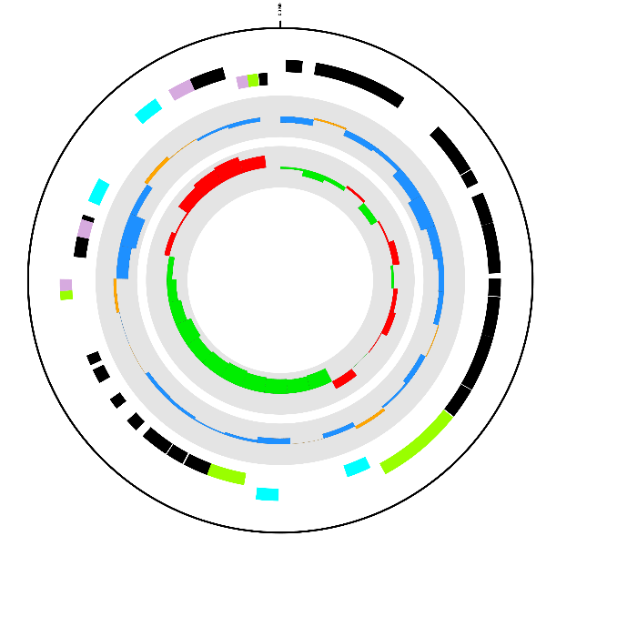
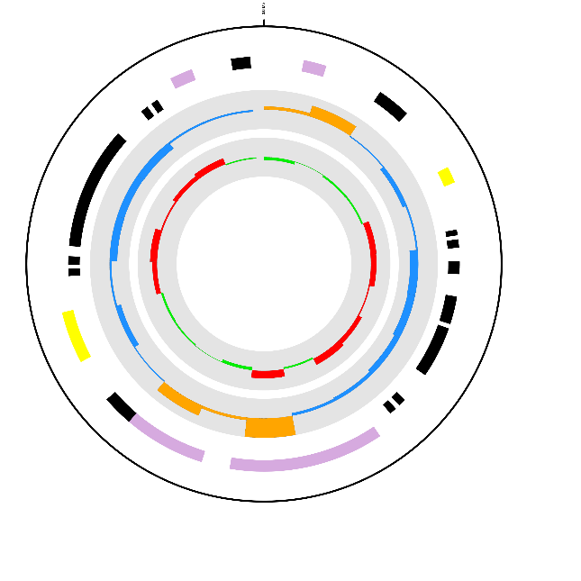
Identification of strains
❑ Comparative genome analysis
TSA15_small
(30,607 bp )
TSA30_small
(21,246 bp )
Toxin YoeB
GATA zinc finger domain-containing protein 14
Antitoxin YefM
Toxin RTX-III translocation ATP-binding protein
Putative multidrug export ATP-binding/permease protein SA1683
Lactococcin-G-processing and transport ATP-binding protein LagD
Histone-lysine N-methyltransferase 2D
Protein rlx
Probable replication protein rep
Lactococcin-G-processing and transport ATP-binding protein LagD
Bone sialoprotein-binding protein

Slide 12
Summary of the pilot study
Various culturable bacteria including pathogenic bacteria are present in the sample community
33 % of bacteria were resistant to at least one of tested antibiotics and 10 % of them were resistant to two antibiotics
The pilot study demonstrated the potential prevalence of antibiotic resistance in community and the importance of constant surveillance
Also, the study clearly showed a number of limitations including culture-dependent analysis and the small sample size
We successfully performed the 1st city sampling!
More to come!

Slide 13
Acknowledgements
❑ Antibiotic Resistance Research Laboratory
Yunmi Lee
Hyungjun Kim
Junhyung Park, Yunsun Cha, Takhyun Kim,
& Hye-ri Lee (Interns)
Dr. Christopher Mason
Department of Physiology and Biophysics
in Weill Cornell Medical College
❑ MetaSUB consortium

Slide 14
Thank you for your attention

