Slide 1
Egyptian Subway Plan and Red Sea Metagenomic projects
Amged Ouf
Genomics Specialist.
Member of Dr. Rania Siam Research group
The American University in Cairo, Egypt.

Slide 2
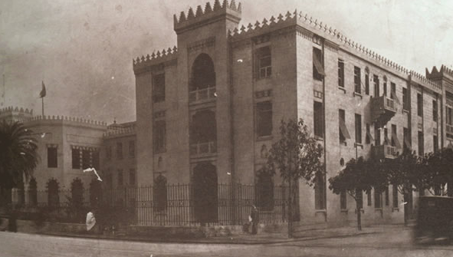
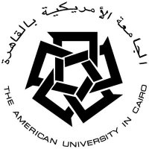
The Microbiome of the Red Sea
BIOLOGY DEPARTMENT
YJ-Science and Technology Research Center
AMERICAN UNIVERSITY IN CAIRO
Image of American University in Cairo Downtown Campus-
Tahrir Square
Notes:
This is an old picture of our down town campus, taken following the time it was founded in 1919, one year after the end of the 1st world war, it’s the second oldest university in Egypt. The downtown campus (shown here), is right on Tahrir square, where the revolution started. Now, the university has two campuses, the old downtown campus, and the New Cairo (which is where we are now located) and was founded in the fall of 2007.

Slide 3
Image of American University in Cairo New Campus -New Cairo

Slide 4
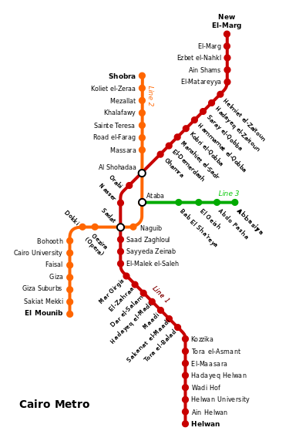

Slide 5
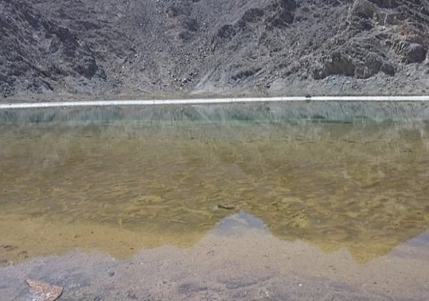
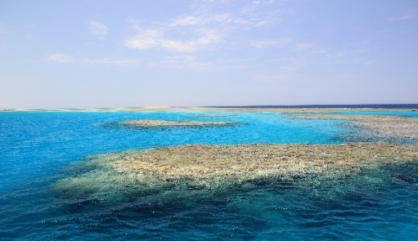
Research Projects
AUC Red Sea Marine Metagenomic project
In collaboration with the King Abdullah University for science and Technology, KSA
Ocean Sampling Day (OSD) initiative
Coordinated by Professor Frank Oliver Glockner-Max Plank Institute for Marine Microbiology, Bremen, Germany
Assessing the effect of industrialization along the Red Sea coast
Study the effect of industrial and touristic activities on Red Sea biological life. The project utilizes microbial communities alteration in different industrialized site.
Sampling campaign of world’s oceans and Seas
Aim: Standardized sampling and processing techniques, large database for future research
Solar lake
Abu-Hashish

Slide 6
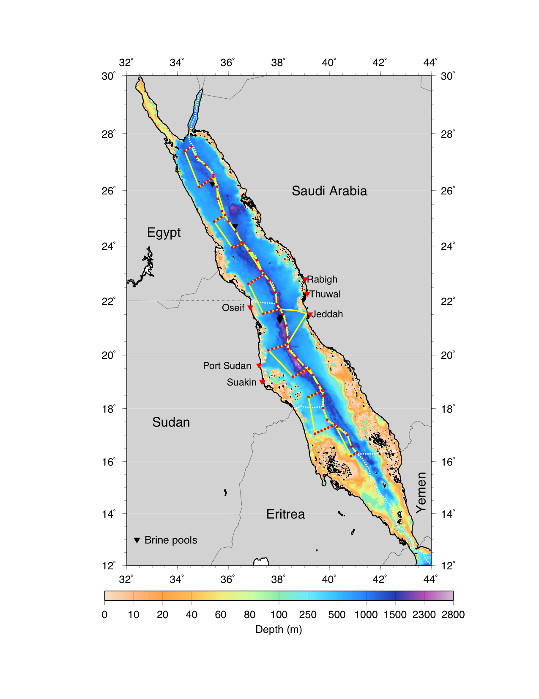
Why the Red Sea?
Expeditions in the Red Sea and Sample Collection
Poorly studied
Unique environments
Brine Pools
Coral Reefs
Biotechnological/Pharmaceutical applications
Mining Importance
Seabed minerals in the Red Sea basins is
estimated to have a value of up to
$8.21 billion
Notes:
The Red Sea borders several countries, predominantly…… This slide shows our initial sampling plan, in Rd (with dots were the different sampling points we planned to sample). However, we were faced with several limitations in this study, the main challenge was obtaining permits for sampling including Egypt (where I am working) where we are unable to obtain permits for sampling. other countries allowed us to collect samples from some interesting sites. For some of you who are interested in coral reefs, the Red Sea have a diverse coral reef population, and studying Coral reef and the deeply buried sediments would be interesting. Other interesting sites include Brine pools, cold seeps and Hydrothermal vents, which we had an opportunity to sample. However, the sites we are interested in, in the Red Sea are the brine pools, which I will talk about in a few slides.

Slide 7
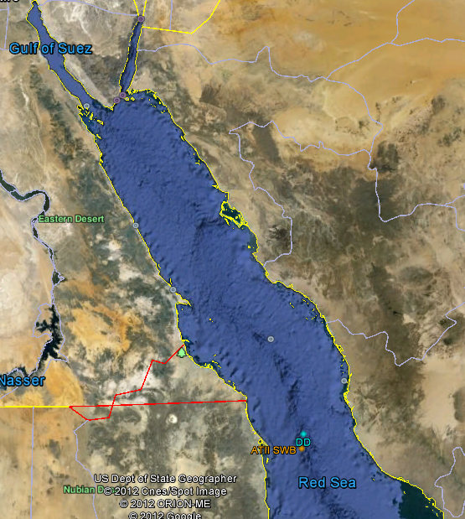
Atlantis II Area
Notes:
We first started in a region in the Red Sea between KSA and Sudan known as the Atlantis II area. This area has two major brine pools shown here: ATII and DD

Slide 8
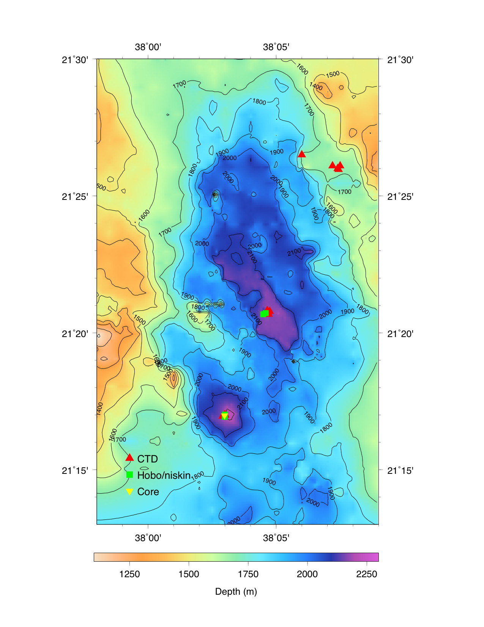
Atlantis II/Discovery Deep Brine Pools
Expeditions in the Red Sea and Sample Collection
Brine Pools:
topographic depressions filled with geothermal
brines
High temperature
up to 70ºC
High salinity
7.5X surface sea water
High concentration heavy metals
Hg, Mg, As…
High concentration of Hydrocarbons
(methane) and H₂S
Notes:
The Atlantis II brine pool has multiple harsh environments: it is hot up to 70 ºC, Saturated salt (250PSU), very high concentration of heavy metals. It is also an Anoxic environment ,and is relatively deep not as deep as the Med brine pools but is at a depth of 2200 meters below the sea surface. This shows 3 pools: ATII, DD and CD. Each one of these pools has different parameters.

Slide 9
Objectives
Microbial Communities in the Red Sea Brine Pools
Extremophiles in Red Sea Pools [Microbial Evolution]
Applications in Biotechnology

Slide 10
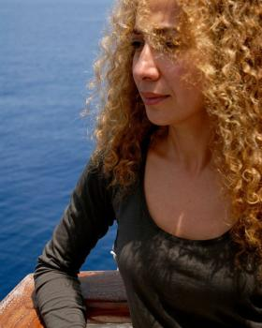
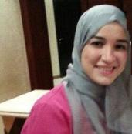
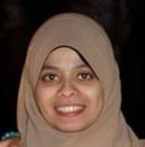
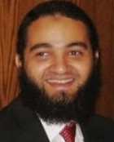
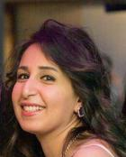
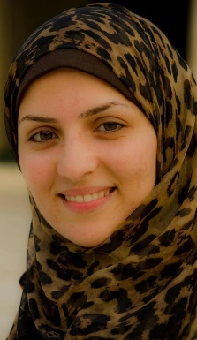
Research team
Rania Siam-Principal Investigator
AMGED OUF-Genomic Specialist
Noha Attalah-Thermophilic Ligase from LCL ATII Red Sea Pools
Ali El Behery-Antimicrobial and antimicrobial resistance
(Professor Ramy Aziz)
Sherry Kamel-sediments only viruses in Red Sea brine pools.
Ghada Moustafa-Microbial Communities in Sediments
Sarah Sonbol-Integrons in Extreme Environments
Laila Ziko-Anticancer Polyketide Synthases and Non-Ribosomal Peptide Synthases
from the Red Sea Brine Pools.
Funding: King Abdullah University for Science and Technology-CRP grant
Courtesy of M. Ghazy

