Slide 1
Sacramento’s Lighting Talk
Briana Pompa-Hogan
Dr. Jonathan Eisen

Slide 2
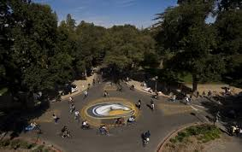
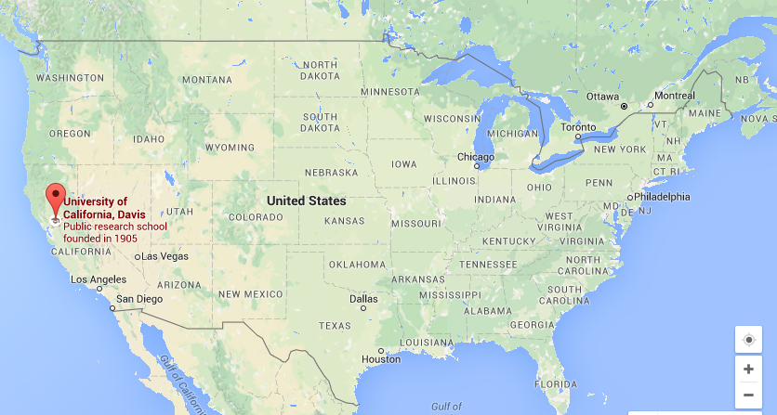
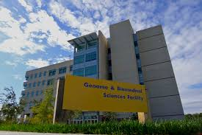
University of California, Davis
Dr. Jonathan Eisen’s Lab
Notes:
-Introduce myself
-How got involved, convincing people into it, overheard, sucked into it
-5th year UCD student
-I joined the lab 1.5 years ago
-

Slide 3
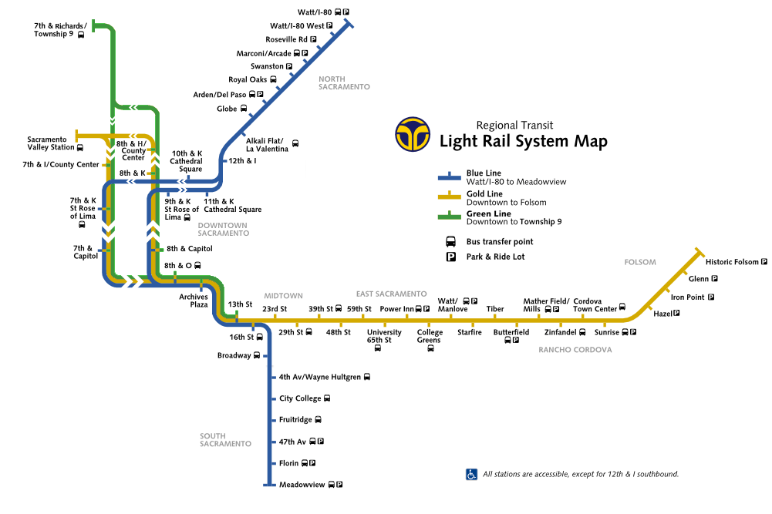
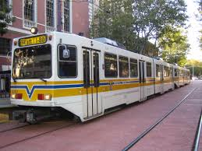
Sacramento, California
Light Rail
Opened in 1987
37 mile track
55,000 passengers per day
Traveled 16 .1 million passengers per year
The longest line only take 55 minutes end to end
48 stations
State capitol
Population: 500,000
Notes:
-Most of us at Davis aren’t that familiar with the Sacramento light rail
-We had a lot of first time riders
-Not very large
-State capitol

Slide 4
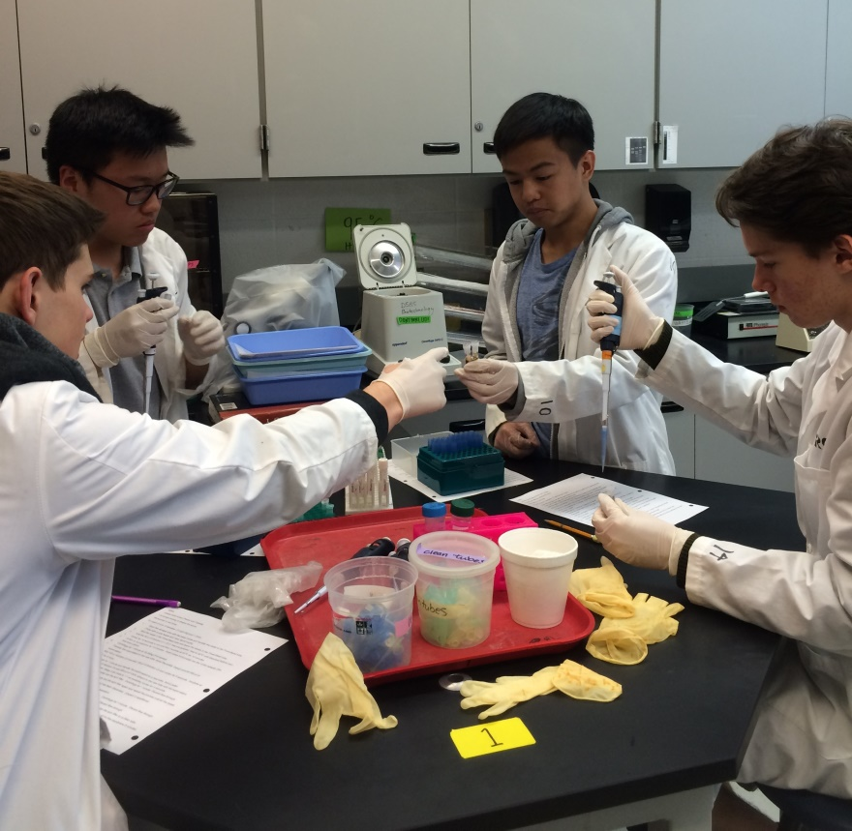
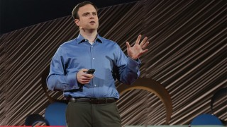
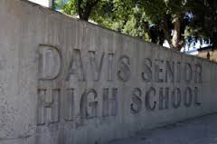
Pilot Study
Best method
Wet swab
5minutes
MoBio Powersoil DNA extraction Low biomass protocol
High School outreach
Collected over 96 swabs
Each student extracted the DNA
Notes:
-High school used dry swab
-good out reach opportunity

Slide 5
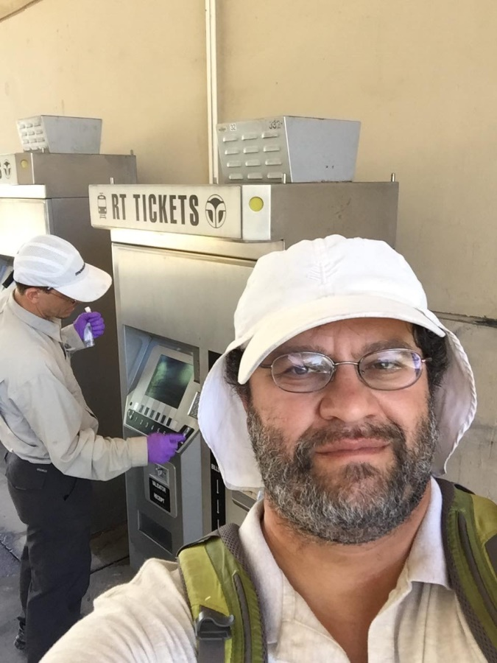
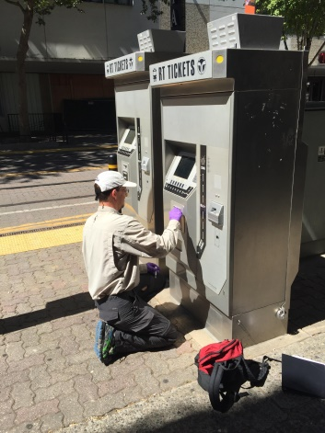
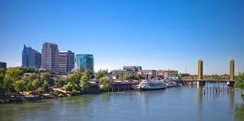
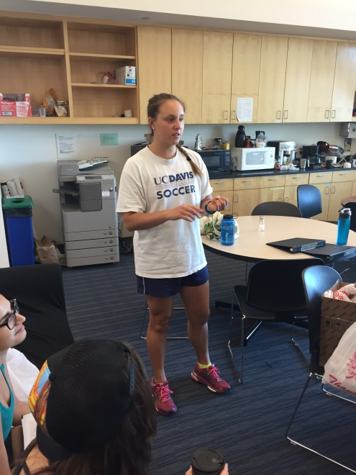
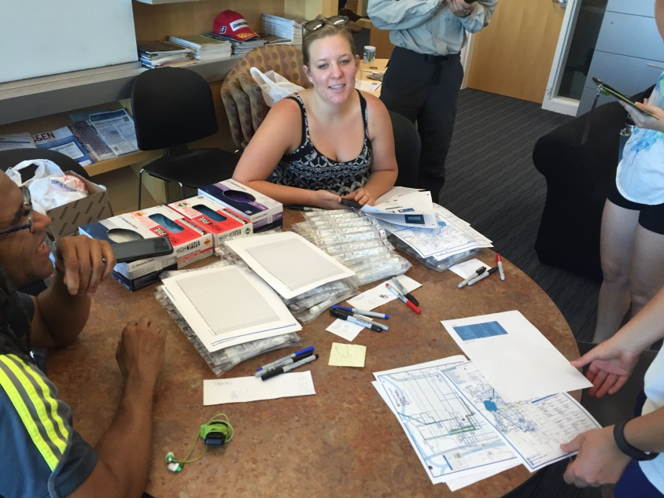
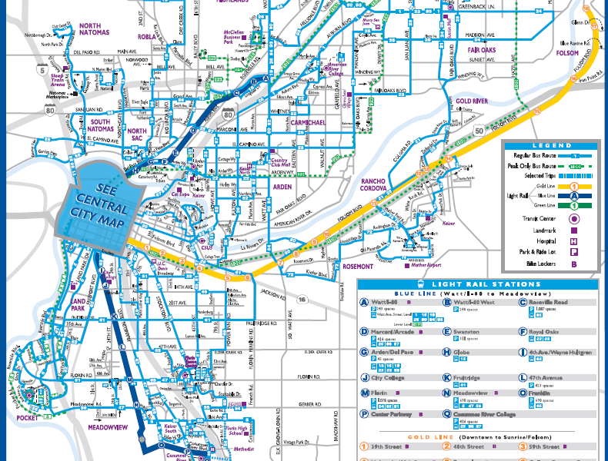
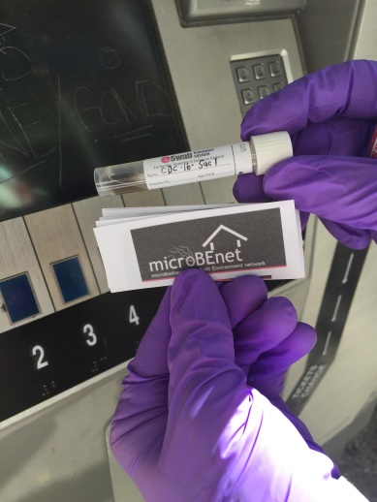
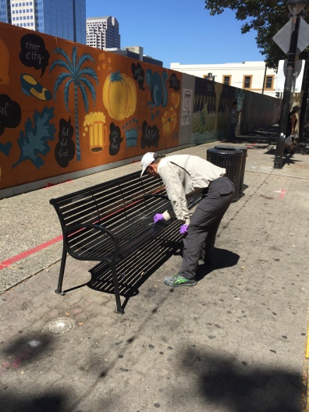
Sampling Day
Notes:
-teams of 2
-teams of 3 would have ideal
-no technical errors?
-Really gross
-Where can we see the results (business card)
-Crime scene
-Cleaning it
-Doubt the sensor push- didn’t seem accurate

Slide 6
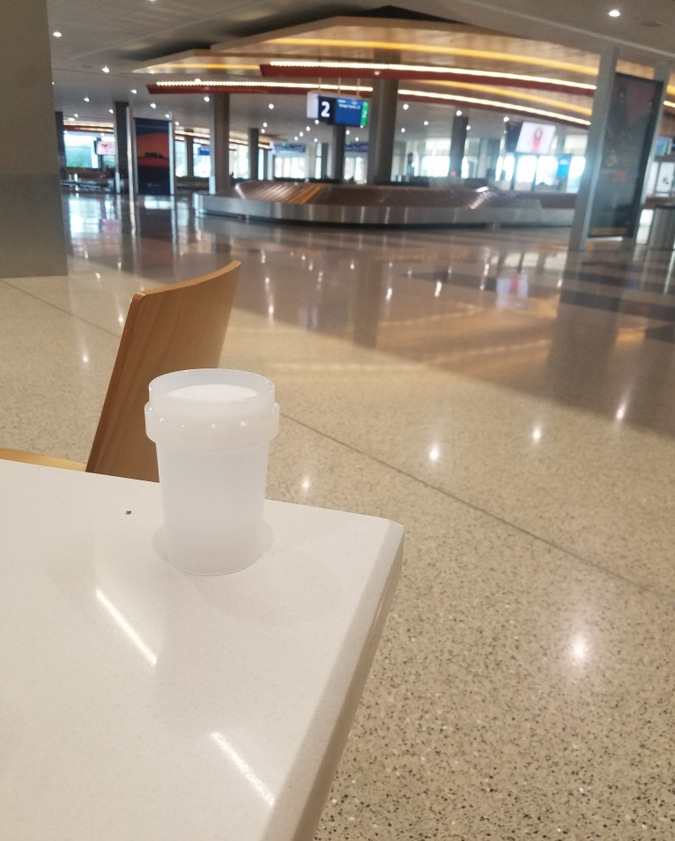
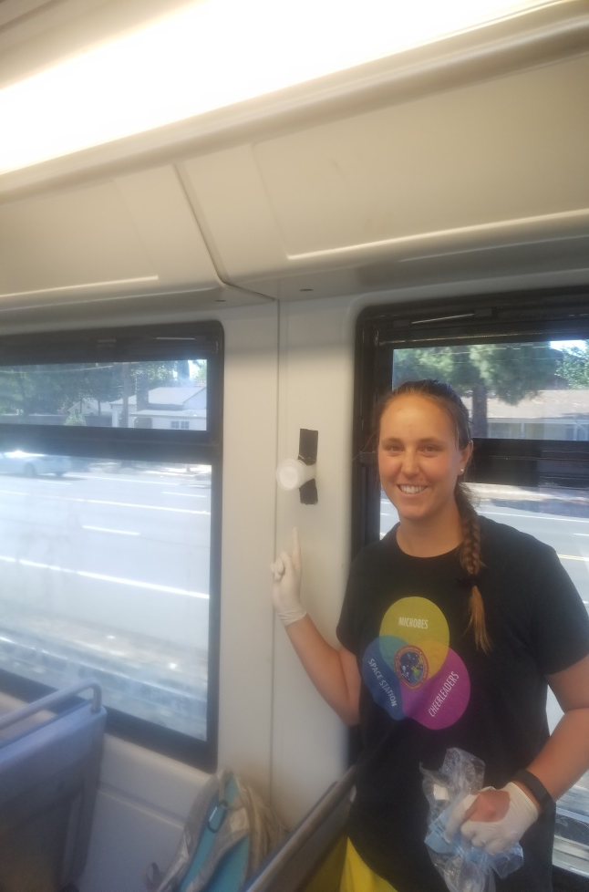
Air Filter Sampling
At the light rail station
On the light rail
Sacramento International Airport
Notes:
-6 samples
-1 negative control
-3 at stations
-1 on the light rail
-1 at the airport

